Slide 1
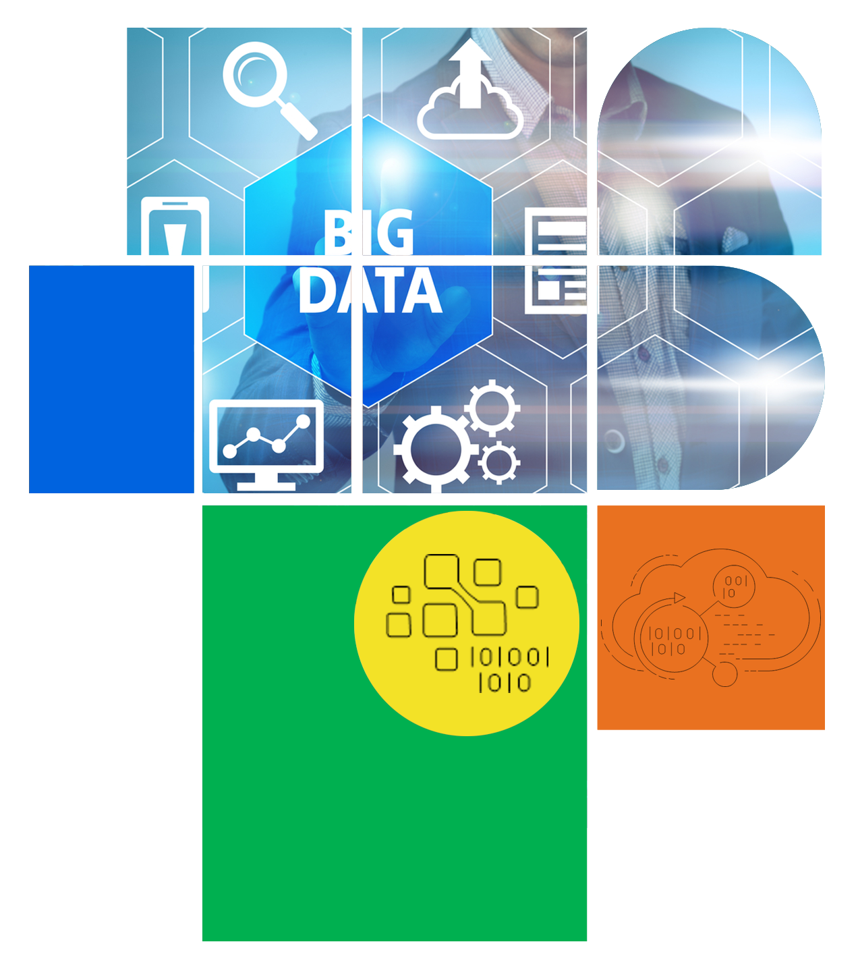
Digital Citizenship
Lesson 8
BIG DATA AND TARGETED MARKETING

Slide 2


What is Big Data?
Big data’ and what it means to our lives.

Slide 3
Definitions You Should Know
Big Data
Analytics
Big Data
The often-complex process of examining big data to uncover information such as patterns or market trends.
A collection of data that is huge in volume yet growing exponentially with time.
Data
Facts and statistics collected together for reference or analysis

Slide 4
Big Data – A Practical Explanation
Can you write down your name and your age? I am sure you can. Can you write it down for everyone in your class? Or for everyone in your school? Or everyone in your town? Everyone in the country? Everyone in the world? And then write down their age, their favourite colour, their favourite animal, their favourite TV programmes, almost anything you can think of […] for millions and millions of people?
That’s too much, isn’t it? You can’t do it, and I can’t do it. But some computers can do this, and we call it ‘big data’. Data is all the stuff we are writing down and you can imagine, for millions, billions, gazillions of people.
It is really BIG.
What can we do with all this data? We can find patterns. For example, people making television programs may discover that children who like music really like drawing too, so they could make a new program about music and art. Or hospitals could discover that people who like different foods may get sick in different ways as they get older.
That could help families and doctors look after our grandparents better.
Donald Farmer
Vice President - Product Management, Qlik

Slide 5
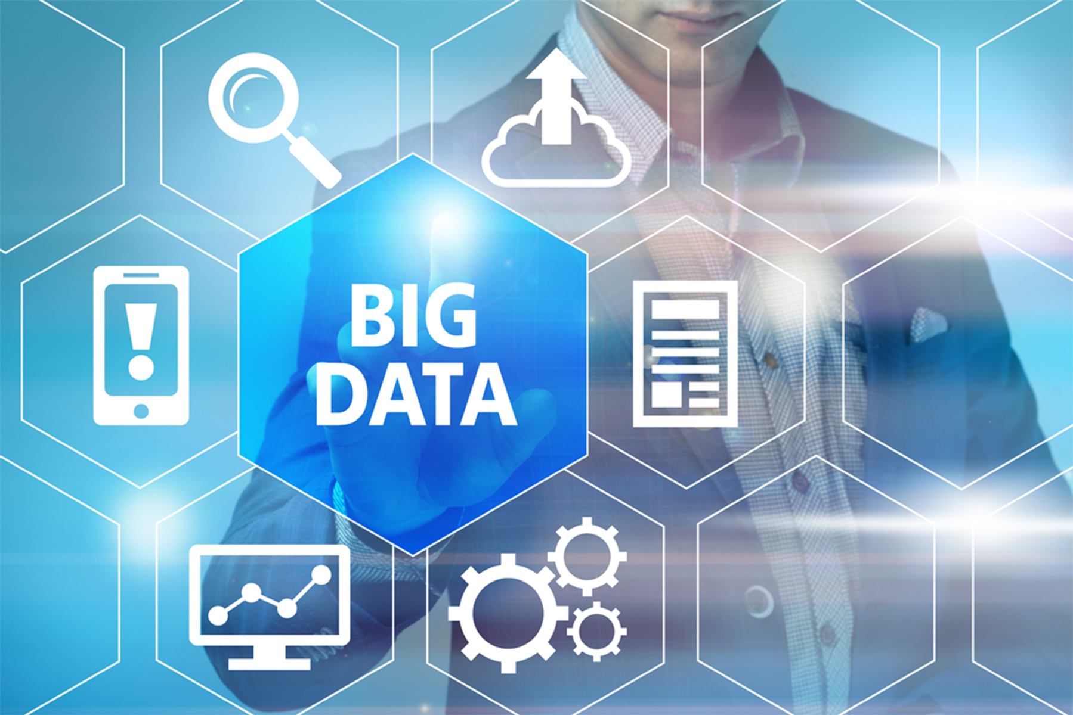
Big Data: What is Your Role In It?
How are you generating big data?
How might big data and big data analytics:
Help you?
Create problems for you?

Slide 6
Big Data in Marketing
Step 1: Collect and Analyse your big data:
Imagine that you wish to start your own business making some kind of frozen treats, but you are unsure which kind of treats are popular.
You decide to go to a large online grocery chain to buy some data from them. Once you see the data, you will decide what treat to make and sell.

Slide 7
Big Data in Marketing
Step 2: Develop a product based on big data:
Each group should answer the following questions to define their product’s characteristics
What kind of frozen treat will you sell?
In what flavour(s)?
How will your customer eat it? In a cone? On a stick?
Will you sell it all year round or only seasonally?
Where will you sell it?
What is the name of your product?

Slide 8
Big Data in Marketing
Step 3: Develop your marketing plan:
Category A: Product tie ins
People who like ice cream, also like cakes.
People who like frozen fruits also like to eat salads and soups.
People who like kulfi also like breakfast cereals like corn flakes.
People who like frozen milkshakes also like to eat kathi rolls and burgers.
People who like to eat ice lollies also like to eat pizza.
Category B: Location
People who like to eat frozen treats in the park also like to go to the beach.
People who like to eat frozen treats at home usually search for recipes online.
People who like to eat frozen treats at the mall usually order food delivery.
People who like to eat frozen treats at parties also like to shop for clothing online.

Slide 9




Big Data in Marketing
Category C: Social Media Platforms
People who like chocolate and vanilla flavours mainly use
People who like pista flavour mainly watch videos on
People who like mango flavour mainly use
People who like coconut flavour mainly use
Based on the 3 categories, plan your marketing strategy.
An example is given in your handbook

Slide 10
Reflection
After six months of sales, how might you use big data to understand whether you should make changes to your product or your marketing strategy?
What data would you like to have?
How much data do you think that businesses would like to collect about you to target their advertising?
Can you identify steps to reduce your exposure to targeted marketing?

Slide 11

Take-home Activity
Develop a logo which may include an image, a stylized script, and/or a tagline which conveys something about your frozen treat product. You may use any software to develop your logo or you may use coloured paper and pens or paints as well.

Slide 12

Created by

