Slide 1

Digital Citizenship
Lesson 16
GROUP PROJECT

Slide 2
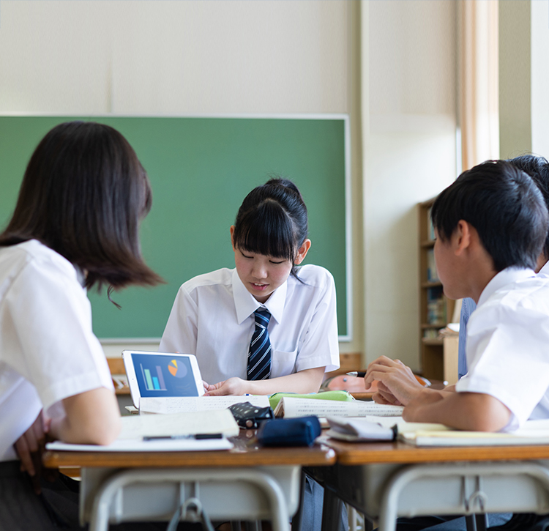
Campaign for Good
Time to change your password!
In groups, students will create a campaign for good using the ideas generated in Lessons 12 and 13. After reviewing all ideas, select one for your group project
Work together to develop and launch the campaign either in your school, in your community, or on social media. Your focus should be on finding a cause for good which the group can rally behind and implement.

Slide 3
Turning Purpose into Action
Sharpen your focus – Marley came up with a very specific goal that was easy to quantify.
You should be able to easily communicate the problem that you are trying to solve so that others will know what you are working towards.
Gather feedback – Feedback is a critical step in the ideation process. Start sharing your ideas with others and ask for their feedback on what you are planning. Do they have ideas to make it better? Do they know someone who can help you?
Connect with others – Leverage all tools at your disposal to connect with others and spread
your message.
  Social media
  Messaging apps or email
  Create a website
  Events (community or school events, create your own events)
  Contacts from family and friends.
Start a campaign – create a campaign about the cause that you care about, what you are doing to make a change, and how others can get involved.

Slide 4

Turning Purpose into Action
Teach the students in the lower grades about an important topic such as recycling, water conservation, digital citizenship, etc.
Help the school’s support staff with a donation drive, an education session on a specific topic like digital citizenship or menstrual health, run a signup drive for medical insurance, etc.
Work with the school administration on a project to improve the school such as a cleanup campaign, an anti-bullying campaign, a water conservation campaign, community kitchen, etc.
Present a play to the students or parents on an important topic such as gender inequality, importance of education, digital citizenship, etc.

Slide 5

Created by

