Slide 1

Digital Citizenship
Lesson 15
EXPLORING DIGITAL CAREERS

Slide 2

Jobs of the Future
Have you thought about the kind of job or career you would like to pursue after school?
What sound interesting?
What skills do you think you would need for these jobs?
What do you think work will look like in the next 10-20 years?

Slide 3

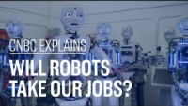
Video
Will Robots Take our Jobs?

Slide 4
Key Questions
Elon Musk thinks that robots will be able to do everything better than humans. What do you think?
Are there jobs which are easier or safer for robots to do?
What are the advantages of using robots in these jobs?
What kind of jobs will be needed that robots cannot do?
What skills do you think these jobs will require?

Slide 5

Level 3 | Digital Citizenship
Now let’s explore
some different career paths

Slide 6

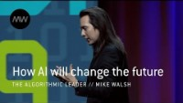
Video on AI
How AI will change the future.

Slide 7

AI and Big Data
What was the main example of the use of big data in the video?
What did you think about the way that Amazon is using this concept of anticipatory ordering?
Do you think it will be beneficial?
Which other companies might find this useful?
How do you feel about an online shopping company anticipating your needs? Is that good or bad?
Any privacy concerns?

Slide 8


Types of jobs in big data
If you wanted to work in a role that deals with big data but is not a programming role, what kind of skills would you need?
What is the job that you might do?
Let’s take a look
Business analyst and a data analyst

Slide 9
What did you learn about
each of these roles?
Business Analyst
Data Analyst
_____________________________________________________________________________________________________________________________
_____________________________________________________________________________________________________________________________
Of all the different kinds of careers that we have mentioned in data analytics, are there any which sound interesting to you?

Slide 10

Cybersecurity Roles
Another area which we have learned quite a bit about over time is Cybersecurity
Do you remember what you learned about ethical hacking or white hat hacking?
What kind of roles might there be in cybersecurity?

Slide 11
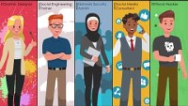
Video
Roles there are in cybersecurity.

Slide 12

Cybersecurity Roles
There are many different kinds of jobs in cybersecurity.
Were you surprised to see the different roles? Do you remember what they are?
What kind of organizations do you think would require workers in cybersecurity?

Slide 13

You!
There are many different job choices in the digital world, a few of which we have spoken about and many more which we did not
Consider other areas like the growth of XR, the Metaverse,
TV and movies, healthcare, and many more.
What would interest you?
Take a few minutes to think about 1-2 potential jobs which sound interesting to you

Slide 14
Exploring Your Purpose
Fill out the KWL template in your handbook to identify what you would like to learn about the career opportunities which sound interesting to you
What I know | What I would like to know | What I learned

Slide 15

Created by

