Slide 1

Digital Citizenship
Lesson 14
EXPLORING THE FUTURE OF OUR DIGITAL WORLD

Slide 2

Back to the Future!
Try to recall all the things that you did yesterday after school. What did you do?
Think about what your parents or grandparents might have done after they reached home after school. How different are your lives?
How much has the world and technology changed in the last 40-50 years?
How about the last 5 years? What changes in technology have you seen?

Slide 3

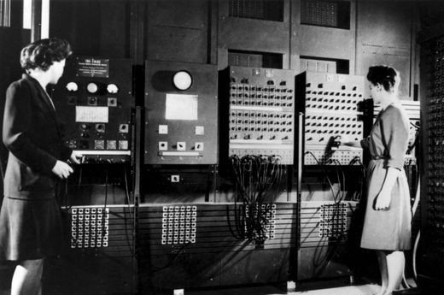
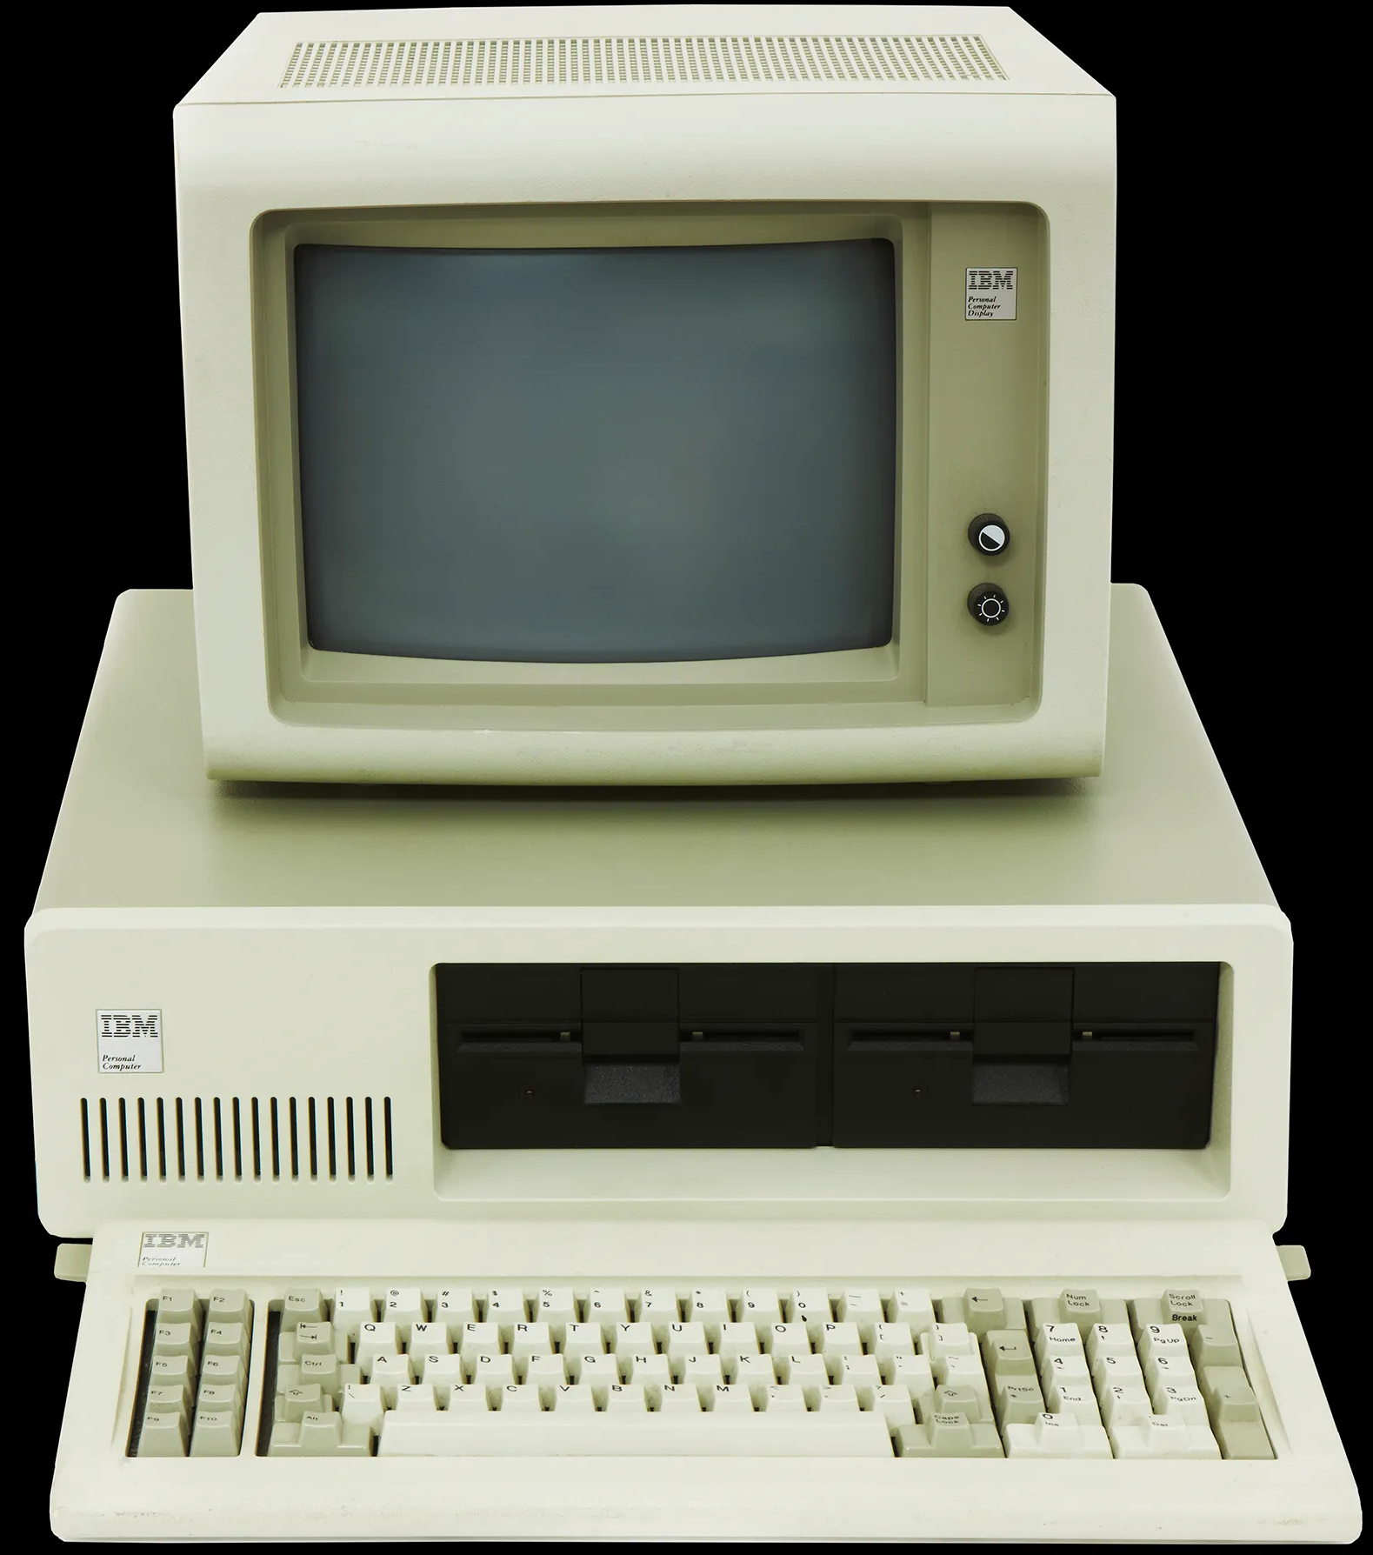
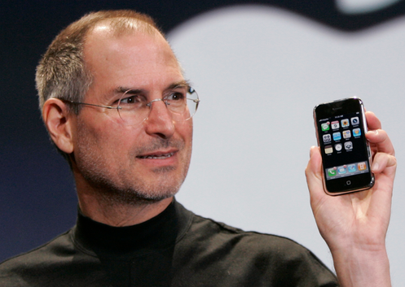

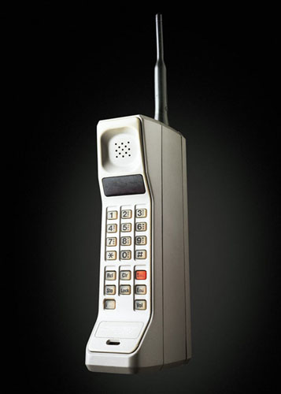
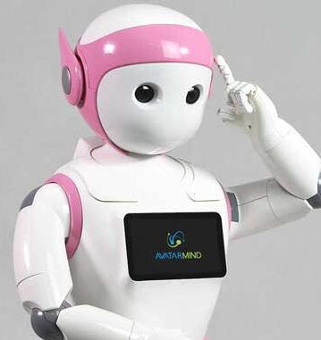
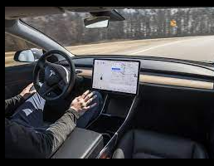
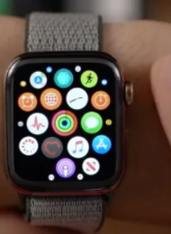
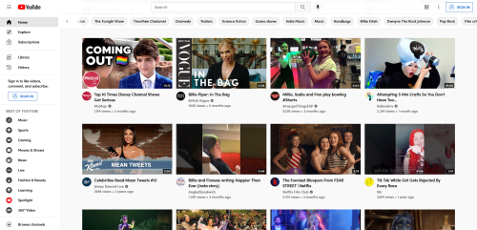
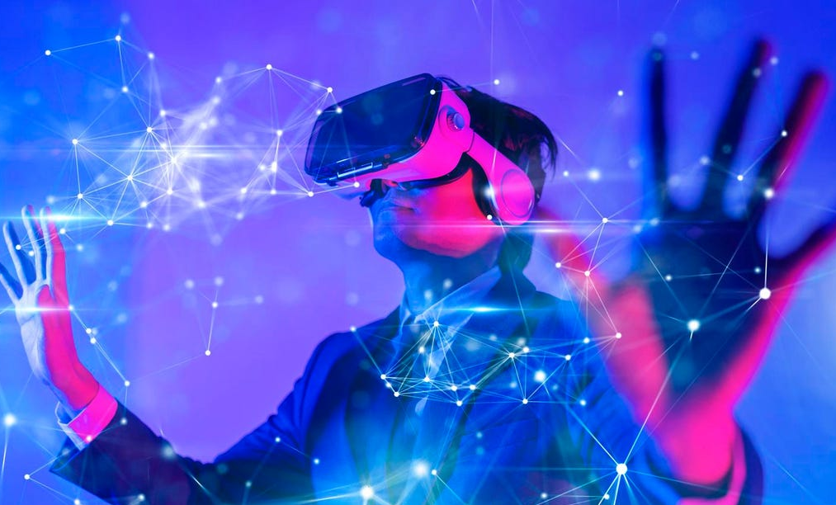
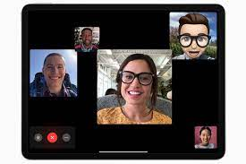
Technological advances
1940s
1981
2007
1952
1983
Now

Slide 4

The Future is now
Do you understand all the words in this graphic?
Do you know where they are from?
What is a simple way to find out?
How might you use this technology?

Slide 5


The Future is now
How do you feel after having seen this video?
In what other ways can healthcare be improved with technology?
Advancements in medical technology

Slide 6

The Future is now
How do you feel about this technology? What are the pros and cons of shopping this way?
What other use cases can you think of for this technology?
Shopping for clothing online because you don’t know how those pants will look on you?

Slide 7
Extended Reality
Have you heard any of the terms AR, VR, MR, XR before?
What do you know about these technologies?
Let’s learn these technologies work.

Slide 8

The Metaverse
Have you heard of the term the “metaverse ”

Slide 9

Definitions You Should Know
Augmented Reality (AR)
An enhanced version of the real physical world that is achieved through the use of digital visual elements, sound, or other sensory stimuli delivered via technology.
Virtual Reality (VR)
The use of computer technology to create a simulated environment, usually via head mounted display (HMD).
Mixed Reality (MR)
The use of advanced computer technology, graphics, and input systems to blend physical and digital worlds.
Extended Reality (XR)
A universal term inclusive of immersive learning technologies like virtual reality (VR), augmented reality (AR) and mixed reality (MR).
Metaverse
An online space where people can interact in a more immersive way.

Slide 10

Think - Pair - Share
In your small groups, let’s brainstorm ideas for the use of XR or the Metaverse.
What were some of the use cases that you saw in the videos?
Where do you envision this tech going in the future?

Slide 11

Take-home Activity
Using your list of ideas from the Think-Pair-Share activity, do some research on your own to see whether something similar already exists. You can check to see what is already available or you can see what research or ideas are being explored along similar lines to what you were thinking.

Slide 12

Created by

