Slide 1

Digital Citizenship
Lesson 12
SOCIAL MEDIA FOR GOOD

Slide 2

Class Debate
You will be divided into two teams to debate the following question:
Are the internet and social media apps a blessing or a curse?

Slide 3

Class Debate
Spend a few minutes collecting your thoughts and preparing to debate
The team: “The internet and social media are
a blessing” will have ~1 minute to present their arguments
After which, the team: “The internet and social media are a curse” will have ~1 minute to present
After the opening statements, each team will take turns of 30 seconds to present their points and rebut the points from the other team

Slide 4
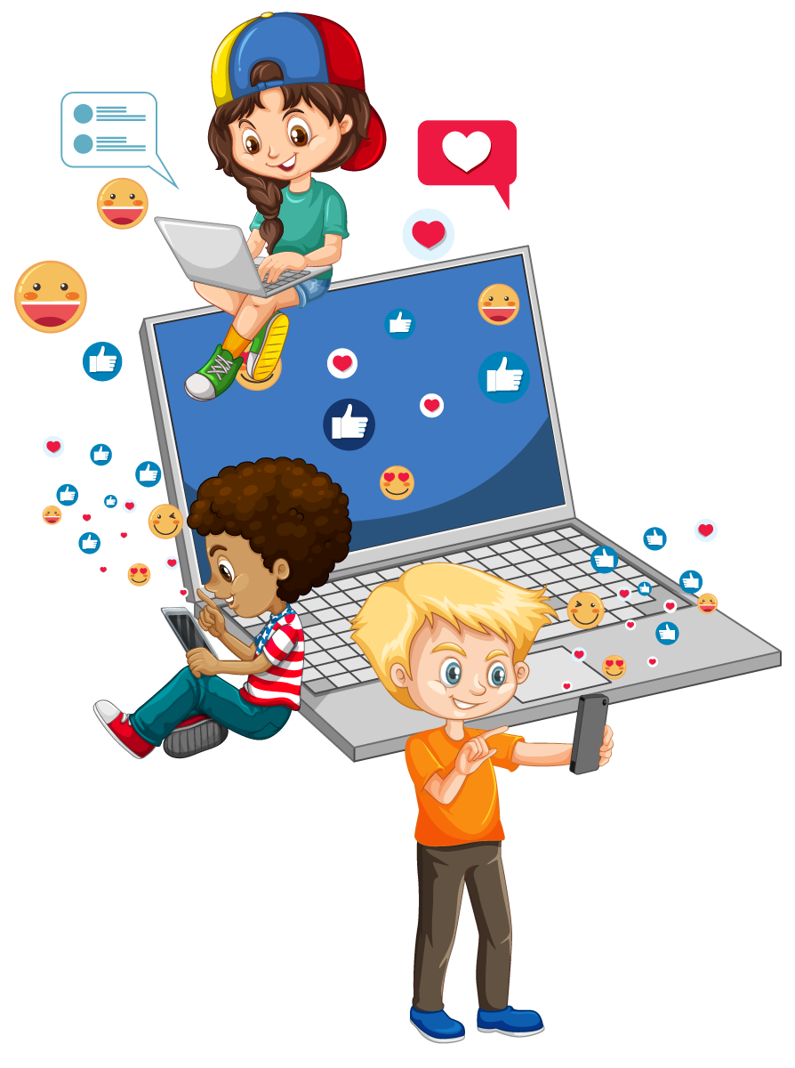
Social Media for Good
Outside of keeping in touch with friends, what are the benefits of social media?
Do you have any examples of teens or young adults using social media to advocate for a cause?
Have you ever followed any of these teens or been influenced by their causes?

Slide 5


Social Media for good
Let’s meet some American teens using social media for good.

Slide 6
Your Purpose
A need in the world
Your skills
What you love to do
Purpose: A stable and generalized intention to accomplish something that is at the same time meaningful to the self and consequential for the world beyond the self

Slide 7
Exploring Your Purpose
A Need I See is | My Skills are | What I love to do
My Purpose is _____________________________________________________________________

Slide 8
Reflection
What are your insights from this lesson?
How can you use technology and social media to do good in your own life?

Slide 9
Action plan
My Goal is: __(example) Collect 100 story books to give to less fortunate students ages 5-10 ____
Action description | Action doer | Start date | End Date | Resources needed (people, items, etc) | Expected result of my action
Make a poster which explains what I am trying to do and asks for book donations | Me | 15/4 | 17/4 | Poster software like Canva, Adobe Spark, etc. A drop off location to be able to collect my books | I will have a poster ready to share on social media, in school and in my community
A Need I See is | My Skills are | What I love to do
Reflect on how you can start towards your goal / purpose
Use the above Action Plan Template to start your journey

Slide 10

Created by

