Slide 1

Digital Citizenship
Lesson 11
CONFIRMATION BIAS

Slide 2

Reading the news
Which of the below headlines is real?
1
Japan Finally Abandons Microwave Ovens by 2022,
by Ima Rider,
January 12, 2022
2
New iPhone Will Come with a Holographic Keyboard and Projector,
by Wren Rudd,
January 12, 2022
3
Australia to Introduce 33 Different Genders on Passports,
by Jordan Lee,
January 12, 2022

Slide 3


Cognitive Bias
What the most common cognitive bias is

Slide 4
Key Questions
What happened in the video? Why did it take so long for people to solve the puzzle?
What is confirmation bias?
Do you have any examples from your own experience of confirmation bias?
What did the host say was the best way to overcome confirmation bias?

Slide 5

Definition
Confirmation Bias
A tendency to interpret new information by looking for information that is consistent with one’s existing beliefs or theories.

Slide 6
Let’s meet Amit and Sara
We are going to meet two diehard cricket fans, Amit and Sara. After you read their profiles, read each of the news headlines and determine if the headline is more likely to feature in Amit’s feed or in Sara’s feed

Slide 7
Reading the news
Meet Amit
Meet Sara
Amit is an avid cricket fan, and he loves Virat Kohli. In his mind, there is absolutely no doubt that Virat is the best batsman and captain that the Indian Test team has ever had.
Not only that, Virat is an upstanding citizen and role model for all. Virat has crushed all the records held by Sachin Tendulkar and can rightly take his place as the number one Indian batsman of all times.
Sara is an avid cricket fan, and she loves Sachin Tendulkar. There is no doubt in her mind that the Master Blaster was and is the best batsman that Indian cricket has ever known.
Not only that, Sachin is an upstanding citizen and a role model for all. She is tired of all the hype about Virat Kohli. He’s always trying to stay in the spotlight, more focused on celebrity than cricket.

Slide 8

Headlines
Virat ties Master Blaster for Most Centuries Against One Team
Virat Kohli’s 100th test: Defining Moments of His Glittering Career
Sachin Inducted into ICC Cricket Hall of Fame
Virat Kohli Quits RCB Captaincy, No Decision on Replacement
Coach Expresses Support in Spite of Virat Kohli’s Lean Patch
Virat Kohli Steps Down as RCB Captain, “There is Nothing to Be Shocked About”
Sachin Remembers the Time Virat Called for His Help, “I am Always Open to Helping the Next Generation”
Virat: “In 2014, I Called Sachin Tendulkar and Asked for His Help”
Sachin’s Diehard Fan Cycled to Lahore to Support India in 2006 Pakistan Tour
Kohli’s Seven Year Captaincy Ends in SA Defeat
Tendulkar Saves Injured Bird in Viral Video Melting the Internet’s Heart
Virat Kohli gets GOAT (Greatest of All Time) Icon on Twitter – Netizens Can’t Keep Calm
Late Lata Mangeshkar Loved Cricket and Sachin Tendulkar
Kohli to Leave Team Mid-tour for Birth of His First Child: “I Want to Be There for My Wife”
MS Dhoni’s First Priority is Nation, No Paternity Leave for Birth of His First Child in 2015
Remembering the 2003 World Cup Loss, Sachin’s Biggest Disappointment

Slide 9
Key Questions
How might confirmation bias impact how you consume or interpret the news?
How do you select which accounts to follow on social media?
Are there any accounts or websites that you don’t like or won’t follow? Why?

Slide 10


Confirmation Bias and Your News Feed
How journalists think about confirmation bias

Slide 11
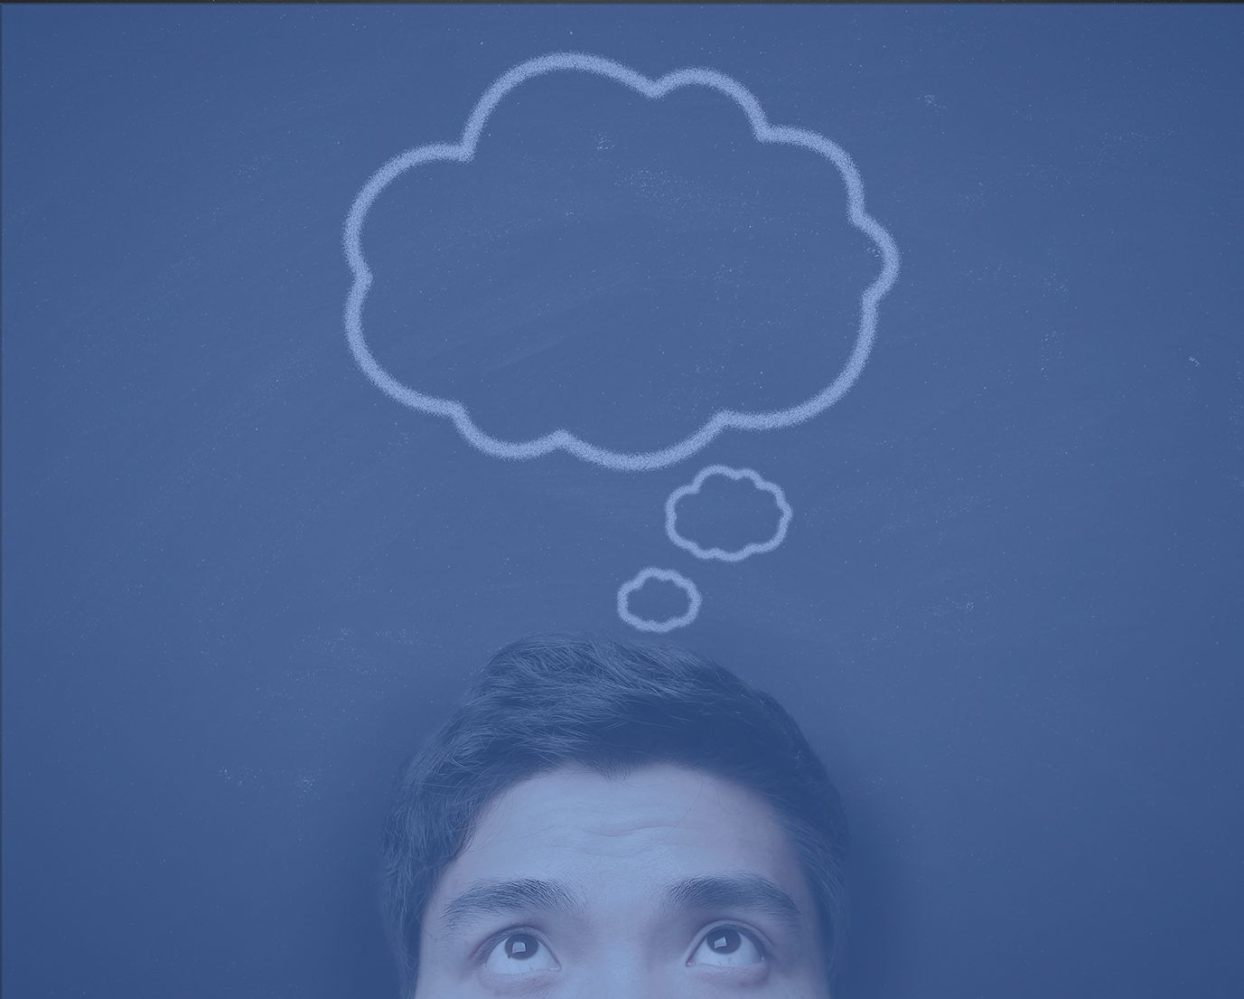
Reading the Same News Again and Again
Can you understand how your news feeds can be individualized based on the algorithms trying to find items that you might like to see?
If this is the case, what are you not seeing?
Are you missing out on other perspectives?
Think
A situation in which an internet user encounters only information and opinions that conform to and reinforce their own beliefs, caused by algorithms that personalize an individual’s online experience.
Filter
Bubble

Slide 12

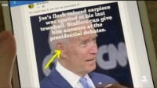
What Can We Do to Break the Filter Bubble?
What can we do about it

Slide 13
Key Questions
What were two suggestions from the video?
What other suggestions do you have based on this lesson and the previous lessons?
What are the repercussions of a newsfeed which only reinforces our confirmation bias?

Slide 14

Take-home Activity
Examine your news sources and social media feed. Identify what kind of confirmation bias is being reinforced by these sources. Document your plan to diversify your sources and seek different opinions and information.
Make a poster about confirmation bias, the filter bubble, and how to break your biases in news sources and social media feeds.

Slide 15

Created by

