Slide 1

Digital Citizenship
Lesson 10
SPOT THE FAKE NEWS – INTERNET INVESTIGATOR 2

Slide 2

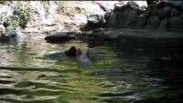
Examining Internet Videos
Pig who saved a baby goat

Slide 3

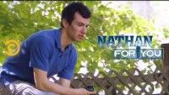
Examining Internet Videos
Captured on video

Slide 4
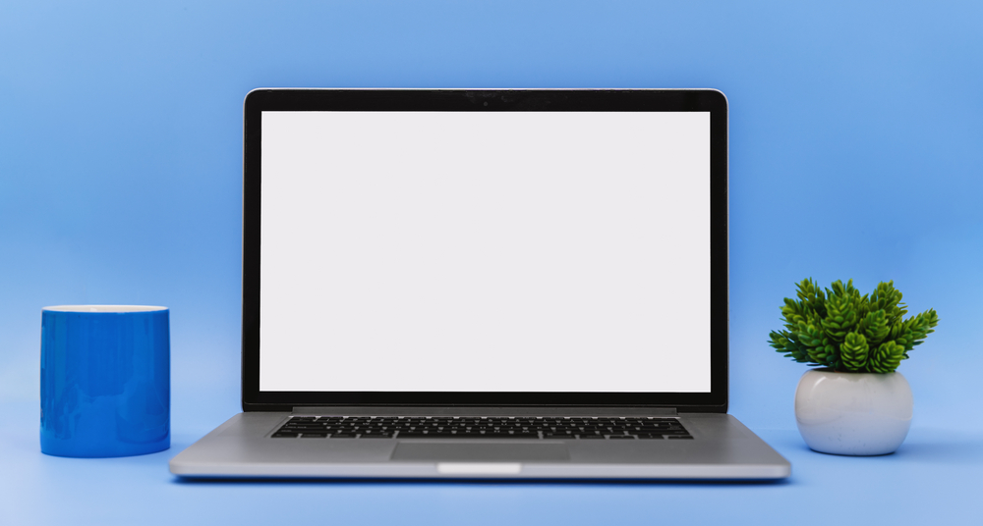
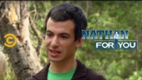
Examining Internet Videos
How such a video can easily go viral

Slide 5

Definitions You Should Know
Disinformation
Misinformation
  False information that is spread with the intent to deceive.
  False information that is spread, regardless of intent to mislead.
Both disinformation and misinformation can have big consequences like:
Increasing tension and anger between groups of people
Damaging the reputations of individuals or groups.
Affecting the outcome of elections
Impacting the public’s understanding of vaccines or pandemic-related protocols

Slide 6
From Vertical to Lateral
One methodology that we can all use to confirm whether an article or video is real is called “lateral reading”.
Lateral reading – in contrast with vertical reading – is the practice of checking and verifying what you read as you read it.
How does it work?
Leave the website that you are reading
Open a new browser tab and look for alternate versions of the news story
Compare across websites to see if the information provided is consistent

Slide 7

The Pacific Northwest Tree Octopus
Let us explore the website of The Pacific Northwest Tree Octopus

Slide 8
Key Questions
What do you think about the website about the Pacific Northwest tree octopus
Does it look real and legitimate?
How can we check if this creature is real? Think laterally
If you saw this website for the first time, do you think that you would believe it?

Slide 9
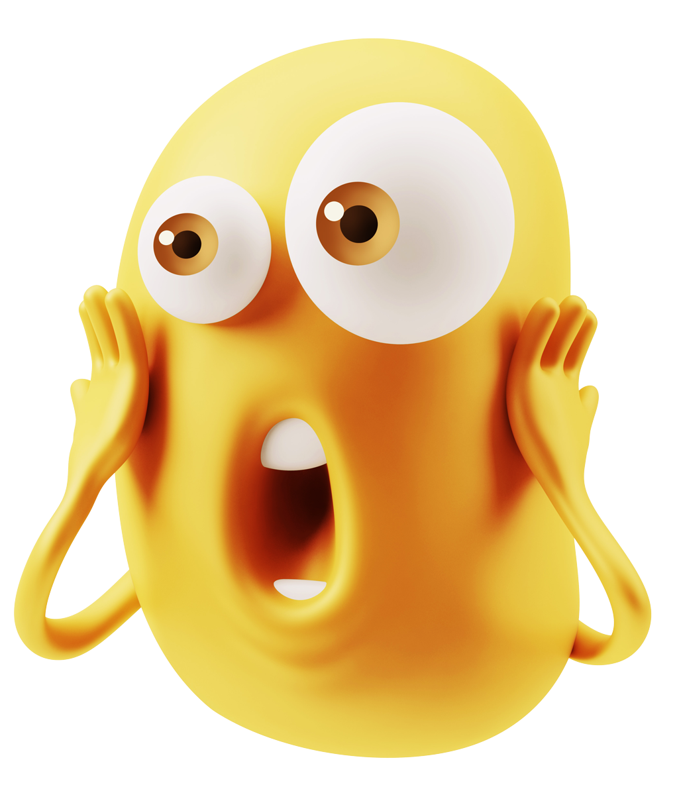
Are you surprised?
A 2011 US Department of Education study that used the tree octopus website as a focal point revealed that students who encountered this website completely fell for it. In an NBC news story, Scott Beaulieu wrote: In fact, not only did the students believe that the tree octopus was real, they actually refused to believe researchers when they told them the creature was fake.

Slide 10

Think About It
A good-looking website can be very convincing, regardless of what it says. A good rule is to take a moment to think logically:
Does the website claim sound logical? Is it something that you have heard in the past?
Does the website stand up to scrutiny? Can you do an internet search on the listed “sources”? What do you find?
Remember what you learned about clickbait: If it is too good to be true, then maybe it is not.

Slide 11
Reflections
How can you avoid being fooled by fake online information?
How can you check to make sure that an article or video is factual and real?
How might personalized content create problems when it comes to news? How might filter bubbles influence our lives?
How can you recognize clickbait?

Slide 12
Quiz
Why is lateral reading a more effective way of determining misinformation than reading vertically (scrolling down a page)?
  Staying on the page and reading closely doesn’t always help you determine whether information is credible
  A website might look authoritative and official, but that doesn’t always mean it’s reliable
  You need to find corroboration to verify a source’s claim
  All of the above
The intention of the creator behind the “Pig Rescues Baby Goat” viral video is an example of:
  Credibility
  Disinformation
  Corroboration
  Lateral reading

Slide 13
Quiz
Kuldeep often gets his news from YouTube. In one video he watched, someone reported that the government is changing the legal voting age to 16. Why is it important for Kuldeep to verify the credibility of the video before believing it or sharing it?
  To make sure his friends find the video interesting too
  To get more likes if it is a verified video
  To prepare in case someone disagrees with the video in his post
  To make sure others don’t believe or share disinformation
Abhiram is helping his younger sister prepare a report on healthy eating. She found an article about the negative effects of eating fish. The website looks reliable, and his sister wants to quote some information from the article. What advice should Abhiram give his sister?
  Make sure to include the website’s URL in the report
  Ask a friend if they think the information on the website is real
  Share the website on social media so others can see what she is working on
  Research the information from the website to make sure it is credible
How confident are you in knowing how to verify the accuracy of the information you find online?
  I feel very confident
  I feel somewhat confident
  I do not feel confident

Slide 14
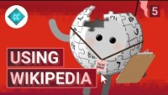
Take-home Activity
Using Wikipedia Carefully
Watch the video about the use of Wikipedia and document three ways in which you can use Wikipedia successfully.

Slide 15

Created by

