Slide 1
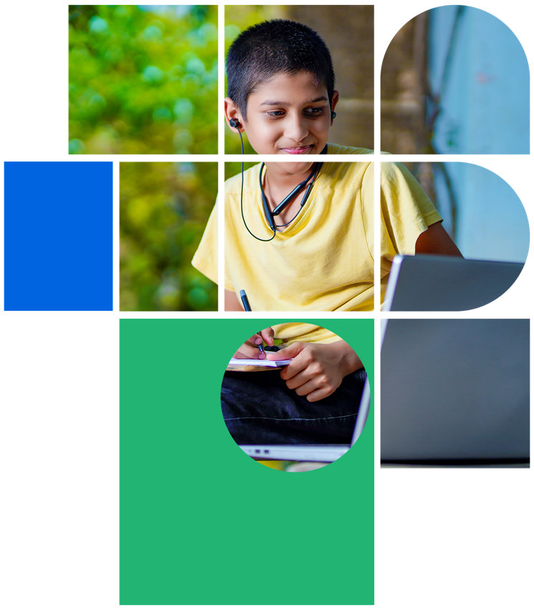
Digital Citizenship
Lesson 1
WELCOME TO DIGITAL CITIZENSHIP LEVEL 3

Slide 2


Level 3 | Digital Citizenship
Being a Good Digital Citizen
what it means to be a good digital citizen.

Slide 3
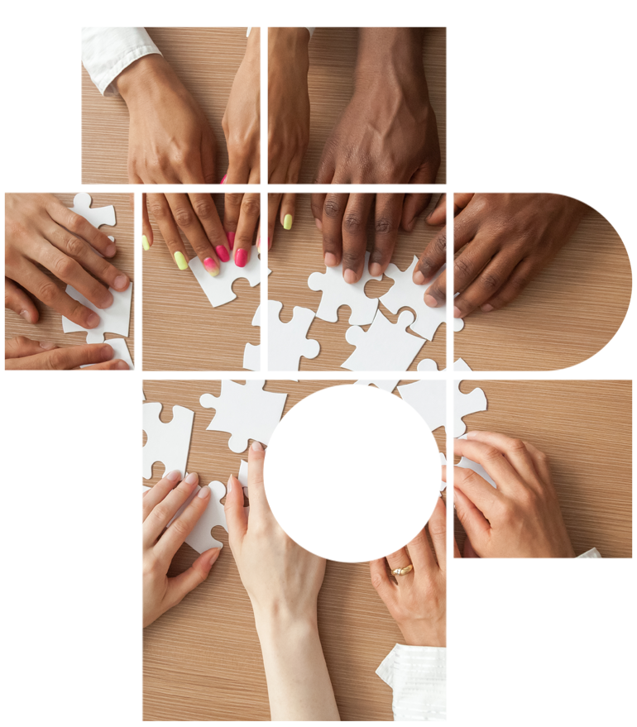
Refreshing our Knowledge
Scenario
1
Your teacher Ms. Pinky creates a class blog for the English class. She grants everyone permission to compose, edit, and post comments on the blog. This is meant to inspire creative story-writing.
One day, Ms. Pinky is absent from school and Mr. Rahul is taking the class instead. Mr. Rahul is unaware of the blog and, hence, does not check it as Ms. Pinky would. Someone in the class has been posting mean comments about a student in the class.
You…
Comment on the mean posts by saying: This is not at all cool! I am his friend, what you are saying is not true!
Ignore it until Ms. Pinky returns and can deal with it.
Get other students to post nice comments and compliments about the targeted student.
Tell Mr. Rahul that someone is posting mean comments on the class blog and that he should inform Ms. Pinky.

Slide 4
Refreshing our Knowledge
Scenario
2
You have waited until the last minute to write your comparative essay for class. It is due tomorrow, and you are only halfway done. You are only able to start your work at 10:00 PM and you can’t be up all night finishing the essay.
You run a few quick internet searches to see what other work is already out there on the subject. You find a great essay on the exact topic that you are writing about. Hooray! Now you won’t have to be up all night writing this boring essay.
You…
Insert a few copied paragraphs here and there into your essay. No one will be able to tell since you are still writing most of it yourself.
You decide to just copy the whole essay into your document. You quickly go through it and do some basic rephrasing. That’s enough, because you need to get some sleep!
You do your research and find a few other sources that enable you to make your own comparisons and write the paper. You only sleep at 1:00 AM but, at least it is your own work.

Slide 5
Refreshing our Knowledge
Scenario
3
When Ila first got her phone, her parents were quite strict and monitored her screen time carefully. Each night, she had to give her phone back to her parents until the morning. It didn’t matter to Ila because most of her friends didn’t have phones anyhow.
After about six months, her parents began to trust her more and she got to keep her phone at night. At the same time, more of her friends got their own phones. Suddenly, they were messaging each other constantly.
Did you hear what happened today after school?
Who is that new kid in your class? He’s kinda cute!
OMG, I’m still doing my homework, I hate school!!
If Ila keeps this up, what do you think some consequences might be? What do you recommend that she do?

Slide 6

Level 3 | Digital Citizenship
Digital Footprints
our digital footprints.

Slide 7

Discussion
What is the key message that the speaker wants you to remember?
She mentioned how we create digital footprints for other people. Have you done this? Do you always ask their permission first? Why or why not?
What would you do if a friend posts a photo of you that you don’t like? Has this ever happened to you before? What did you do?
Can you recall three rules to follow about posting on social media?
ccc

Slide 8
Level 3 | Digital Citizenship
Being a Good Digital Citizen
threat modelling which can help us manage our digital footprint and keep ourselves secure.

Slide 9

Discussion
What are the five important questions to ask about managing data which is already “out there” online?
What were some suggestions on how to protect your privacy?
What did they discuss about passwords? Are you using strong passwords on your devices?
What are some of the consequences of you fail to keep that data safe?
ccc

Slide 10

Take-home Activity
Key Question | Your reflection
What do you want to protect?
Who do you want to protect it from?
How likely is it that you will need protection?
How bad are the consequences if you fail?
How much trouble are you willing to go through to avoid the consequences?
Based on my reflection, I will take the following actions

Slide 11

Created by

