Slide 1

Digital Citizenship
Lesson 8
THREATS TO AND RULES FOR DIGITAL WELL-BEING

Slide 2

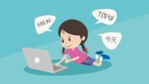
Level 2 | Digital Citizenship
Managing Screen Time
Tips For Healthier Screen Time
Notes:
https://www.youtube.com/watch?v=1RUM5mM2MZw

Slide 3
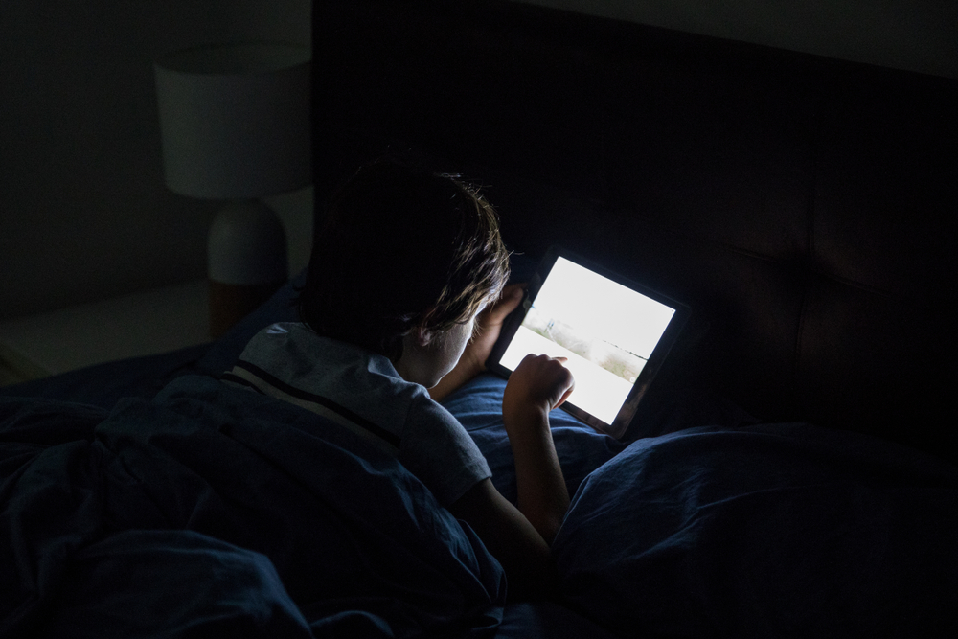
Level 2 | Digital Citizenship
Managing Screen Time
What are some of the unhealthy screen habits that you sometimes practice?
How are these habits harming you?
What would you like to change about your screen habits?

Slide 4
Reflection
Threat
Solution
I scroll through my social media at night and then I cannot sleep properly.
I will not use my device in bed before I go to sleep.

Slide 5

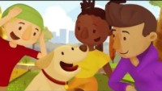
Level 2 | Digital Citizenship
How can we improve our digital well-being?
Five ways to improve our digital well-being.
Notes:
https://www.youtube.com/watch?v=yF7Ou43Vj6c

Slide 6

Non-screen time activities to add to your daily life
Write down two (or more) examples of activities to improve your well-being
Be mindful (Take notice)
Social / Emotional (connect with others)
Intellectual (Be creative, keep learning)
Be generous (Give or be empathetic)
Physical (Be active)

Slide 7

Level 2 | Digital Citizenship
Managing Screen Time
Wheel of well-being
Notes:
https://www.wheelofwellbeing.org/

Slide 8
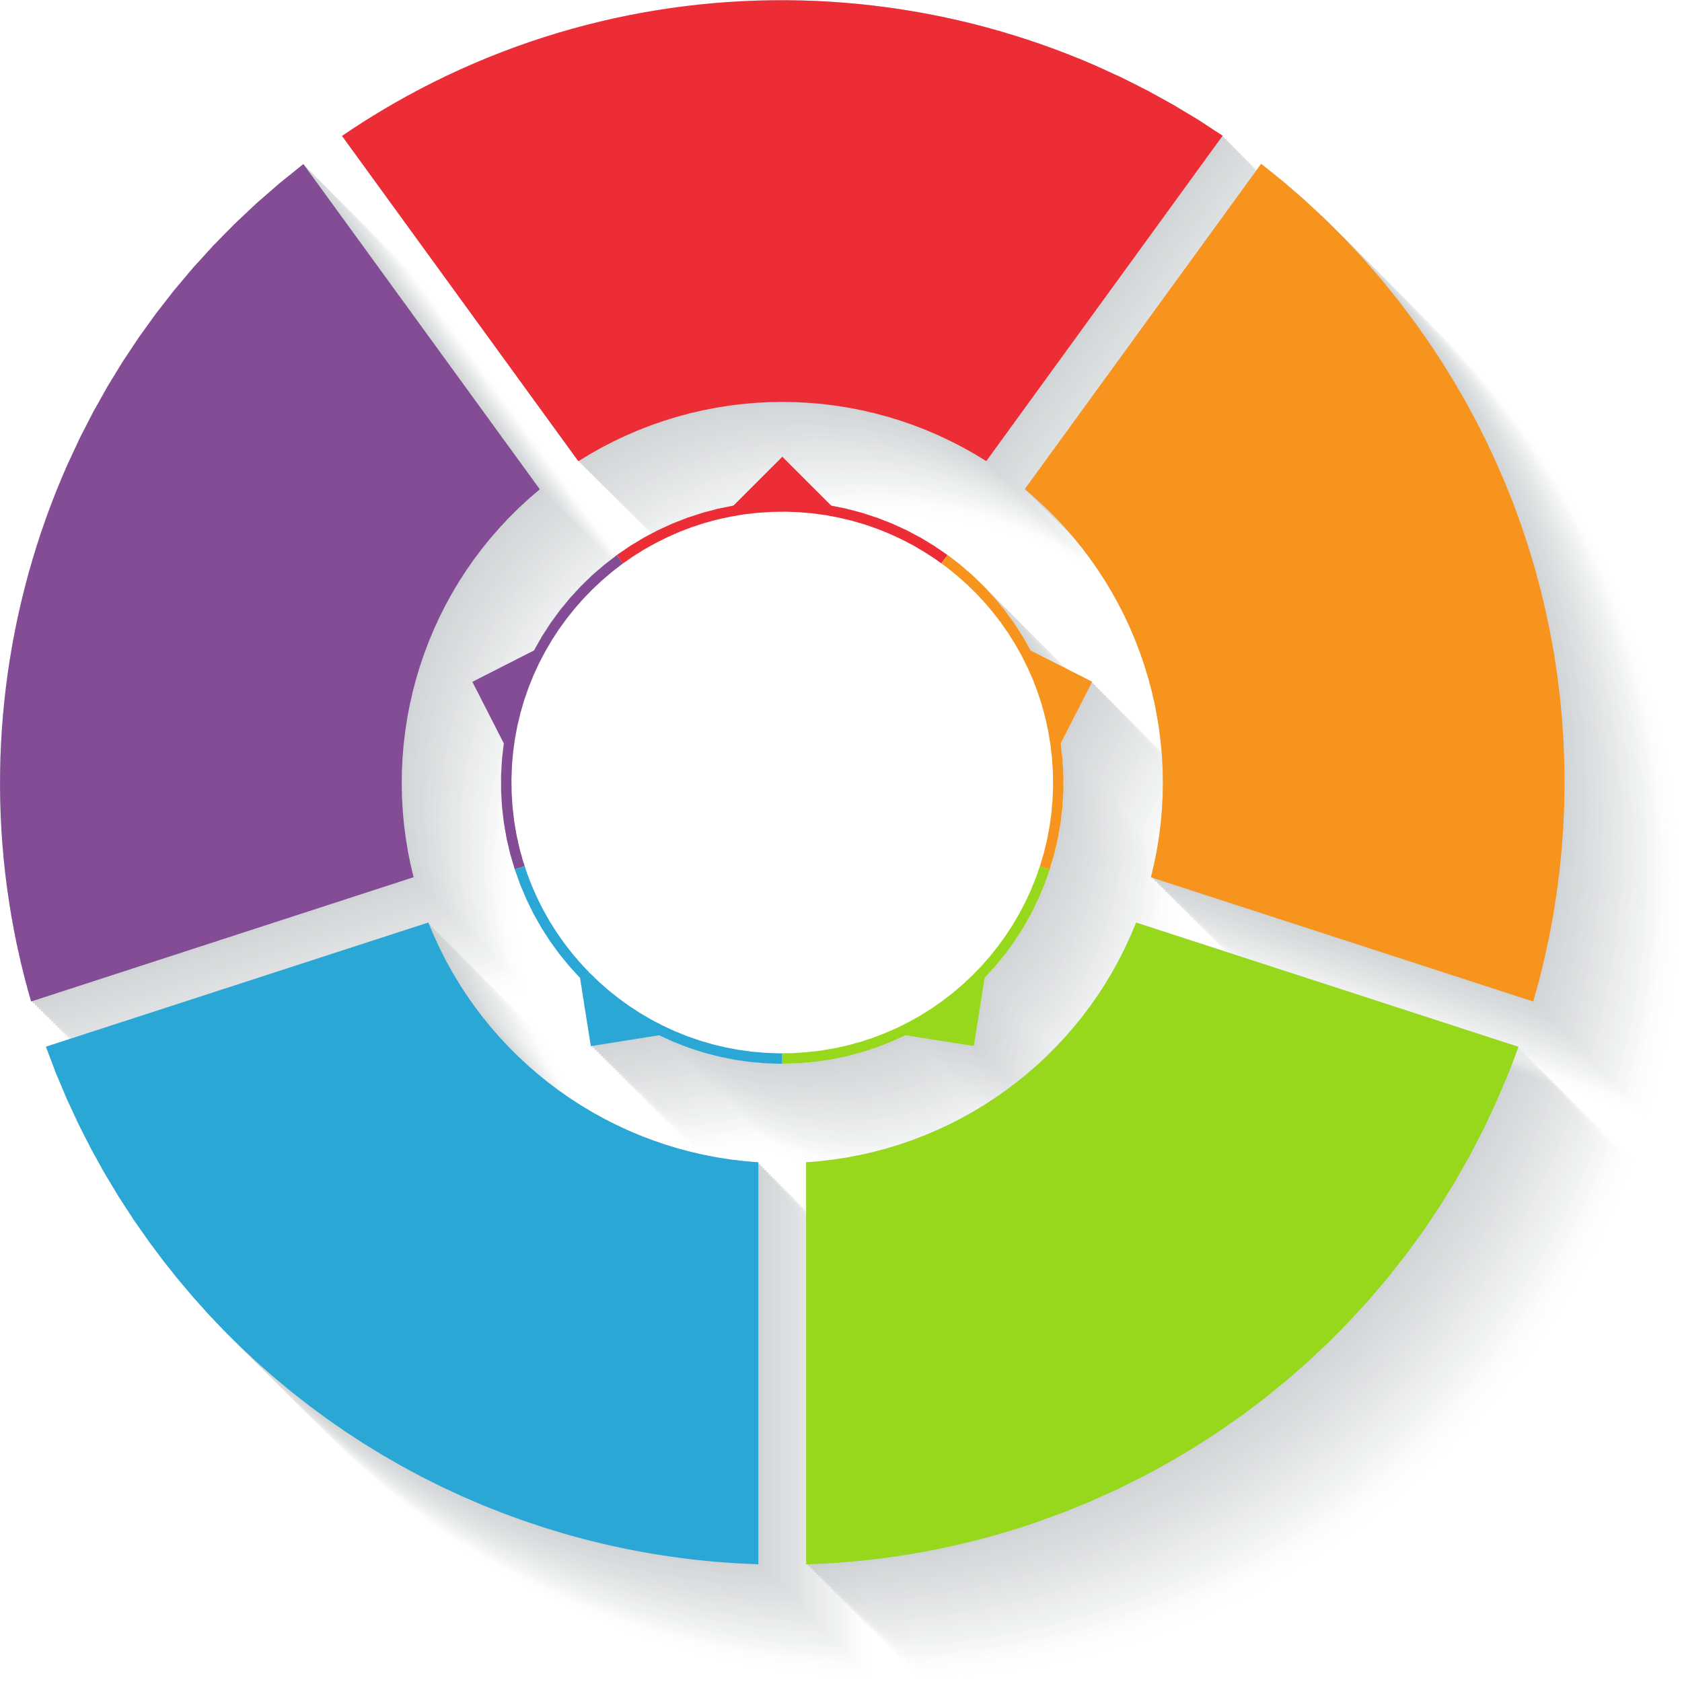
Make your own Wheel of Wellness
Be Mindful
Social/
Emotional
Physical
Place your regular activities under each relevant category
Be
Generous
Intellectual

Slide 9
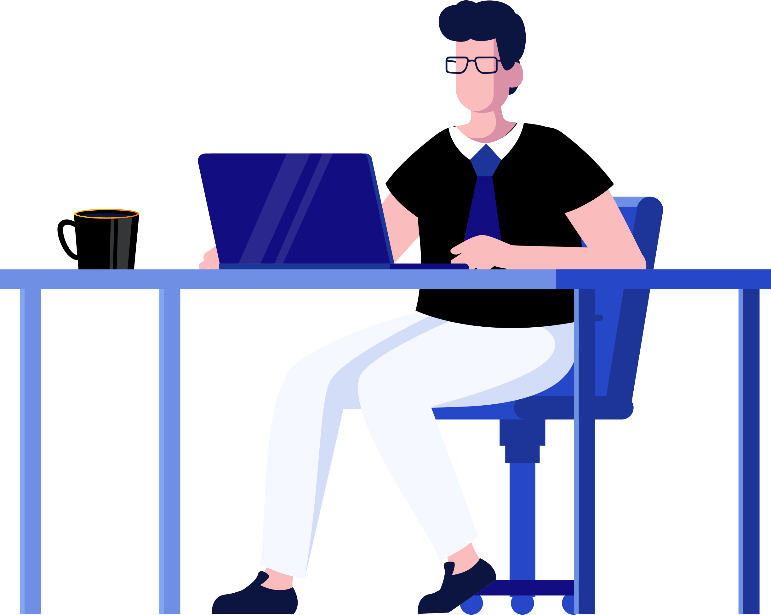
Take-home activity
Get creative! Choose one of the below activities.
Make a Movie: You can create and model screen-free times and zones to help all family members manage their screen time during the course of their day (while sleeping, studying, working or at the dinner table). You can use any online tool or app for this.
Make a poster: Use any creative tool to make a poster based on the digital wellness wheel you’ve created. You could do this by hand (using paints, colour pencils, markers, crayons etc.) or digitally (using any app or online drawing tool). Once it’s done display it in your room as a reminder to lead a digitally balanced life!

Slide 10

Created by

