Slide 1

Digital Citizenship
Lesson 6
WHAT ARE THE DIFFERENT FORMS OF CYBERBULLYING?

Slide 2
Quiz time!
Which of these statements are true and which are false?
It’s OK to say mean stuff about other people online because no one can find out it was you______________
If someone you know is being bullied online, you should stay out of it. It’s none of your business__________
Cyberbullies can face serious consequences such as being kicked off sports teams or suspended from school. Some even face legal punishments_______________
Technology like social media sites can only be used to hurt people.
You should ignore a mean or threatening message_________________
Cyberbullying may take many forms including text messages, screen shots, photos, etc.________________

Slide 3


Level 2 | Digital Citizenship
The different forms of cyberbullying
Cyberbullying Facts - Top 10 forms of Cyberbullying
Notes:
https://www.youtube.com/watch?v=0Xo8N9qlJtk

Slide 4
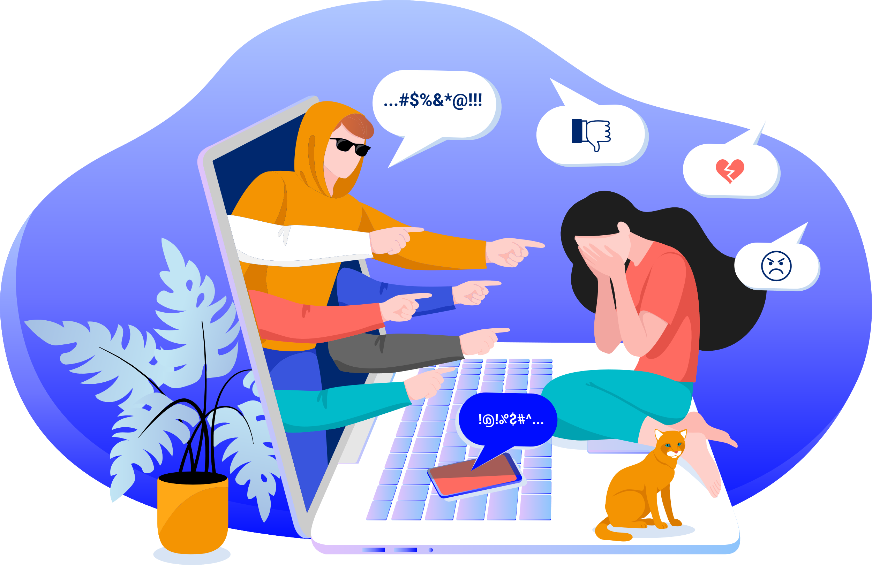
Decoding Domain Extensions
How many forms of cyberbullying are there?
What are they?
Were you aware of all these different types of cyberbullying?
How do you think cyberbullying affects someone mentally and socially?

Slide 5


Puzzle time
Forms of Cyberbullying
Click here

Slide 6

Role Play: Story Pair 1
Nakul and Nikita, 13
I’m Nakul and I have a twin sister, Nikita. Before dinner, Nikita looked at her phone and saw she had received a photo of herself. When I asked to see it, she told me she can no longer access it. I asked her about the photo but she would not discuss it and she seemed quite uncomfortable. I’m worried about her. How can I help her?
Tanya, 14
They call me ‘paparazzi’ because I’m always taking photos. I just discovered Snapchat. I love the idea of publishing photos online that disappear after a few seconds — it’s much more exciting than photos that sleep online forever. The other day, I took a photo of my friend while she was putting on her makeup and sent it to her anonymously on Snapchat. Hilarious! Anyway, I found a fun thing to do without anyone knowing it’s me. Watch out everyone, I’m Tanya Paparazzi.’

Slide 7
Role Play: Story Pair 1
Ananya, 17
Hi, I’d like to tell you about my friend. She sends me everything online – texts, mails, direct messages. She is everywhere at all times! After a while it just gets annoying! To make her stop, I decided to post a photo she sent me privately. Apparently, many people are interested in it because it’s now gone a little viral
Diya, 16
I live online, I love posting! I pay a lot of attention to what and where I post. My parents have drilled it into me that there can be disastrous consequences if the wrong people have access to my personal information. On the other hand, one of my best friends posted a picture of me without my permission and since then, everyone’s commenting on it. These comments are really hurtful and now I find it hard to sleep I’m thinking about it so much

Slide 8

Level 2 | Digital Citizenship
Cyberbullying Do’s and Don’ts
Tip | Do | Don’t
Post only positive comments.
Accept a friend request from a stranger.
Think before you post.
Post private information.
Respond to an angry message with anger.
Report the person you blocked.
Reach out to a parent, teacher, or other trusted adult.
Post whatever you like and think of in the moment.
Believe what the bully says about you.
Save any evidence of cyberbullying.
Block the person who is saying bad things about you.
Reply to the message you received from a stranger.

Slide 9

Word Wall
Form pairs with your classmates and together with your partner, create a poster explaining one of the below mentioned term you’ve been assigned.
Cyberbullying Vocabulary
Bullying
Cyberbullying
Exclusion
Harassment
Outing
Cyberstalking
Fraping
Fake Profiles
Dissing
Trickery
Trolling
Catfishing

Slide 10

Created by

