Slide 1

Digital Citizenship
Lesson 5
INTRODUCTION TO CYBERBULLYING AND ETHICAL BEHAVIOUR

Slide 2
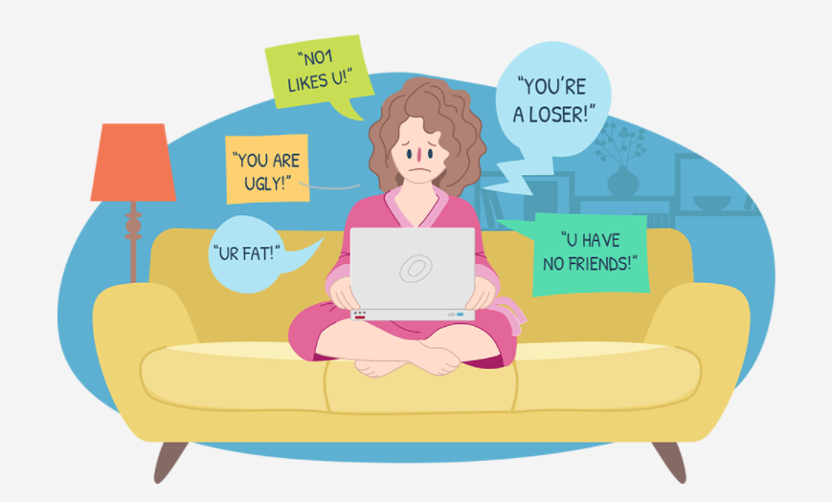
Examine the scene
What is happening here?
Is this a case of cyberbullying?

Slide 3

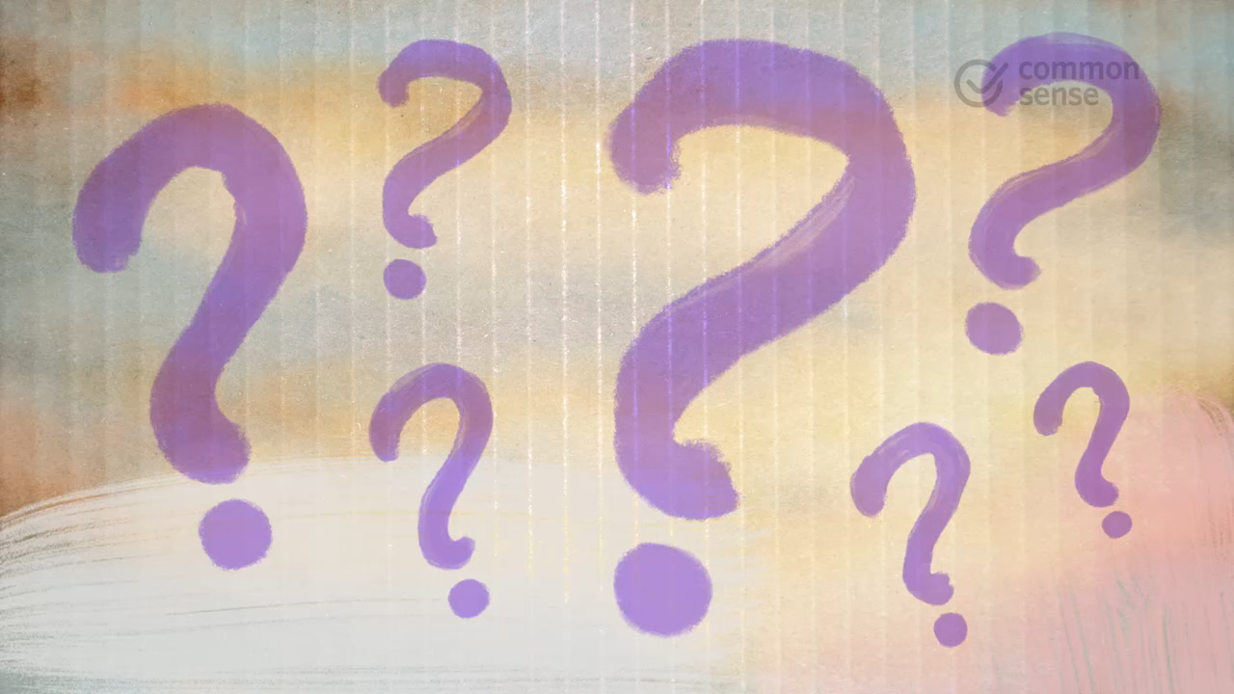
Level 2 | Digital Citizenship
Let’s learn about Cyberbullying
What is Cyberbullying?
Notes:
https://www.commonsense.org/education/videos/whats-cyberbullying

Slide 4
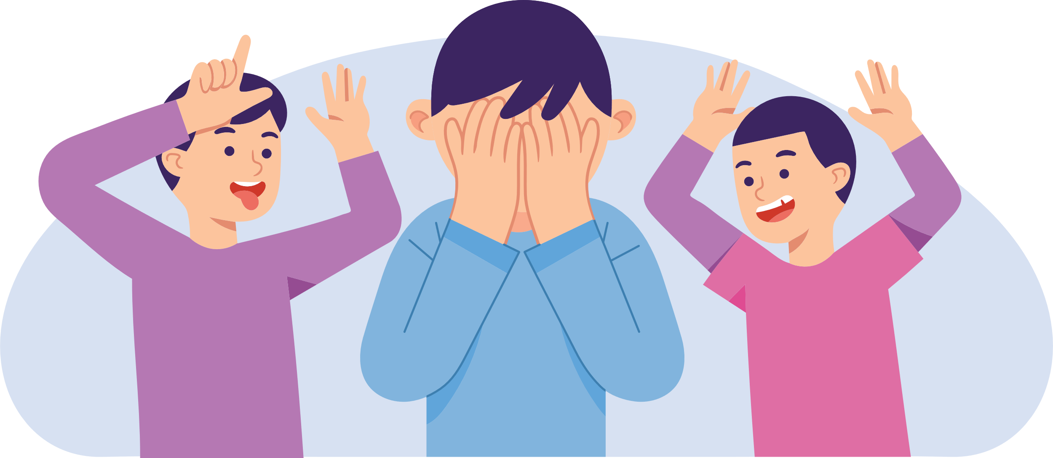
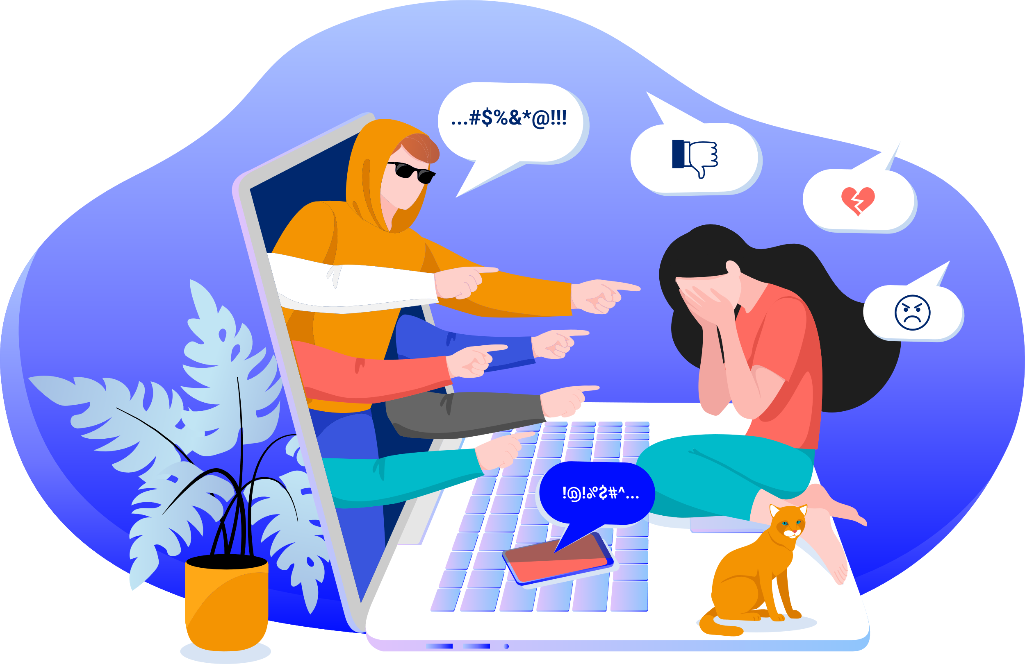
Definitions & Differences
Bullying
Cyberbullying
When a person seeks to harm, intimidate, or coerce someone who is perceived as vulnerable
The use of electronic communication to bully a person, typically by sending messages of an intimidating or threatening nature
Done face-to-face, can be physical or verbal, and may only be witnessed by a small number of onlookers, if any. The bully can be identified, and the victim may be able to leave the bully behind and find a safe space
Can take place at any time (24x7) and at any place as there are no geographical boundaries to it. It usually takes the form of written communication and may have a large audience which can grow larger if the bully’s message is shared or forwarded. The bully can remain anonymous, and the victim may not be able to find a safe space unless they completely leave the online environment.

Slide 5

Let’s meet Amal
Amal is often bullied at school, by other boys and girls. He stammers when he speaks and is always nervous. Children throw small stones at him, call him names and make fun of him at school and in chat rooms online. They send humiliating messages to his mobile phone and post mean comments on his Facebook wall.
Follow the numbers on the worksheet. Read through each box and write down your thoughts on how to help Amal

Slide 6
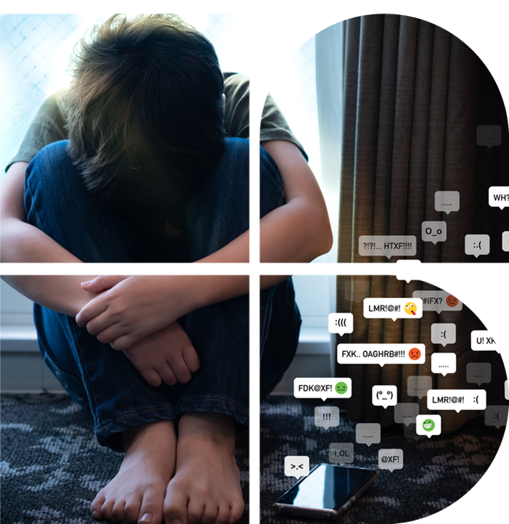
Victims of Cyberbullying
Now that you have heard the story of Amal, let’s consider the victims of cyberbullying
Based on your understanding, who are the most likely to become victims of cyberbullying?
Do you know what to do if you are the victim?

Slide 7
Cyberbullying victims
Block communication from the cyberbully
Do not respond to or even read the messages
Ask a friend or family member to print out the messages as evidence
Report the problem to an adult like a parent or a teacher
Do not pass along the cyberbully’s messages
Enlist the help of your friends by asking them to not pass along the messages and to help you stand up to the bully
Seek revenge on the bully
Avoid your friends or activities
Cyberbully them back or cyberbully someone else
If YOU are the victim,
what can you do?
If YOU are the victim,
what should you not do?
Remember, the Cyberbully is the one who is doing the wrong thing, not you!

Slide 8

Case Studies
Scenario 1
Madhu was bored on a Saturday afternoon, so she took a screenshot of her classmate Sudha’s photo from social media. She then used an app to make Sudha look like a monster in the photo and added some insulting words. She thought it was funny and decided to share it online.
After sharing it in a group text, some classmates replied with hurtful, mean comments about Sudha. Others laughed and shared it further. Eventually, it was forwarded to Sudha who was upset and hurt to see it and hear that Madhu was behind it.
Do you think this behaviour qualifies as cyberbullying?
What do you think motivated Madhu to hurt Sudha?
Do you think that Madhu meant to hurt Sudha and does that matter?
What can Sudha do?

Slide 9

Case Studies
Scenario 2
Dev plays multiplayer video games online with people he only knows through gaming. A few of them have added him on social media. One player, Aarav, would chat with him a lot while playing, asking a bunch of personal questions. Dev would answer without thinking too much about it. One day, Aarav posted all kinds of personal information about Dev on social media mixed in with lies and comments about his ethnicity and gaming skills
Is this a case of cyberbullying?
How was Aarav trying to harm Dev and his reputation?
What can Dev do?

Slide 10

Case Studies
Scenario 3
Ajay and his friend Dolly were playing around after school. Ajay took some photos and posted them online. One photo showed Dolly making a weird face, which they both found funny. But other kids who saw it started posting mean comments about Dolly’s face in the photo. Dolly was upset by the photo and comments.
Do you think that this is a case of cyberbullying if Ajay didn’t mean any harm and he is willing to delete the photo?
What if Ajay does not delete the photo after seeing the negative comments being posted about his friend Dolly?
What can Dolly do?

Slide 11

Created by

