Slide 1

Digital Citizenship
Lesson 2
ACCESSING SAFE AND SECURE WEBSITES

Slide 2
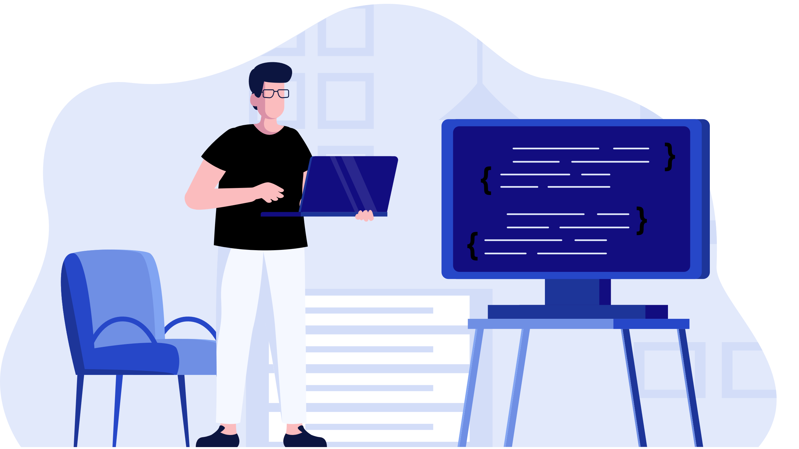
Decoding Domain Extensions

Slide 3
Understanding URLs
Have you heard the term domain extension before? What does it mean?
Can you name any common domain extensions?
Domain Extension
The notation at the end of a web address that specifies an internet category or a country code.

Slide 4
What do these extensions mean? Match them to the definitions
Domain Extension
Its Meaning
.org
Official domain extension of India
.com
A Government of India website
.net
A business or commercial website
.edu
For banks, registered companies, and trademarks in India
.gov.in
An advocacy website such as a not-for-profit organisation
.in
A site affiliated with a higher education institution
.co.in
The website of a network organisation or internet service provider

Slide 5
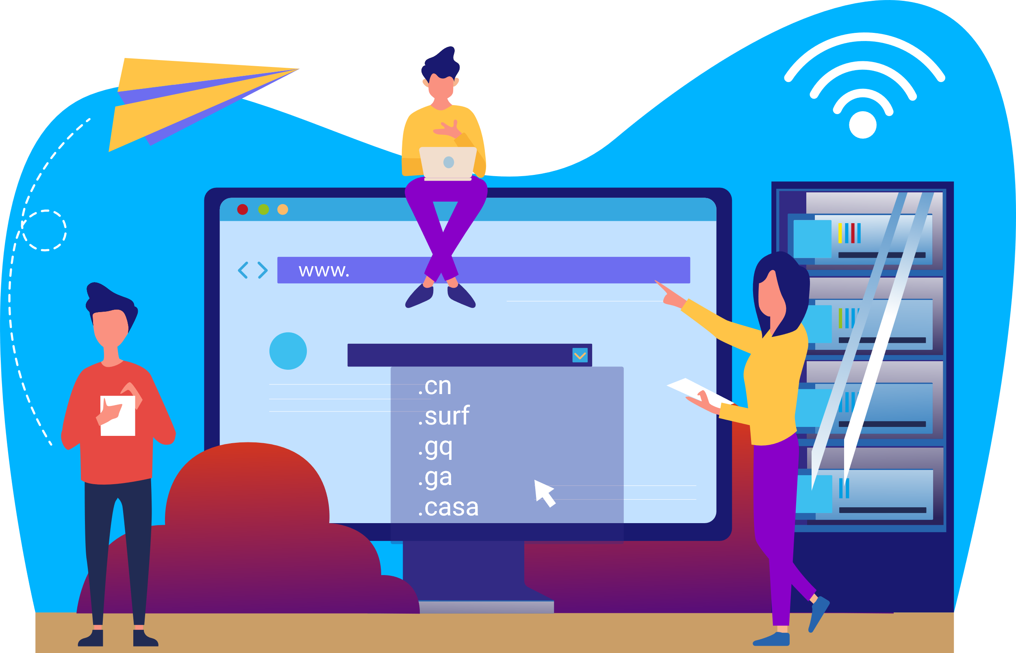
Watch out!
Top Most Abused Domain Names as of February 2022
.cn
.surf
.gq
.ga
.casa
If you see a domain extension like this in your email inbox, it is best to flag the email as spam and block the sender. Do not click on the email or on any link in the body of the email.

Slide 6

Level 2 | Digital Citizenship
How can you tell if a website is safe?
Five signs that can help you tell whether a website is safe or not.
Click here
Notes:
https://www.sitelock.com/blog/is-this-website-s

Slide 7

5 Signs of a Safe Website
Look
Look for the “S” in HTTPS
Check
Check for a website privacy policy
Find
Find their contact information
Verify
Verify their trust seal
Know
Know the signs of website malware

Slide 8
Hands on!
Step 1: In your internet search bar, type “Times of India”.
Step 2: You should get a search result in which you can clearly see the “https” portion of the URL.
Step 3: Click on the website. We will now check for the website privacy policy and their contact information

Slide 9
Hands on!
Step 4: Now, let’s verify the trust seal. You can find this by clicking on the padlock symbol next to the web address in the browser.
Note: If the website is not deemed as secure by the web browser, you might get a different symbol other than the padlock!
Step 5: You will get a pop-up. Click on “connection is secure” and you will get a second pop up. Click on “Certificate is Valid”. You will be able to see the details of the trust certificate.

Slide 10
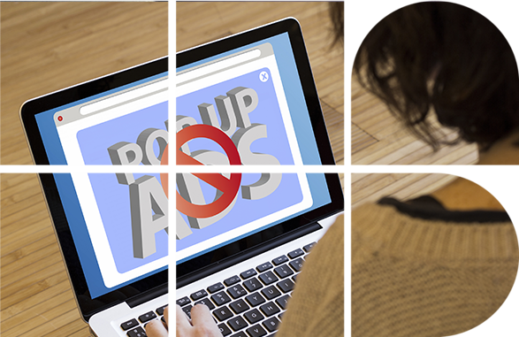

Pop-ups
Have you heard of a pop-up?
A Pop-up is a graphical display area, usually a small window, that suddenly appears or pops-up on top of a webpage.
For example, in the above exercise, when you clicked on the padlock symbol, you got a small box popping up. That was a pop-up!
Pop-ups may be used to show you ads or may ask you if you would like to allow notifications from the website (click “block”)
Look for the small “X” in the corner of the pop-up window to close the window.
Learn more about how to manage pop-ups by reading this article: pop-up blockers.
Click here

Slide 11

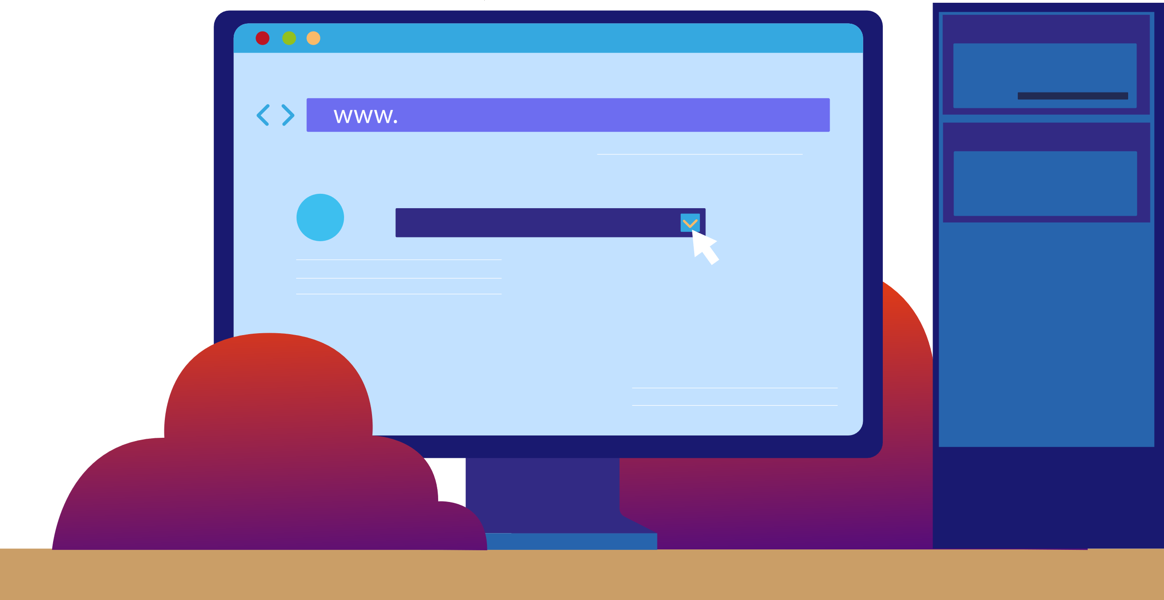
Websites as Traffic Lights
A “GREEN” website is:
A good site for kids your age to visit.
Fun, with things for you to do and see.
Has appropriate words.
Doesn’t let you talk to people you don’t know.
Did you know that there are almost 118Cr websites worldwide!
Which ones are safe for you to visit?
A “YELLOW” website is:
A site you are not sure is right for you.
One that asks for information such as who you are, where you live, your phone number or email.
A place where people are allowed to communicate freely with others, even those that they do not know.
A “RED” website is:
A site that is not right for you.
A website that encourages risky or illegal behaviour.
A place you might have gone by accident.
Filled with things that are for adults.

Slide 12

Hands on!
In your search bar, type “Fun games to play with friends”
What results did you get?
What are some of the clues which indicate that the website is appropriate?
ccc
If you are unsure, ask an adult for help!

Slide 13


Digital Footprints Recap
What do you remember about digital footprints from the level 1 course?
Digital Footprints are the trails of data that you leave when you are on the Internet as a result of your online activity.
Your digital footprint can be your emails, your social media posts, or any of your search history.

Slide 14


Cookies
Level 2 | Digital Citizenship
Notes:
https://www.youtube.com/watch?v=DyO87X04Fj8

Slide 15
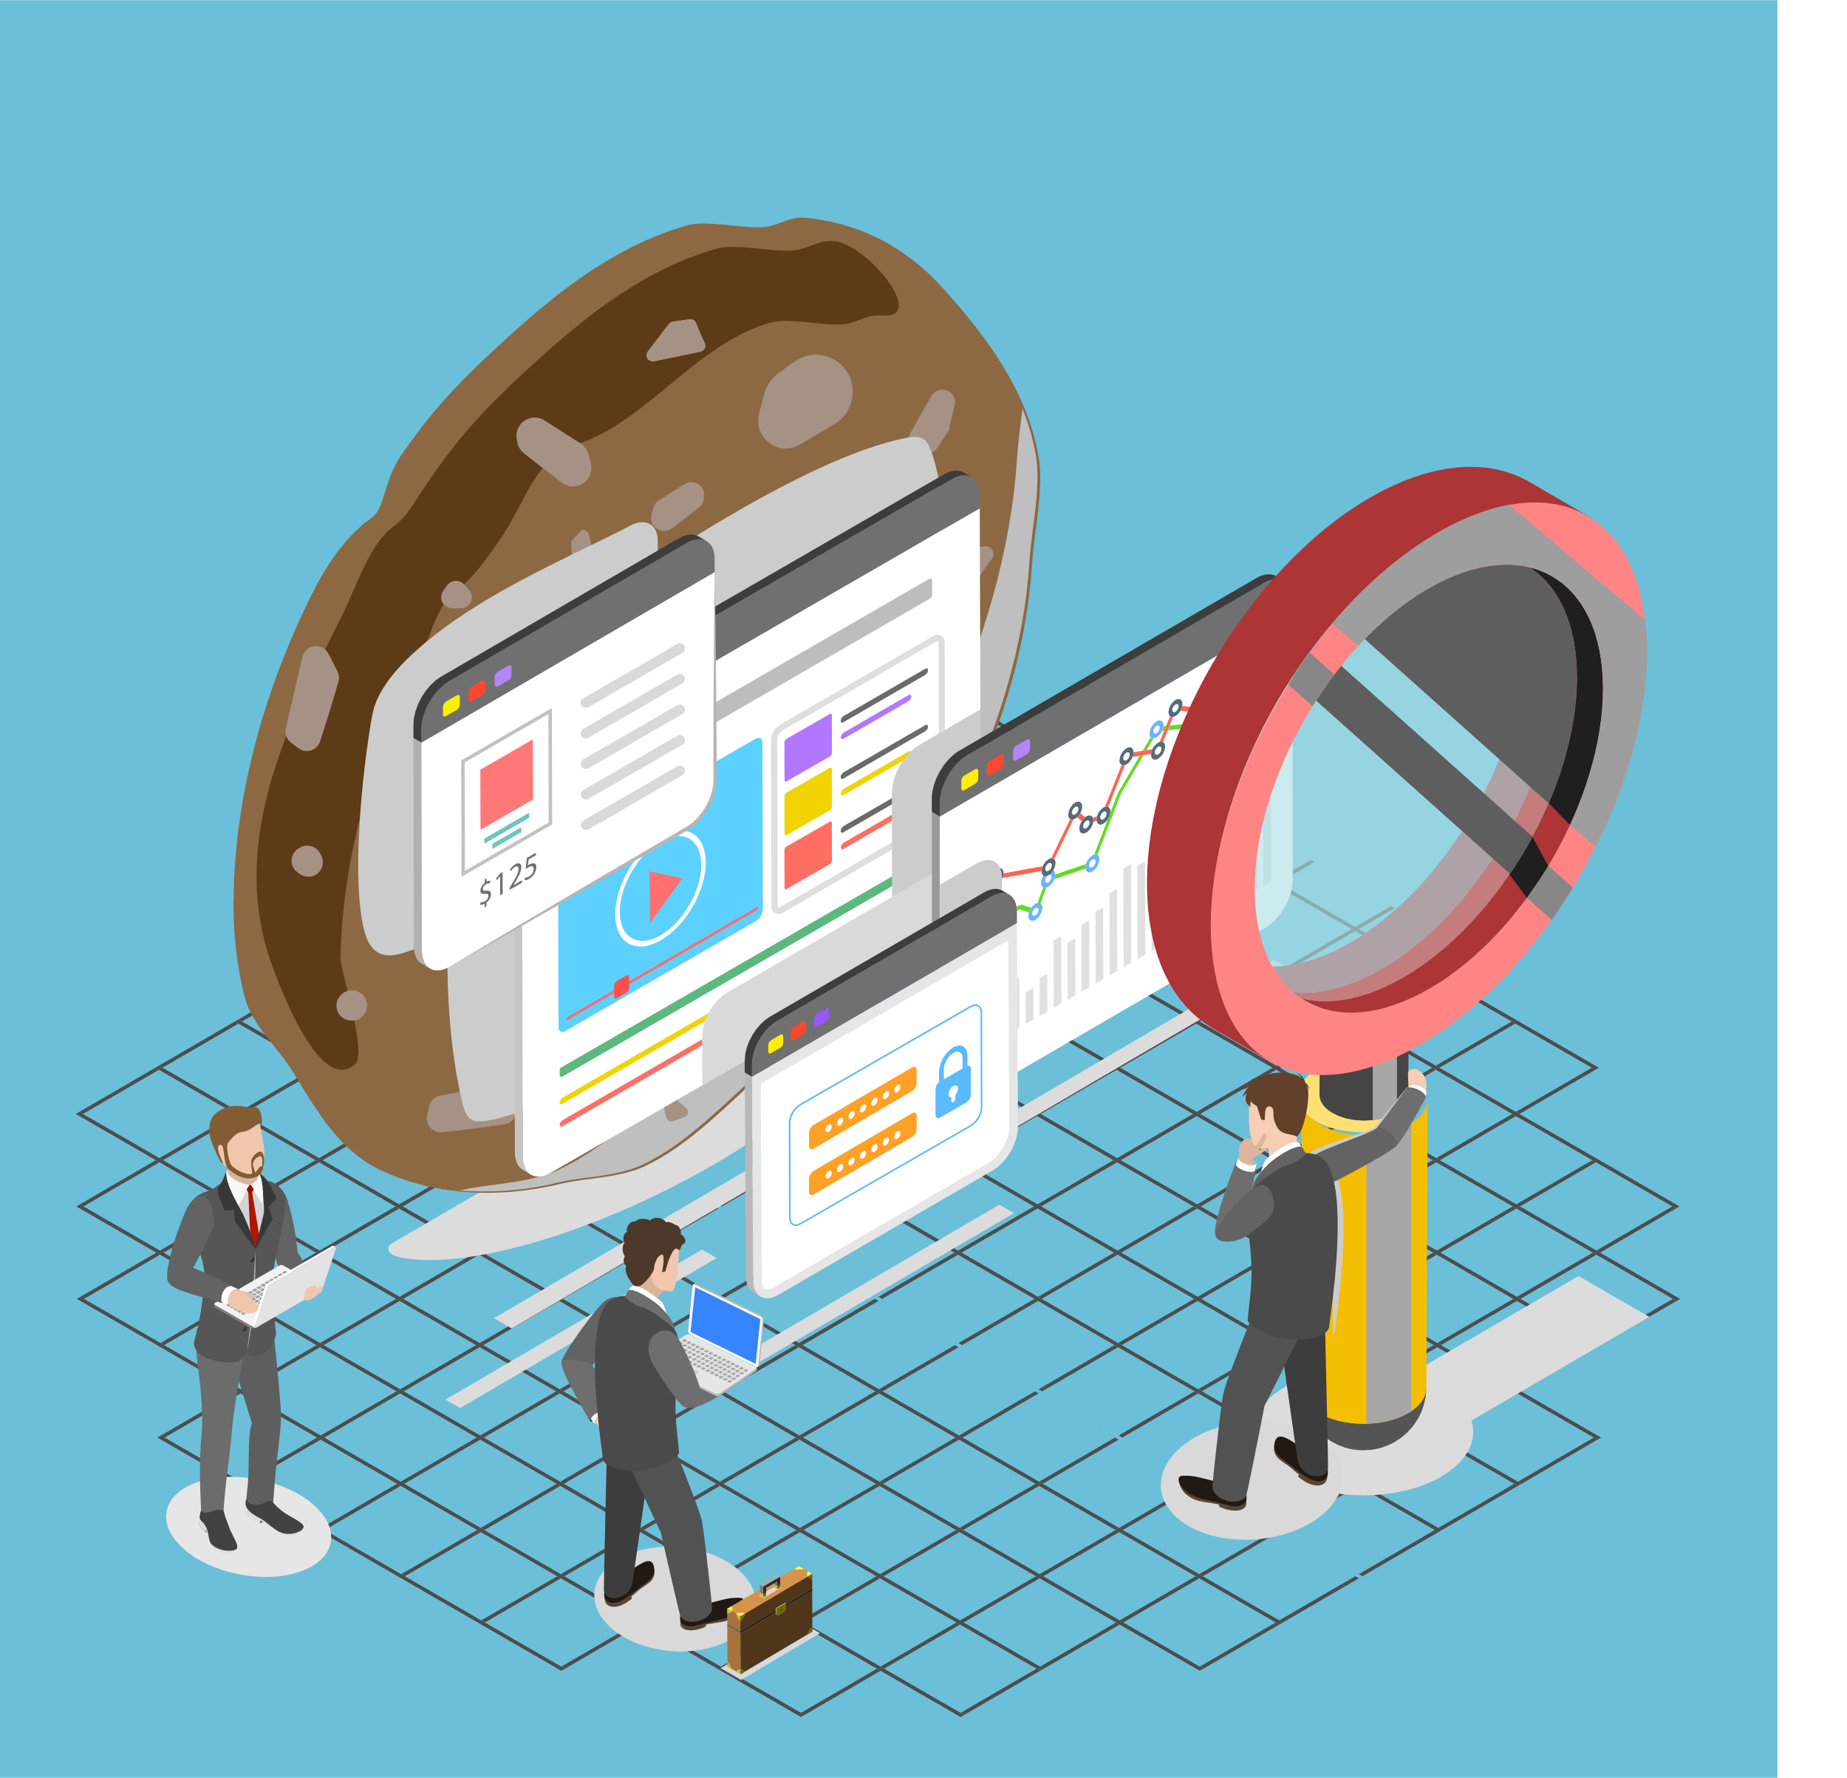
Hands on!
Cookies can pose a security threat. Especially if you are using cookies to remember your password for a website, there is a risk that the website could be hacked and your password stolen.
Cookies store personal information. Cookies remember the websites that you visit and your preferences on those pages. Companies can use this information to build a profile of you.
You can learn to manage your cookies and keep your system more secure
Google Account Help | Clear Cache and Cookies
Microsoft Edge Support | Delete Cookies in Microsoft Edge

Slide 16

Wrap up: Spot the Fake URLs
Domain Name | Real | Fake
Timesofindia.indiatime.com
NDTV.com
Bigbasket.com.co
Amazon.in
Pr1mev1deo.com.in
Myntra.com
Nykaa.com
Flipcart.flip.com
BBC1.site/business-news
Timesofindia.Indiatimes.com
Espncricinfo.com
Amazon.go.com.co
Primevideo.com
Myntra1.site/shopping

Slide 17
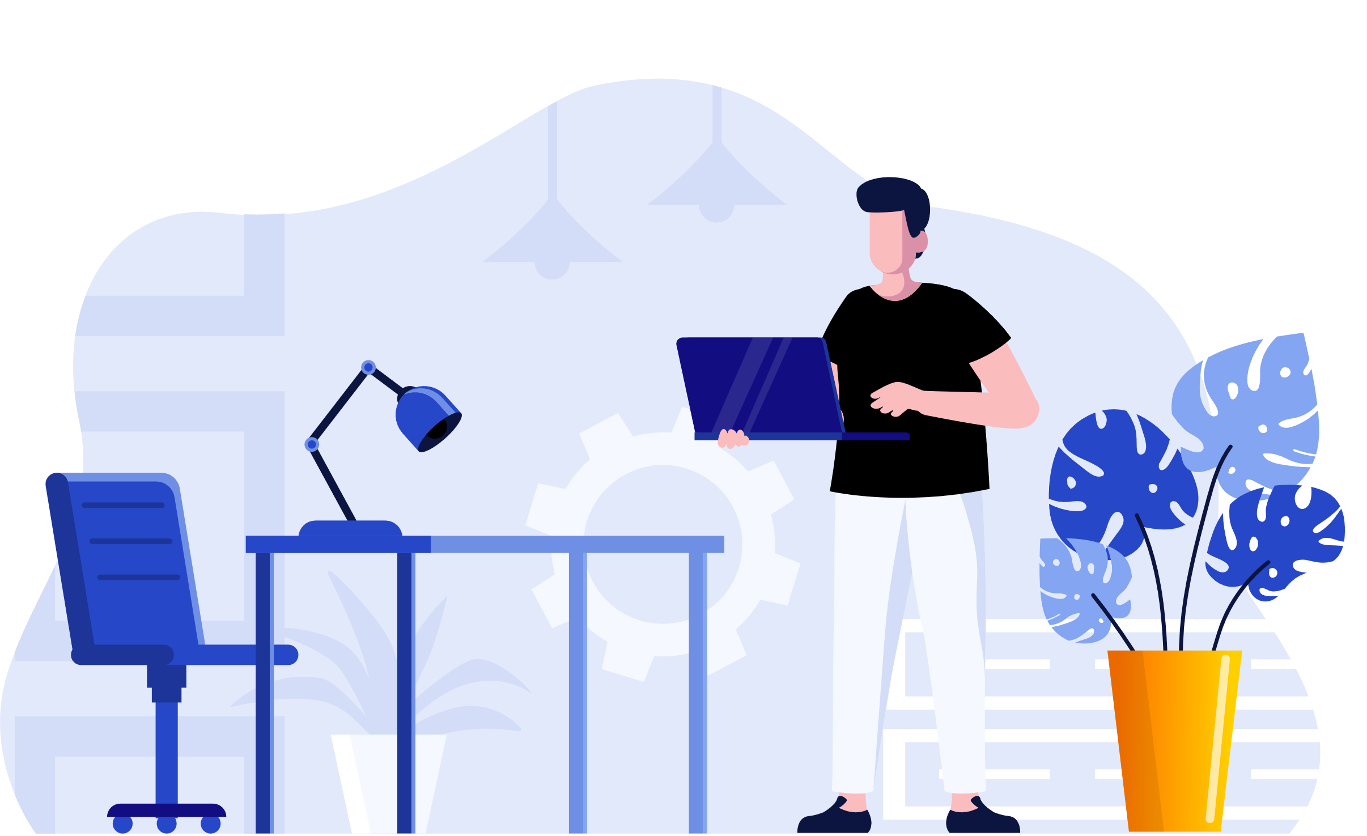
Take-home activity
Check the cookie settings on your parent’s Android or iOS devices and clear the cookies using this guide from Google Chrome Help.
Click here

Slide 18

Created by

