Slide 1
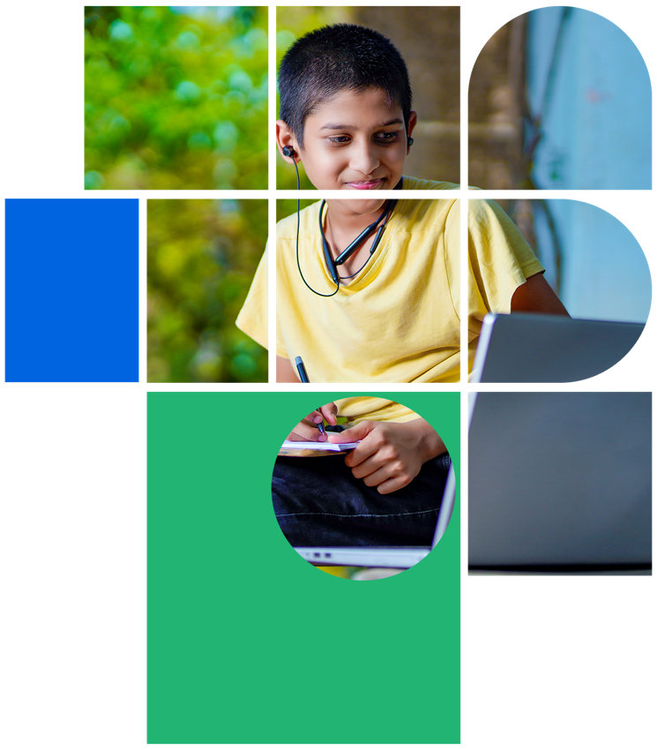
Digital Citizenship
Lesson 2
DIGITAL CITIZENSHIP LEVEL 2

Slide 2

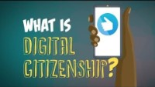
Level 2 | Digital Citizenship
Let’s refresh our memory about Digital Citizenship

Slide 3








Write down your own definition of the DC topics
Computer Basics
Digital Etiquette
Digital Well-being
Digital Footprint
Cybersecurity
Information Literacy
Cyber Exploiters
Digital Citizen

Slide 4

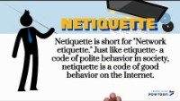
10 Examples of Good Netiquette
Level 2 | Digital Citizenship

Slide 5
Let’s refresh
What were some of the 10 examples of good netiquette given in the video?
How do these tips keep us safe?
Do you act differently online vs. offline? Why?

Slide 6
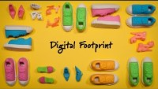
Level 2 | Digital Citizenship
Digital Footprints

Slide 7

Let’s understand your Digital Footprint
Access the short poll on quizzizz
Choose all applicable answers for each question
Q1: How do you go online?
I use Instagram, Snapchat or other social media
I am on at least one Discord server or What’s App chat group
I watch videos on YouTube
I send emails
I use streaming services like Amazon Prime or Hotstar to watch movies, sports, or shows
QUIZZIZZ

Slide 8
Q2: Who else is shaping your digital footprint?
Q3: Are you in control of your Digital Footprint?
My friends take photos of me and post online
My friends tag me in posts or stories
I know all the people in my social media network in real life
I have been featured online by a news or other organization
I have searched my name online to see what is online under my name
I was searching for something online and then started receiving online ads about the same
My social media (or other) picture is a picture of me
I include personal information about myself on my social media (like birthday, address, school name, etc)
I have tagged or untagged photos of myself when I liked or didn’t like what it said about me

Slide 9

Poll results
Time to change your password!
Did you realize all of the ways in which you go online?
Do you think about how other people are shaping your digital footprints by tagging you?
Are you proactively managing your own digital footprint?

Slide 10
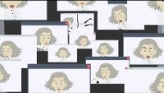
Level 2 | Digital Citizenship
Let’s revisit Cybersecurity

Slide 11





Level 1 | Digital Citizenship
Simple tips to keep you safe online
1
Trust your feelings. If something doesn’t feel right when you are online, stop what you are doing
2
Think before you click. Don’t open emails or download attachments from strangers.
3
Talk to a parent, teacher, or trusted adult if something makes you feel uncomfortable.
4
Keep your personal information private. Avoid sharing your name, address, telephone number, and the name of your school when using the internet or apps.
5
Just like in real life, treat others the way you wanted to be treated online. Do not bully or say or post things online that could hurt others’ feelings or get you in trouble.
6
Remember to protect your mobile phone or tablet. Use a PIN or a password to lock your devices.
7
These tips apply regardless of which device you use to access the internet—be it your smartphone or your game console.

Slide 12
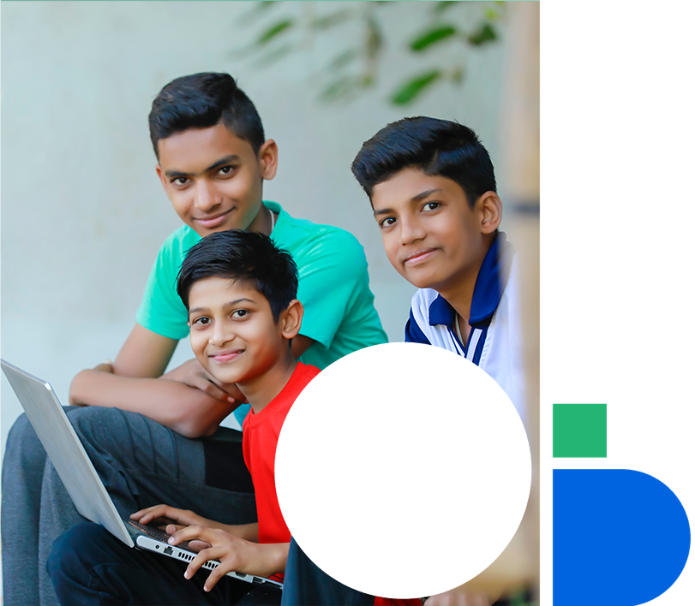
Level 1 | Digital Citizenship
Let’s Recap
A strong password should contain at least one ______________ letter.
_____________________ is the practice of sending an email which pretends to be from a company but is really trying to gather your personal information.
A ___________________ is a person who tries to steal your personal information online.
A fraudulent email is called _____________________.
One clue that you should not open the email is that it sounds __________________too good to be true_______________.
Your school network has a ___________________ to keep it secure.
A weak password is one that contains __________________________ information.
Someone who meets you online and then would like to meet you in person might be a _____________________.

Slide 13

Created by

