Slide 1

Digital Citizenship
Lesson 15
SPOT THE FAKE NEWS – INTERNET INVESTIGATOR

Slide 2

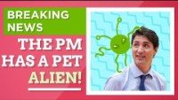
Level 2 | Digital Citizenship
What is fake news?
Explain fake news
Notes:
https://www.youtube.com/watch?v=RDOFt1tFYx8

Slide 3
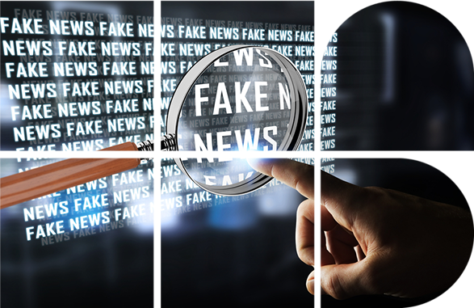
Categories of fake news
False stories
look like actual news but are completely made up!
Half-truths
some mixture of truth with misrepresentations or lies
Clickbait
attention-grabbing headlines to drive ad revenue

Slide 4
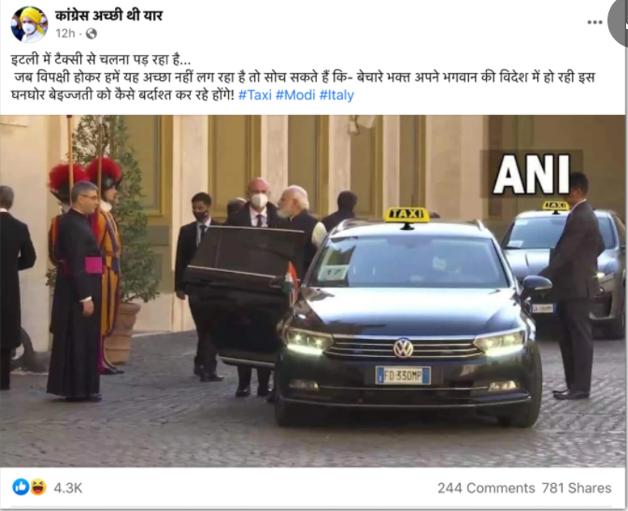
Is it real or fake?
Why would a news website or an individual publish a false story or a half-truth?
Can you think of when someone would want a false story to be published?
ccc

Slide 5
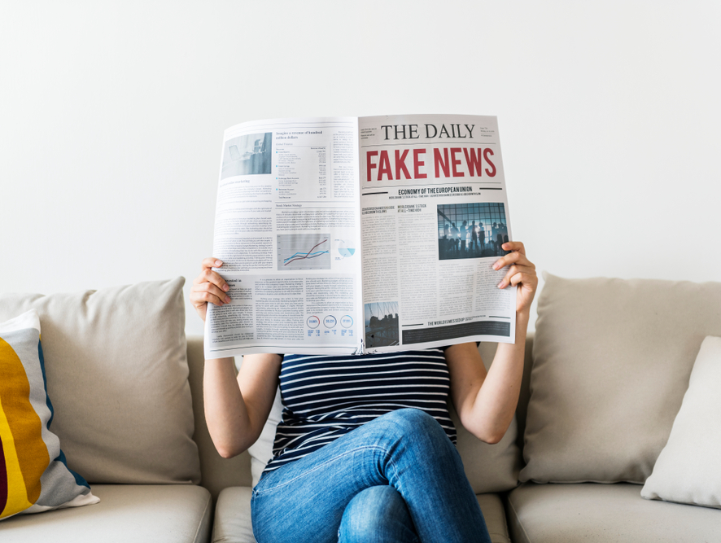
Is it always “fake”?
Let’s examine a high-profile event and how different news sources reported it.
In February 2020, the President of the USA, Donald Trump, travelled to India. He gave some speeches, met dignitaries, and visited the Taj Mahal.
News outlets across the world reported the visit. Did they all say the same thing? If they did not all say the same thing, are the “wrong”?
Work in pairs or small groups to analyse the articles.
ccc

Slide 6

Analysis
Which news source had the most positive press coverage?
Which news source has the most negative press coverage?
Just because they are different, does that make them fake?

Slide 7

Level 2 | Digital Citizenship
Tips to analyse the news
Think. Does the news story make sense when you stop and think about it? If no, then it is likely not true.
Gut check. If reading the headline or the story makes you angry, it might be because someone wants you to be angry.
Check other news sources. Are all major websites or newspapers reporting the same story?
Does the website’s URL look suspicious? Fake websites often add “.co” to the name of a proper website to make it seem real. Example: “abc.com.co” (fake) as compared to “abc.com”.
If you land on an unknown website, check the “about” page or section. Then Google the information to see what you can find.
Check the date. Sometimes old stories will be forwarded to make it seem like they are new or recent.
Check the website and the article. Does it look sloppy? Are there a lot of errors in spelling and grammar?
If the website has a lot of pop-ups, then it might be a clickbait site.
ALL CAPS is a good sign of clickbait.

Slide 8
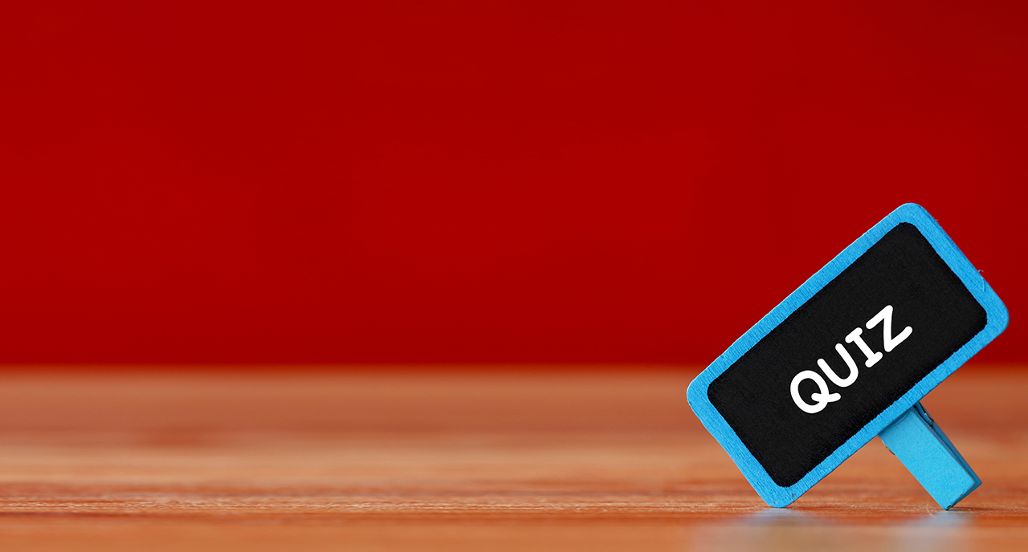
Level 2 | Digital Citizenship
Tips to analyse the news
Headline
Type of News
Is she or isn’t she? Is that a baby bump?
Prime Minister of Sweden flees country, says she’s moving to a warmer country
Divorce scandal! Marriage on the rocks.
FREE! FREE! FREE!
US President living in Alaskan igloo to experience global warming first-hand.
What does Anushka Sharma eat in a day? Find out here!

Slide 9

Take-home Activity
Write your own fake news headline.
Make it seem as real as possible.

Slide 10

Created by

