Slide 1

Digital Citizenship
Lesson 11
SELF-IMAGE, SOCIAL MEDIA, AND SELF-ESTEEM

Slide 2
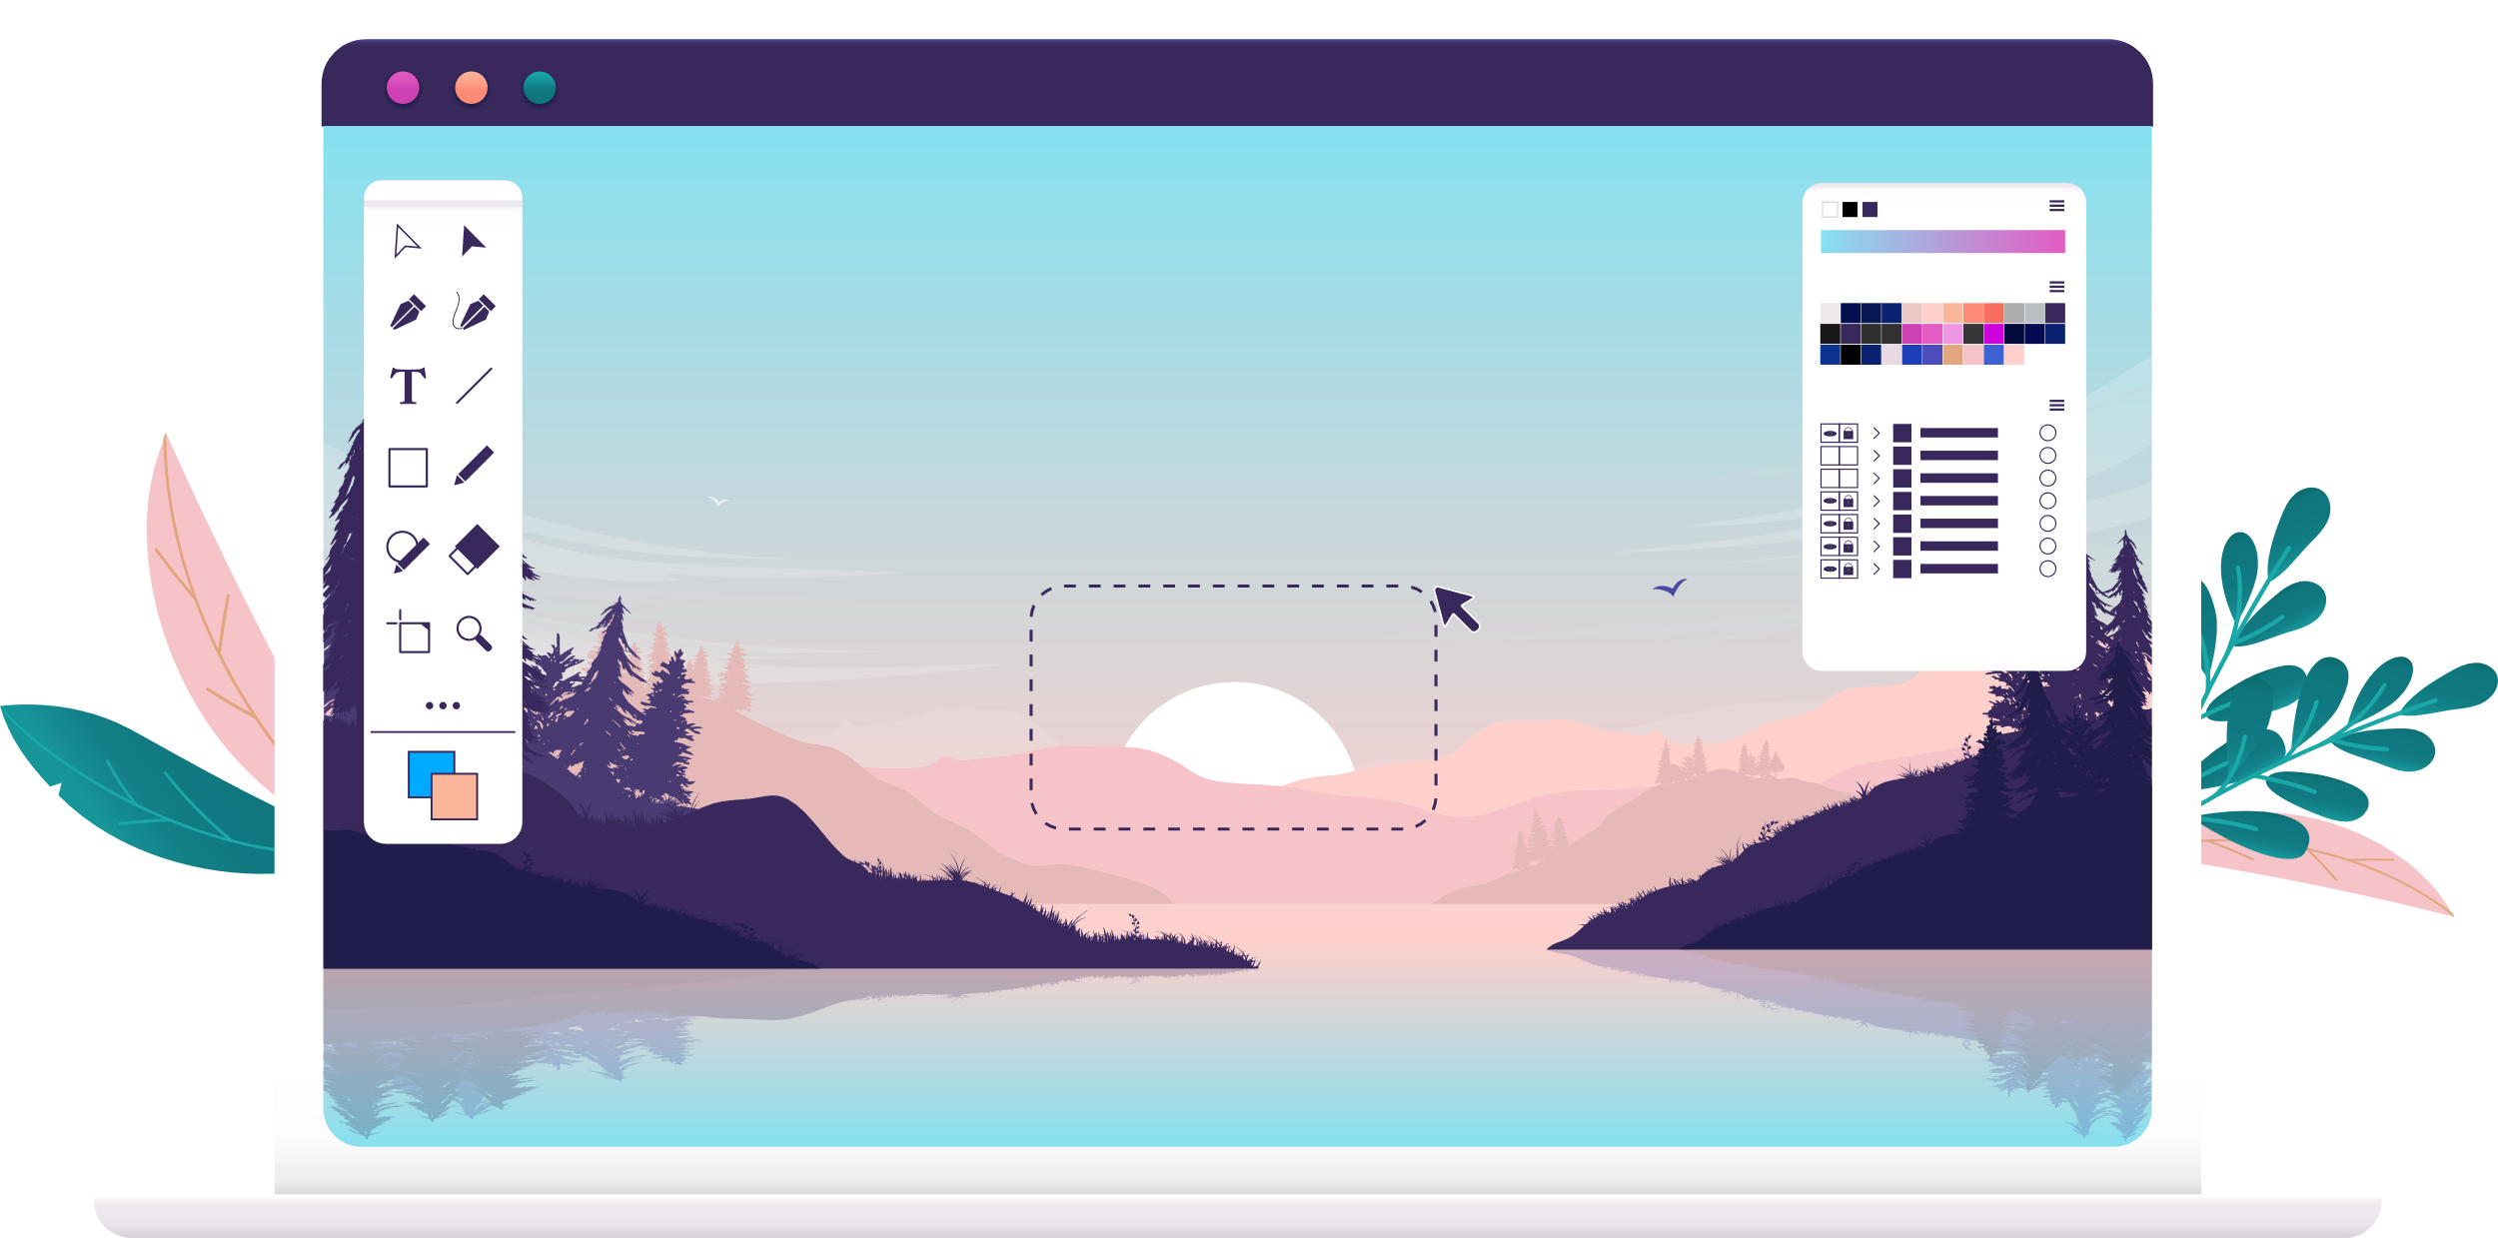
Altering Images
Have you ever used a filter on social media before you posted a photo?
Which filter did you use?
Why did you choose it and what changed about your photo?
ccc
Which of the filters help in altering a person’s looks? Are they popular? Why or why not?

Slide 3
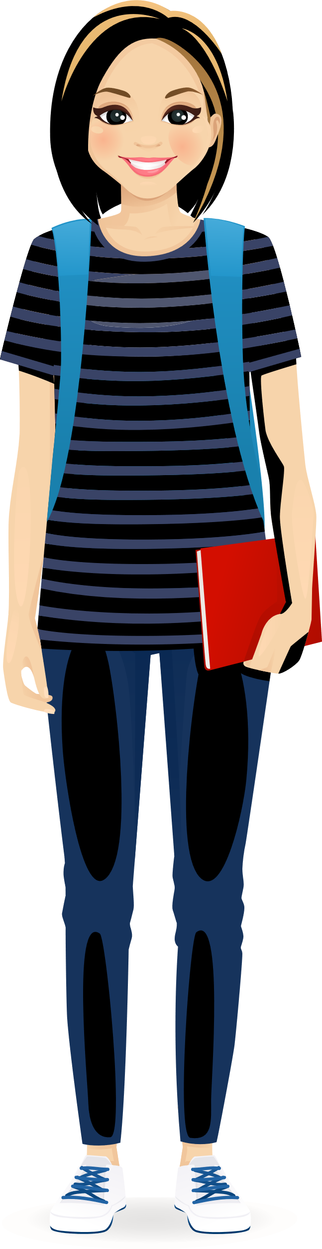
Tara’s story
Tara is 13 years old and is one of the popular girls in school. She is outgoing, loves sports and is fairly good at studies. She pleads with her parents and manages to convince them to gift her a phone for her birthday. With their permission she creates Instagram and Snapchat accounts. Tara soon creates an active social life with many followers. She follows all the cool students in grades above her and becomes friends with some of them. She has a lot of fun posting pictures, memes, selfies, and other fun stuff on social media.
She learns how to use different face-enhancing filters that make the pictures so much better. She enjoys all the appreciation that she gets and she starts to experiment with different kinds of clothes and makeup too. From posting pictures on the weekend, she graduates to posting pictures almost every day. While she enjoys the positive comments, when a picture doesn’t get enough likes, it affects her immensely. If someone posts a negative comment, she feels angry and/or dejected. All the time she spends on social media impacts her schoolwork and friendships too. She becomes quiet and withdrawn. She also starts to dislike herself without make-up and feels she looks ugly. She sometimes wishes that she could just wear a permanent filter in real life too.

Slide 4
Tara’s story
How did Tara change as a person due to her experience on social media?
Can social media influence how or what we think and feel about ourselves?
Explain.

Slide 5

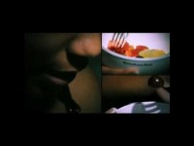
Level 2 | Digital Citizenship
Influences
How various influences affect how we feel about ourselves
Notes:
https://www.youtube.com/watch?v=HuDwHMpOMe4

Slide 6
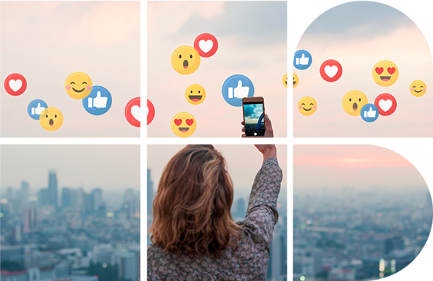
Influences
How does the media influence the way that we see ourselves and others?
How do you feel when you see repeated advertisements for something that you are self-conscious about?
Do you find yourself judging others and their bodies? Explain. How do you feel about that?

Slide 7
Self-assessment
Try to be as honest as possible in grading yourself on the metrics below.
This is a private assessment.
 |  | Strongly Agree | Agree | Disagree | Strongly Disagree
1 | On the whole, I am satisfied with myself. | 3 pt | 2 pt | 1 pt | 0 pt
2 | At times, I think I am no good at all. | 0 pt | 1 pt | 2 pt | 3 pt
3 | I feel that I have a number of good qualities. | 3 pt | 2 pt | 1 pt | 0 pt
4 | I am able to do most things as well as most other people. | 3 pt | 2 pt | 1 pt | 0 pt
5 | I feel I do not have much to be proud of. | 0 pt | 1 pt | 2 pt | 3 pt
6 | I certainly feel useless at times. | 0 pt | 1 pt | 2 pt | 3 pt
7 | I feel that I’m a person of worth, at least on an equal plan with others. | 3 pt | 2 pt | 1 pt | 0 pt
8 | I wish I could have more respect for myself. | 0 pt | 1 pt | 2 pt | 3 pt
9 | All in all, I tend to feel that I am a failure. | 0 pt | 1 pt | 2 pt | 3 pt
10 | I take a positive attitude towards myself. | 3 pt | 2 pt | 1 pt | 0 pt
Reflect on your answers and determine if there are any changes that you would like to make.

Slide 8
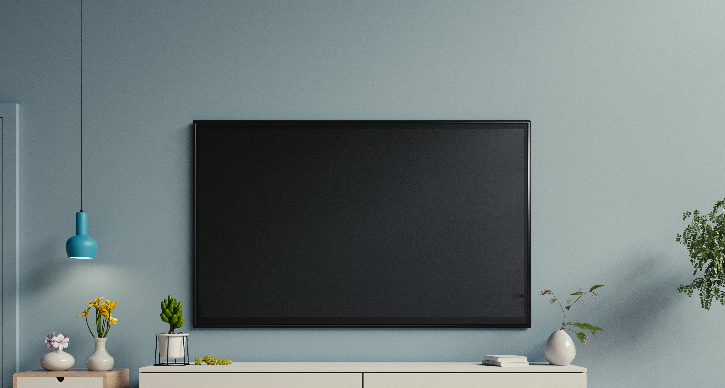
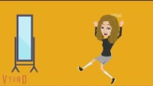
Level 2 | Digital Citizenship
Teens and self-esteem
Share two things that we can do to ensure that social media does not have a negative impact on our self-esteem
Notes:
https://www.youtube.com/watch?v=nxolrIIWEMQ

Slide 9

Take-home activity
Based on your self-assessment, reflect on the impact that social media or other influences are having on your self-esteem.
If you are happy with the way things are, that is great and keep doing what you are doing.
If you would like to make a change, think about what that might be. How can you improve your self-confidence and increase your happiness?
Think about how you can extend a helping hand to your friends and others who would like to make a change.

Slide 10
Altering Images
Have you ever used a filter on social media before you posted a photo?
Which filter did you use?
Why did you choose it and what changed about your photo?
Which of the filters help in altering a person’s looks? Are they popular? Why or why not?

Slide 11

Created by

