Slide 1

Digital Citizenship
Lesson 10
APPROPRIATE
BODY IMAGE

Slide 2
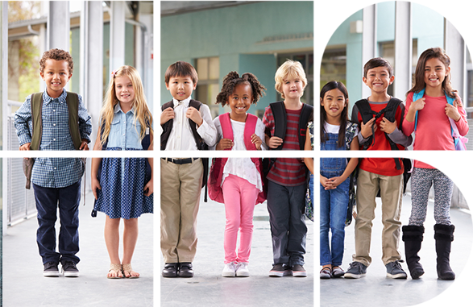
Let’s talk body image
Have you heard of the term ‘body image’?
What does it mean to you?
What is an appropriate body image?
How might social media play a role in increasing the pressure to have the “ideal body type”?

Slide 3
Some important aspects of body image
Perceptual body image
Affective body image
Cognitive (mental) body image
Perceptual body image
How you see your body
How you feel about your body
How you think about your body
The way you behave as a result of your perceptual, affective, and mental body image

Slide 4

How real are photos that we see online?
How real are the images that we see in advertisements or on social media?
How might these photos be altered? Have you heard about photoshopping or airbrushing?
Have you ever seen any photos of a celebrity that you suspected were altered?
What do advertising companies gain by altering or ‘touching up’ photos?
Do you know of any celebrities who have spoken out against photo editing?

Slide 5

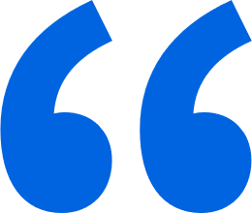

Quote
In an interview with the model Gigi Hadid, American actress Blake Lively had this to say:
It’s so important for young people not to compare themselves with what they see online. It’s our job as actors and/or models to be in shape. We have access to gyms and trainers and healthy food. And then on top of that, 99.9 percent of the time the images are photoshopped. I’m guilty myself of being at a photoshoot and saying, “That looks terrible on me”, and they’re like, “We’ll fix it.”

Slide 6

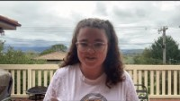
Level 2 | Digital Citizenship
Teen battles body image issues
Breanna shares her thoughts on self-esteem
Notes:
https://www.youtube.com/watch?v=6fOYJXiBmyU&t=4s

Slide 7
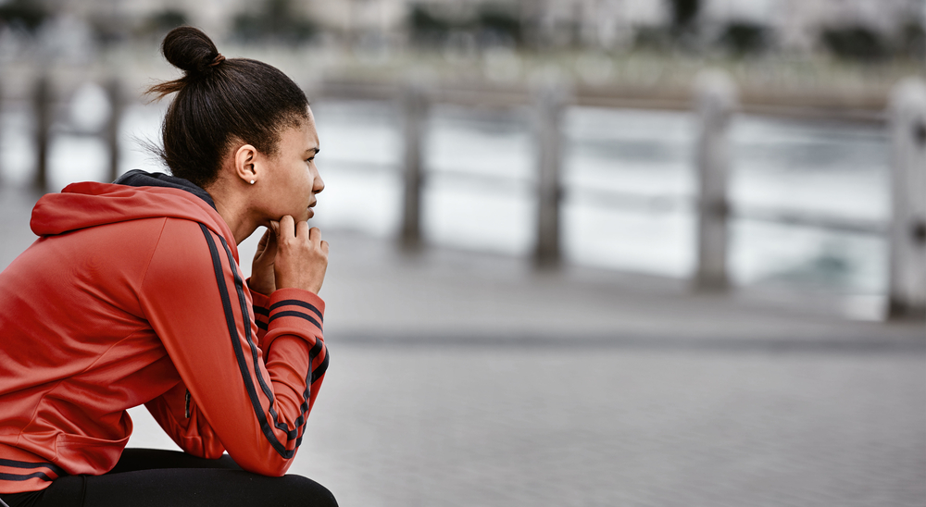

Self reflection
Name one physical attribute that you have always felt self-conscious about
Does this affect your self-confidence? What can you do to address it?

Slide 8
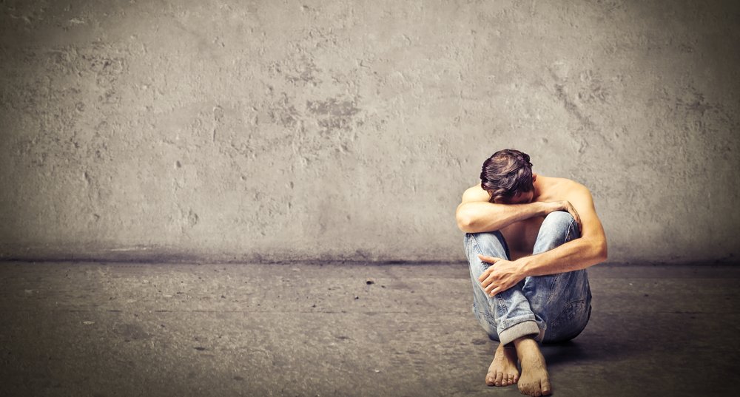
Level 2 | Digital Citizenship
Body Shaming in Boys
Many people associate body shaming with girls or women
Do boys or men also experience body shaming?
What might be the features that boys would be shamed over?

Slide 9

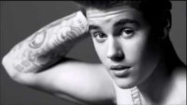
Level 2 | Digital Citizenship
How much is too much?
Why body image has become such a problem for boys
Notes:
https://www.youtube.com/watch?v=KF7OtqvIsV8

Slide 10
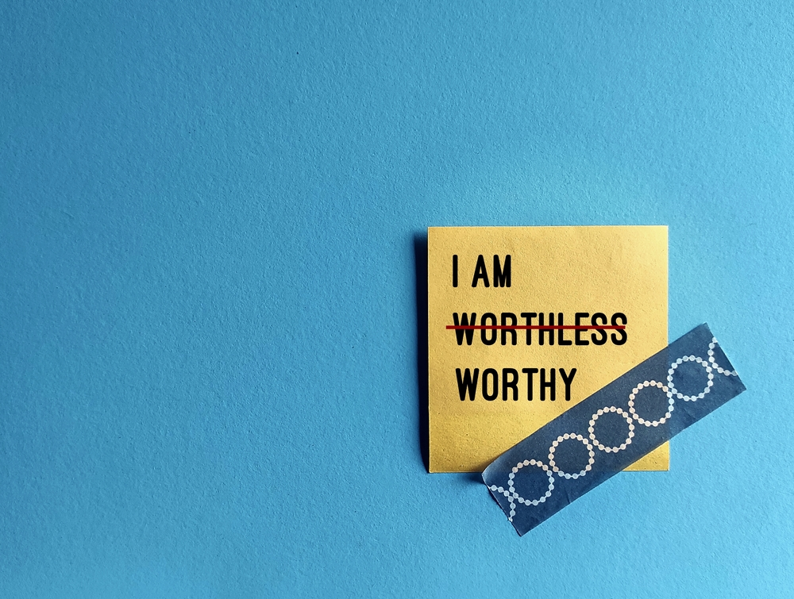
I am worthy…
Write down three things that you like about yourself that are not physical traits.
ccc
What are you good at?
What do people admire about you?
When do you feel your best and most powerful?

Slide 11
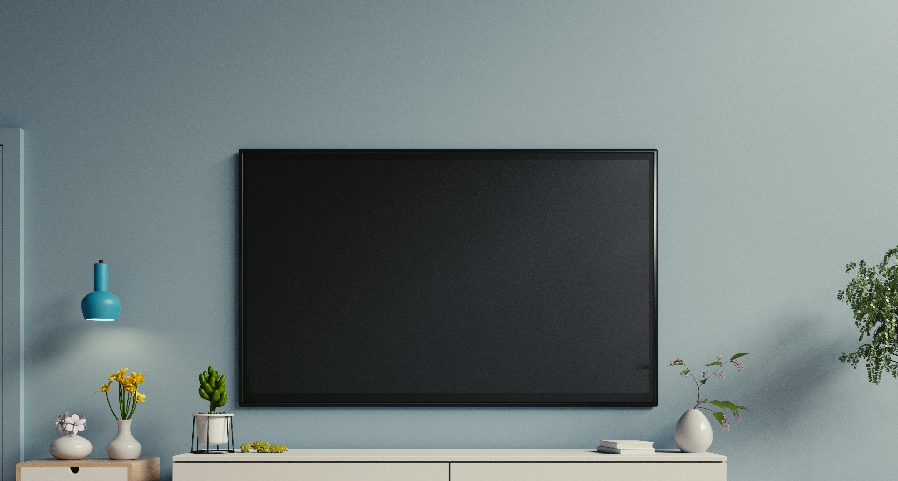
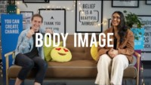
Level 2 | Digital Citizenship
Take the Power Back!
Body image and how you can take the power back
Notes:
https://www.youtube.com/watch?v=-ZiDrqte-HE&t=2s

Slide 12
Take the Power Back!
Finish the sentence:
1
Next time I catch an advertisement on TV or social media or a magazine, I will remember that _________________________
2
When I hear someone talk negatively about themselves, I will ____________________________________
3
Instead of worrying about my body or certain body parts, I can inculcate a new habit/hobby like _________________________ that will make me feel good about myself.

Slide 13
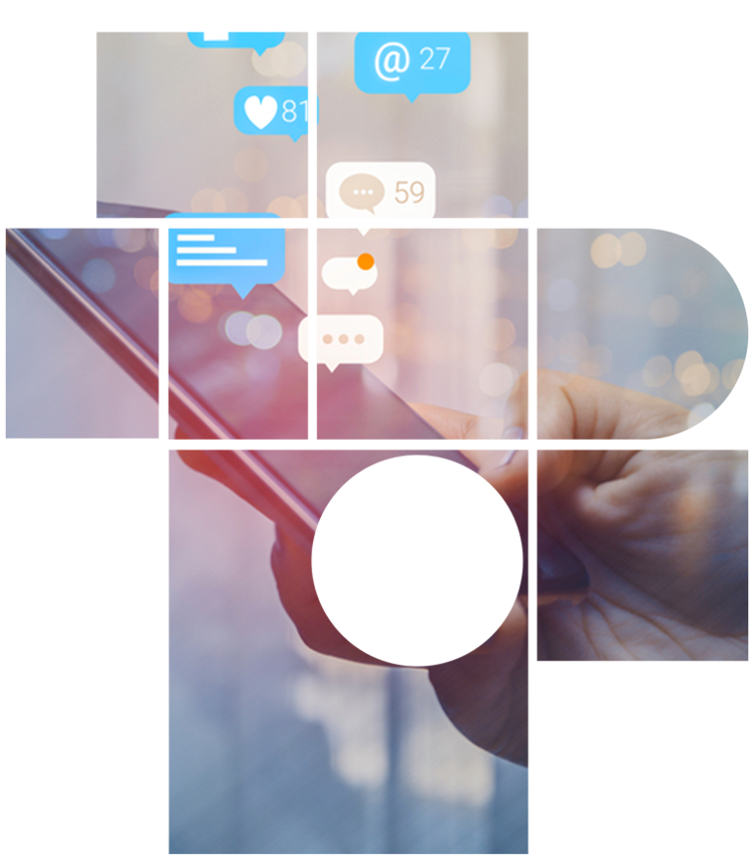
True or False?
Examine your regular social media feeds and identify any which may be contributing to a negative feelings about your body or make you feel stressed because you do not have the ‘ideal’ body.
Is it worth continuing to follow these accounts?
Remove these negative influences.
Find new accounts or people to follow who spread a more body-positive message.

Slide 14

Created by

