Slide 1

Digital Citizenship
Lesson 9
IMPORTANCE OF TRACKING YOUR SCREEN TIME

Slide 2
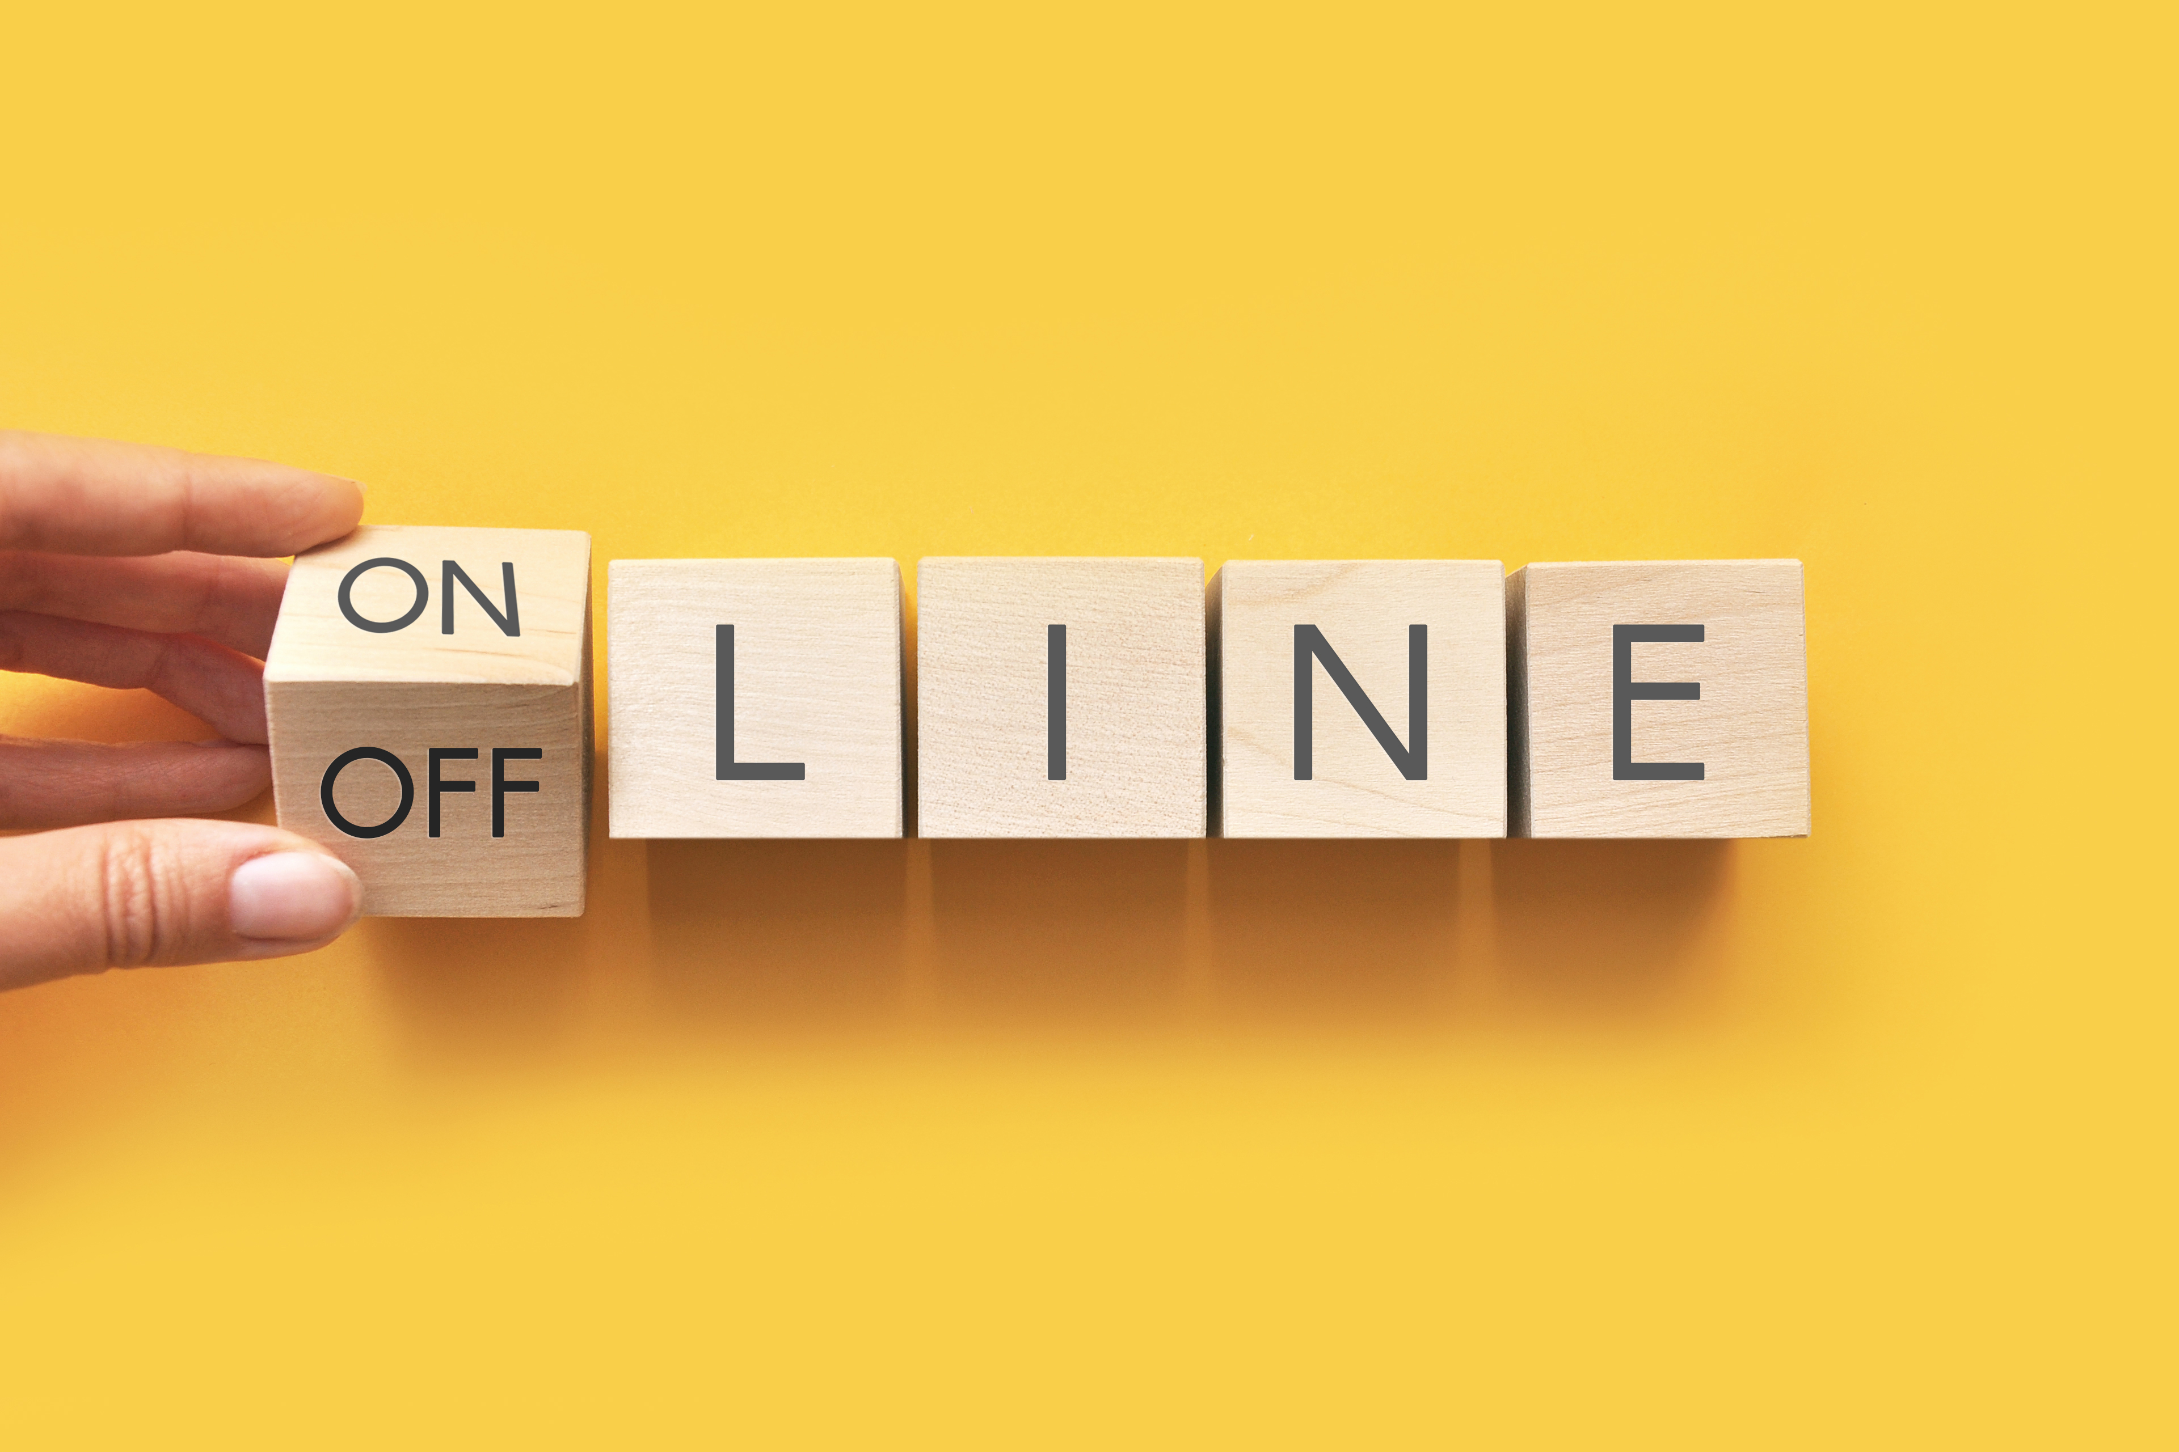
Level 1 | Digital Citizenship
Your Activities
What do you like to do offline?
How has that changed over the last 2 years?
Have you been able to continue any of your offline activities?
Have you been online more? What do you like to do online?

Slide 3
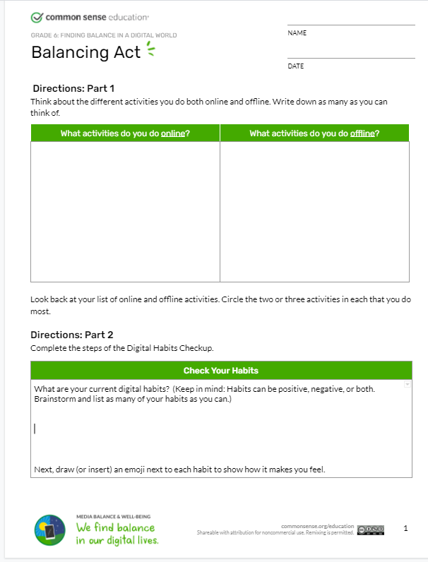
Level 1 | Digital Citizenship
Let’s Think About Our Favourite Activities
Fill in part 1 of the worksheet.
List your favorite online and offline activities.
Once you have completed the list, circle your top 2-3 activities in each category.

Slide 4
Level 1 | Digital Citizenship
Digital Wellness: What Is It?
Digital wellness (also called digital wellbeing) refers to creating balance between the online and offline worlds. This balance enables people to lead happy and healthy lives.
Some aspects of digital wellness:
Controlled use of technology.
Improved mental and physical health.
Healthy personal relationships.
Ability to interact socially and safely in both the online and offline worlds.

Slide 5


Level 1 | Digital Citizenship
Let’s Talk About Screen Time!

Slide 6

Level 1 | Digital Citizenship
Finding Balance: Do You Control Your Screen Time or Does It Control You?

Slide 7
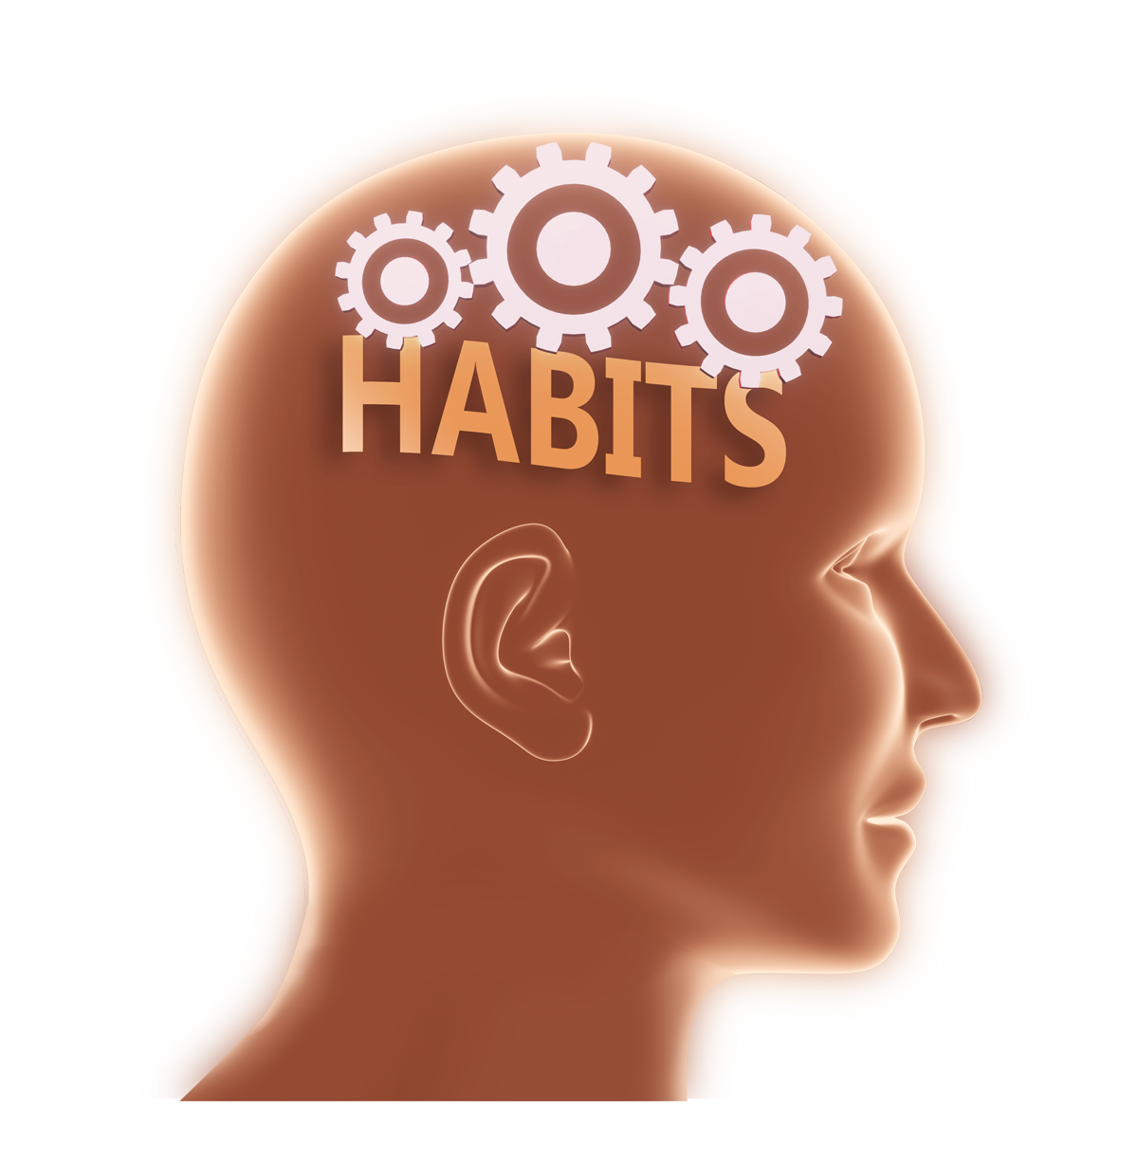
Level 1 | Digital Citizenship
What Is a Habit?
A habit refers to a settled tendency, a manner of behavior or an act or activity that you do often and almost without thinking, especially something that is hard to stop doing.
How does something that you start doing become a habit?
What are common habits that people usually want to start or change?
Have you ever tried to change a habit? Were you successful?

Slide 8
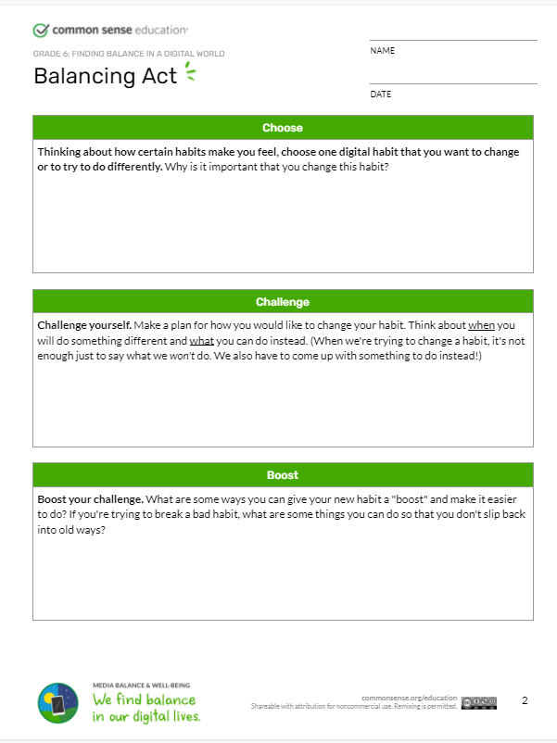
Level 1 | Digital Citizenship
Activity: Worksheet
List your current digital habits.
Select one digital habit that you would like to change.
Challenge yourself by planning how you will change this habit and replace it with a new habit.
Identify a way in which you can boost your new habit by making it easier to do.
1
2

Slide 9
Level 1 | Digital Citizenship
Habit Tracking
Habit tracking is a way to keep yourself accountable.
Use it to track what activities you do, how often and what your goals are.
Note down your activities that you want to track into 4 categories:
Things you want to do more of.
Actions you want to limit.
Self-care.
Learning new skills.
Plus: You can also track things that you are already doing and wish to continue.
Create a simple weekly tracker to monitor your activities.
You can decorate it as much as you like.

Slide 10
Level 1 | Digital Citizenship
Activity | Goal | Monday | Tuesday | Wednesday | Thursday | Friday | Saturday | Sunday
Drink 1L of water | everyday | Yes ☺ | Yes ☺ | No ☹ | Yes ☺ | Yes ☺ | No ☹ | Yes ☺
Go for a 30 minute walk | 3 times a week
Study math for 1 hour | 3 times a week
Spend family time 1 hour | 5 days a week
Video games | No more than 1 hour, 4 days a week | 50 mins ☺ | None ☺ | None ☺ | 45 mins ☺ | None ☺ | 1.5 hours ☹ | 3 hours ☹
Eat vegetables | Every day

Slide 11
Level 1 | Digital Citizenship
Build Your Habit Tracker and Start Tracking!
Remember, you cannot change what you do not track.
Fill in your habit tracker a new part of your routine.
We will use the data from your habit tracker in the next class.

Slide 12

Created by

