Slide 1

Digital Citizenship
Lesson 7
LET’S KNOW OUR DIGITAL FOOTPRINTS

Slide 2
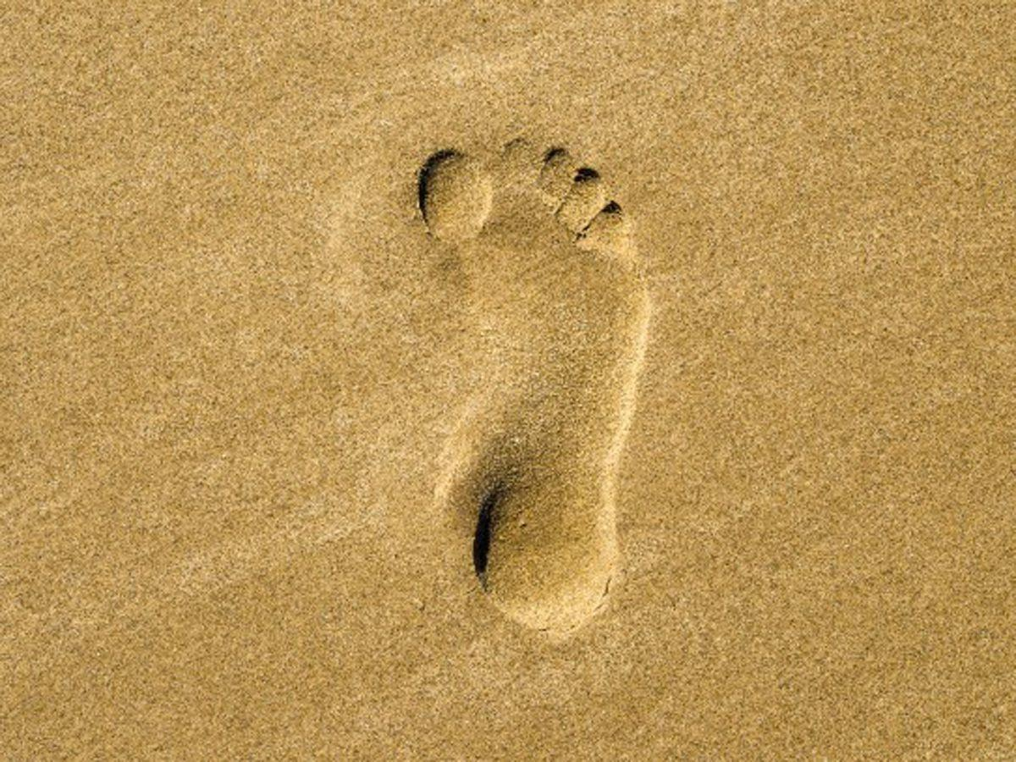
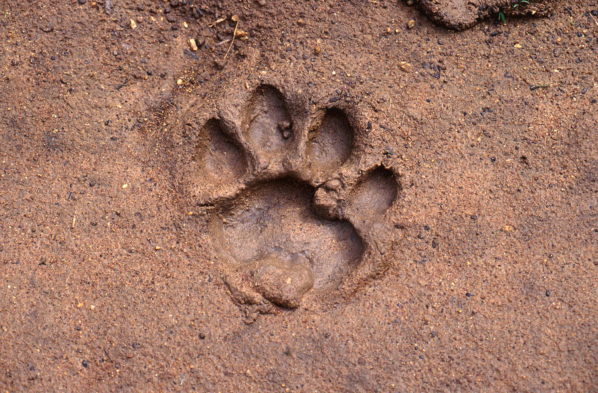
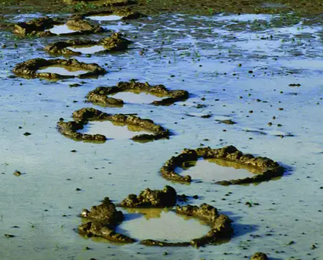

Level 1 | Your Digital World
Guess Who?

Slide 3

Level 1 | Digital Citizenship
Let’s Answer Some Questions!
How are you able to identify who or what might have left these footprints?
What do people use footprints for?
What does a digital footprint mean to you?
How is a physical footprint the same or different from a digital footprint?

Slide 4


Level 1 | Your Digital World
Understanding Digital Footprints
Let’s watch a video to know more!
Notes:
https://www.commonsense.org/education/videos/whats-in-your-digital-footprint

Slide 5
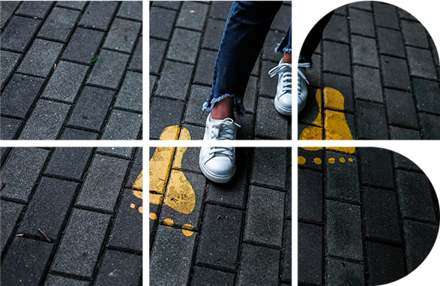
Level 1 | Your Digital World
It’s Time to Reflect!
Where do you leave your digital footprint?
Are you aware of all of the places where you have left your digital footprint?
In the offline world, what are some of the things that you shouldn’t share with a stranger?
Would you be open to share the same information online?

Slide 6

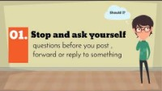
Level 1 | Digital Citizenship
Let’s watch this video on digital footprints to know more about sharing information online!

Slide 7

Level 1 | Digital Citizenship
The Case of Anna
Anna goes to the mall with a friend, and they snap a photo of themselves in the mall.
Later, the girls go to the movies and afterward, Anna makes a comment on social media, “I just saw the new Spiderman movie and it was amazing!”
That night, Anna posts a photo of the new loaded pizza from House of Pizza with the caption, “celebrating my cousin’s birthday!”

Slide 8

Level 1 | Digital Citizenship
What are the consequences of Anna’s actions?
TIP
How much information has Anna shared in just one day?
Do you think Anna was aware of the amount of information she shared?
Knowing all about a digital footprint, share examples of personal information that you should never share on social media or in any other online public forum.
Before you post anything online, think about the “Grandmother test.”
“Grandmother Test” - Any post that could upset your grandmother (or a future employer) would count as inappropriate for a public forum.

Slide 9
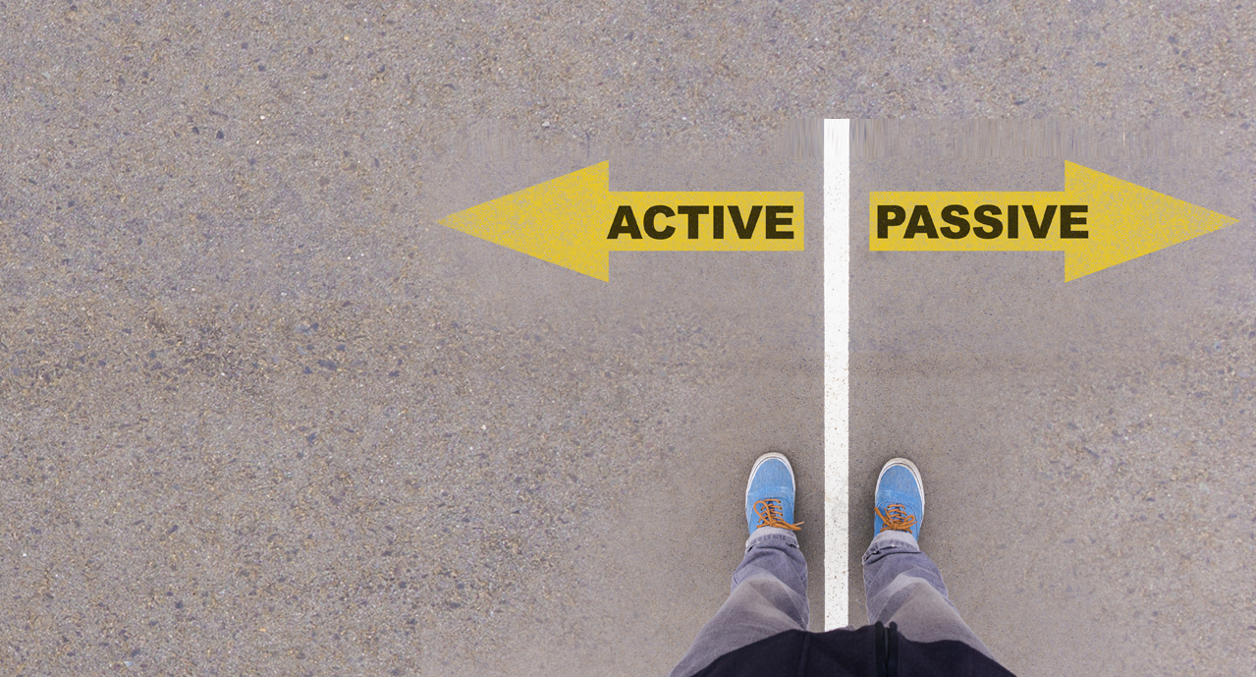
Level 1 | Digital Citizenship
Types of Digital Footprints
Active and Passive are two kinds of digital footprints
Data that is left behind whenever the internet is used while being unaware is called a passive digital footprint.
A few examples include your IP address, location, browser history, etc.
Deliberate submission of information is considered as an active digital footprint.
A few examples include social media posts, emails, etc.

Slide 10

Level 1 | Your Digital World
Activity Time!
Create a log of your online activities for one week and categorize each activity based on active or passive digital footprints.
Activity | Active | Passive
Examples: sent emails, posted on Instagram, conducted a Google search for a class project, listened to music on a streaming service, etc.
You can use this template.

Slide 11



Level 1 | Digital Citizenship
Create an Adobe Spark poster drawing your digital footprints. You can include all the places that you visit when you are online, such as websites or apps that you might have ordered from, any social media that you have visited, places where you store your photos, streaming services, etc.
Take home activity: Google yourself.
Find your digital footprint.

Slide 12

Created by

