Slide 1

Digital Citizenship
Lesson 6
NETIQUETTE - VIDEO CONFERENCING, EMAILS,
& SOCIAL NETWORKING

Slide 2

Level 1 | Your Digital World
How can you be empowered to use technology with awareness and sensitivity?

Slide 3

Level 1 | Digital Citizenship
Communicating Online
How has your online communication experience been in general?
Have you ever been misunderstood over a text or email?
Have you ever misunderstood someone else’s message because of their use of slang, abbreviations or emojis?
What did you do to help clarify the misunderstanding?
What could you do differently?

Slide 4

Level 1 | Your Digital World
Hands-on!
It can be hard to understand how someone is really feeling while reading your text message. You cannot see their facial expression or body language. Their text might contain an emoji but, you cannot say if that was for fun or they want to truly expressing their feelings.
If you need to communicate with someone, make sure you choose the right ways, which include emails, messages and phone calls.

Slide 5

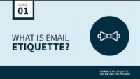
Level 1 | Your Digital World
Email Etiquette for Formal Emails
Let’s learn how to write an appropriate email.

Slide 6


Level 1 | Digital Citizenship
Master of Tone

Slide 7
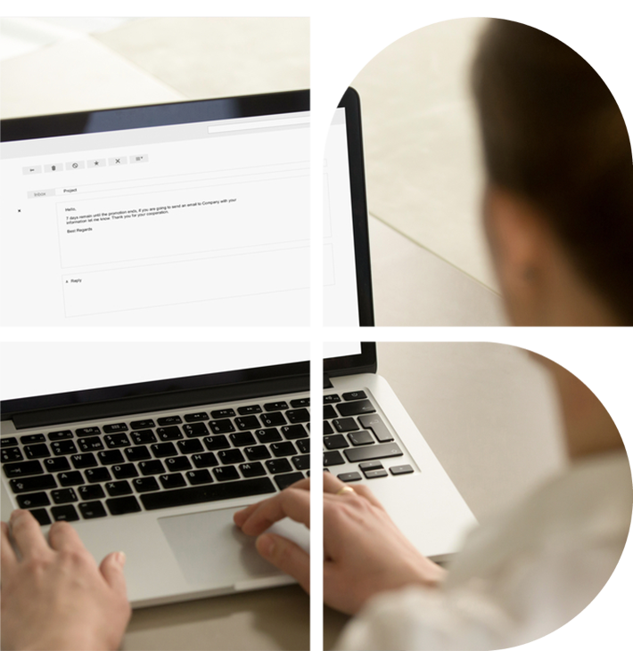
Level 1 | Digital Citizenship
Test Your Understanding
1
What are the six elements of tone you need to consider when writing an email?
2
What is the most important part to remember when writing an email?
3
What are some formal greetings you could use to begin an email?
4
Why wouldn’t it be a good idea to type your email entirely in capital letters?
5
Why wouldn’t it be a good idea to type your email entirely in highly decorative fonts?

Slide 8


Level 1 | Your Digital World
Video Conference Etiquette
Let’s watch the video on how to be presentable during video conferencing!

Slide 9

Level 1 | Digital Citizenship
Key Questions: Online Classes
1
What must be done before attending online class?
Why is it important to do a test call before attending an online class?
2
What are some commons distractions to be avoided during your online call?
How should you dress for your online class?
According to Dictionary.com, a digital citizen is:
A person who develops the skills and knowledge to effectively use the internet and other digital technology, especially in order to participate responsibly in social and civic activities.
3
4

Slide 10
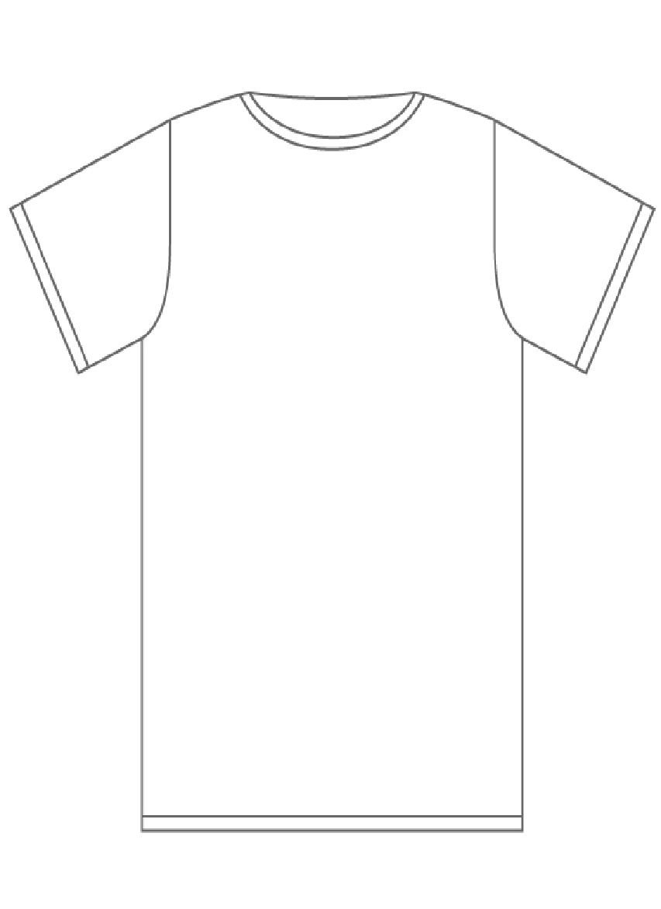
Level 1 | Digital Citizenship
The Language of Emojis
Design a t-shirt to describe yourself using only emojis. You can use no more than three emojis on your t-shirt and people should be able to learn something about you. If the emoji you want is not shown in the emoji grid provided here, feel free to make your own emoji.
After you have decorated your t-shirt, share it with a partner and see if they can guess what you are trying to say about yourself.

Slide 11
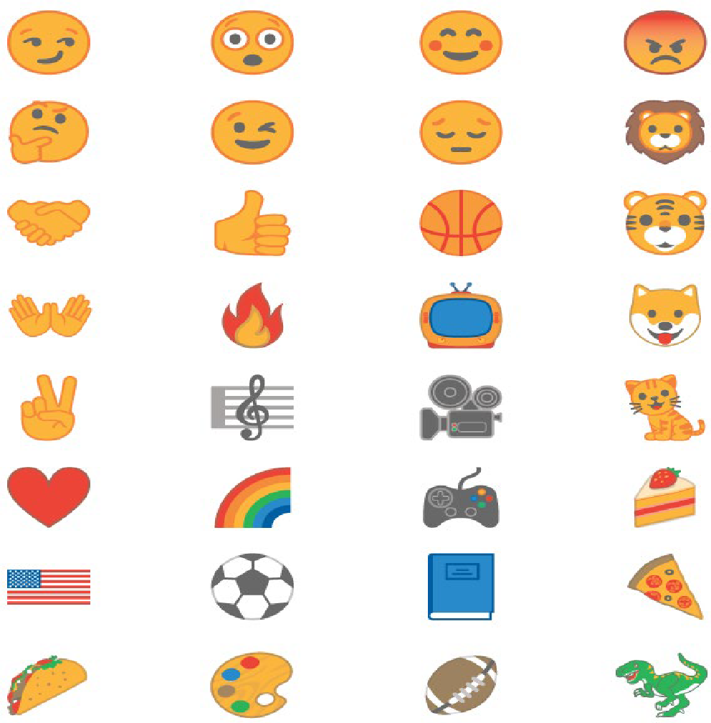
Level 1 | Digital Citizenship
Express Yourself

Slide 12


Level 1 | Digital Citizenship
Homework
Play this quiz to test out your knowledge on email etiquettes.
QUIZ
Notes:
https://quizizz.com/admin/quiz/5ecc6d34a5c152001be1555c/email-etiquette

Slide 13

Created by

