Slide 1
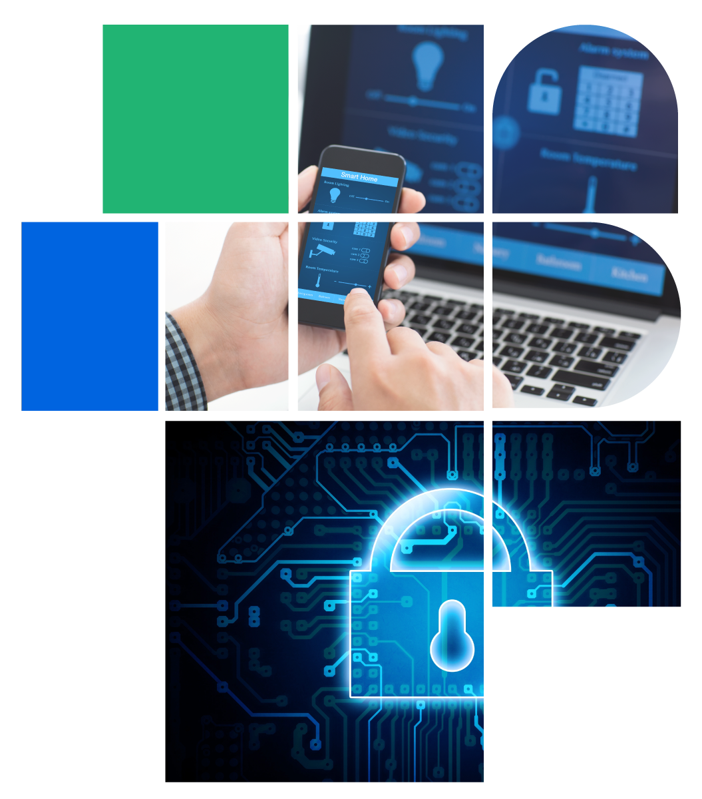
Digital Citizenship
Lesson 3
UNDERSTANDING DEVICE SETTINGS AND STRONG PASSWORDS

Slide 2
Level 1 | Digital Citizenship
Hands-on!
Let’s Navigate Our Computers
Activities:
Change the Background
Locking the Computer Screen
Network Connections

Slide 3

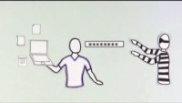
Level 1 | Digital Citizenship
Creating Strong Passwords

Slide 4
Level 1 | Digital Citizenship
True or False?
A password which is very common is a good idea so that you can remember it.
Using the first letters of each word in a memorable sentence is a good idea.
Using information that is easily identifiable to you is a bad idea when creating a password.
A password is strongest when you use only numbers.
Using symbols like & or $ can make your password even stronger.
Writing down your password in your school notebook is best because you will always have it handy.
Using different passwords for different logins will keep my data safer.

Slide 5
Level 1 | Digital Citizenship
Top 20 Leaked Passwords for 2020
Is yours on the list?
1 | 123456 | 11 | abc123
2 | 123456789 | 12 | qwerty123
3 | qwerty | 13 | 1q2w3e4r
4 | password | 14 | admin
5 | 1234567 | 15 | qwertyuiop
6 | 12345678 | 16 | 654321
7 | 12345 | 17 | 555555
8 | iloveyou | 18 | lovely
9 | 111111 | 19 | 7777777
10 | 12123 | 20 | welcome

Slide 6
Level 1 | Digital Citizenship
Password Safety
Do
Don’t

Slide 7
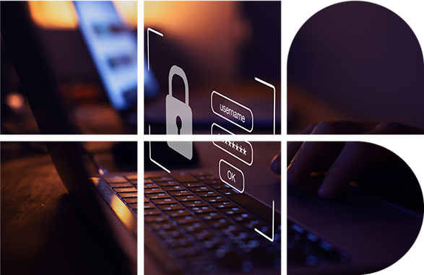
Level 1 | Digital Citizenship
Hands-on!
Time to change your password!

Slide 8


Level 1 | Digital Citizenship
How to Make Your Password Even Stronger!

Slide 9
Level 1 | Digital Citizenship
Wrap-up
A password which includes easily identifiable information is never a good idea.
Two factor authentication just takes too much time. It’s not worth the effort.
When I am in a coffee shop,
I should always lock my computer screen if I am not using it.
Ctrl-Alt-Del is one way to
lock my computer screen.
Once I reset my password, I can share it with my friends.

Slide 10
Level 1 | Digital Citizenship
Take-home Activity
Check the settings on your own or your parents’ smartphone.
See the websites given in the student manual on how to check the following settings:
Privacy
Location
Connecting to Wi-Fi
Fixing internet connection problems

Slide 11

Created by

