Slide 1

Digital Citizenship
Lesson 2
WELCOME TO
YOUR DIGITAL WORLD

Slide 2
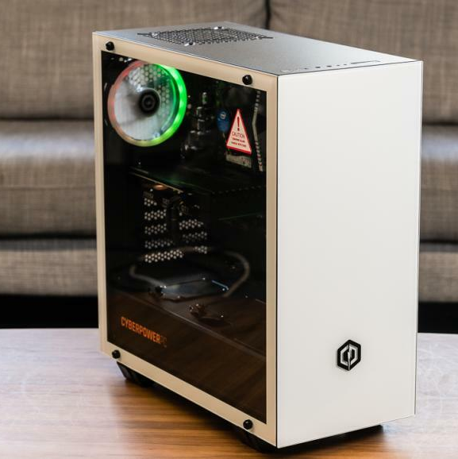
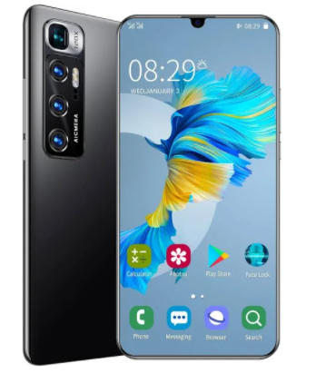
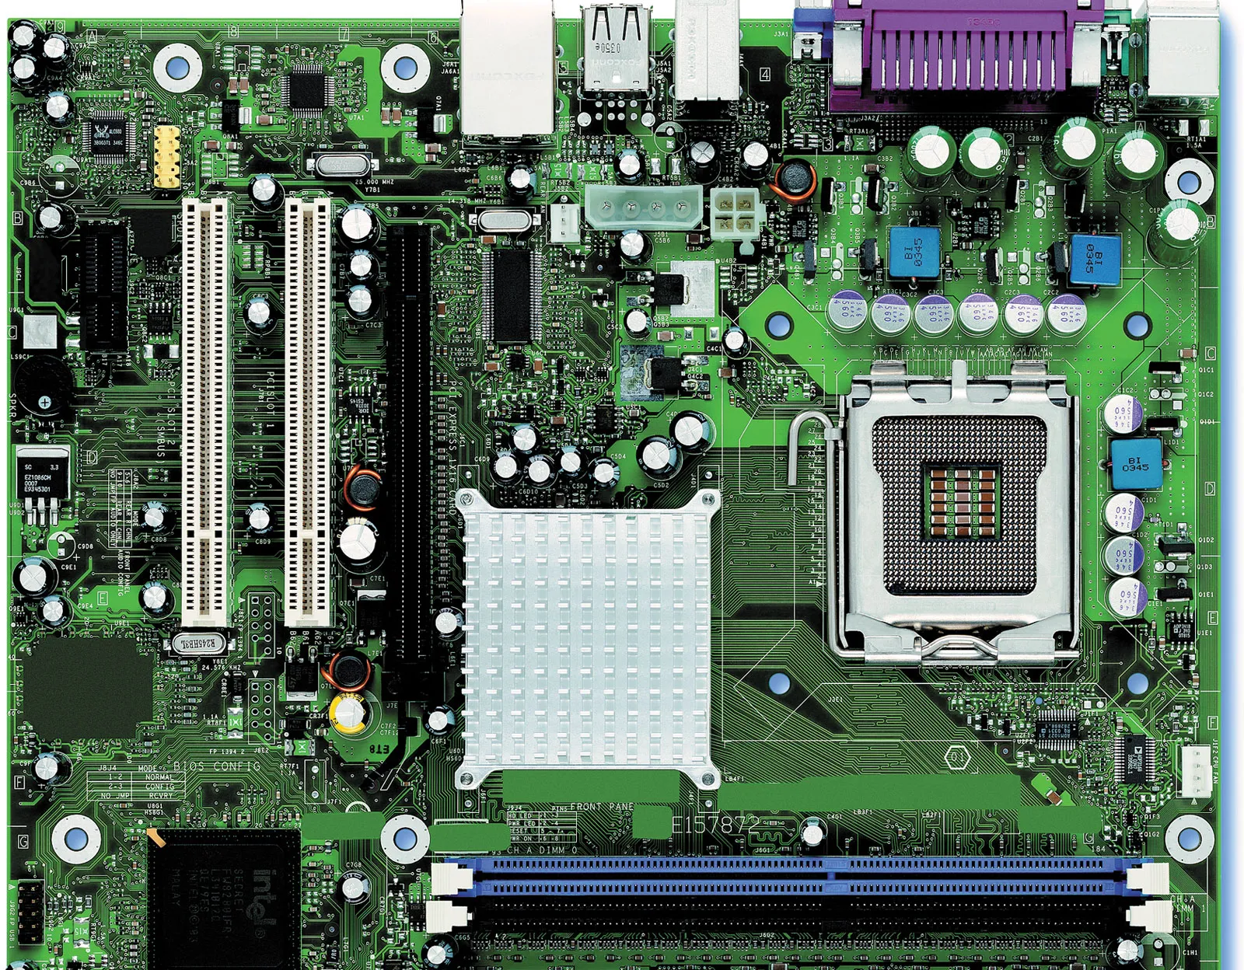
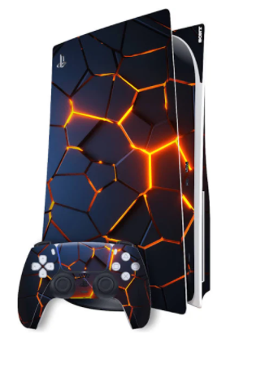
Level 1 | Your Digital World
https://in.pcmag.com/desktop/36887/the-best-desktop-computers-for-2020
What do you know about computers or other computing devices?
https://www.britannica.com/topic/Intel

Slide 3
Level 1 | Your Digital World
Devices and Their Uses
Devices
Uses
1
1
2
2
3
3
4
4
5
5

Slide 4
Level 1 | Your Digital World
Input
Process
Output

Slide 5
Level 1 | Your Digital World
Input
Process
Output
Cucumber sandwich
A drawing of a tree
A cup of tea
A new shirt

Slide 6




Level 1 | Your Digital World
Definitions You Should Know
Computer
An electronic device used for processing, storing, and displaying data or information.
Can you use these terms in a sentence?
Input
Information or data that is sent to or entered into the computer or machine.
Processing
Any operation that the computer performs on the input data by means of a program.
Output
Information or data generated by the computer or computing device.
That’s great but, what does it have to do with Digital Citizenship?
Computer
An electronic device used for processing, storing, and displaying data or information.

Slide 7

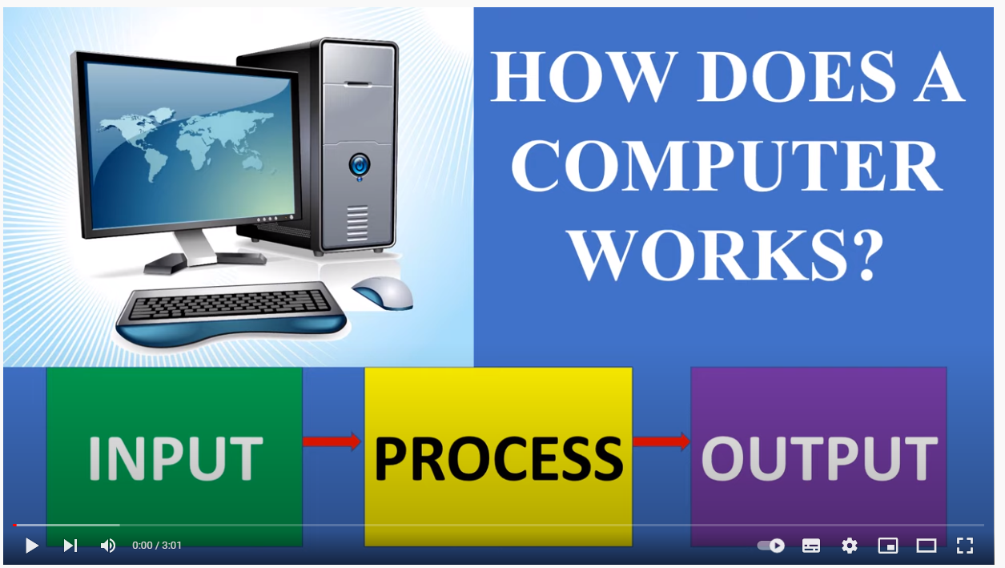
Level 1 | Your Digital World

Slide 8
Level 1 | Your Digital World
Input
Process
Output

Slide 9
Level 1 | Your Digital World
Input
Process
Output
HOW
Keyboard
Mouse
Touchscreen
Camera
Central Processing Unit (CPU)
Screen
Monitor
Printer
Example
I open a word processing program like MS Word to type my homework.
I type my homework into a document
The CPU fetches the program and opens a blank document for me.
I receive suggestions for proper spelling, grammar, and formatting
My screen displays my work.
When I am done, I save my document to my drive.
I upload the document to the drive and email my teacher.

Slide 10
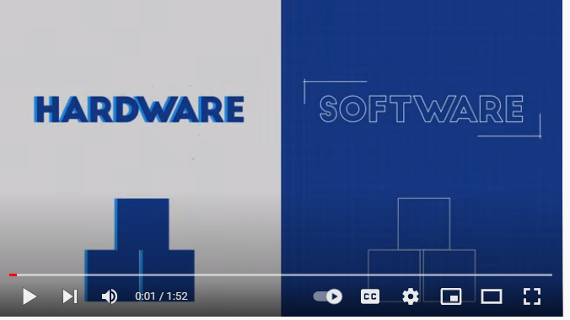
Level 1 | Your Digital World
If a computer’s main job is to process the input and give me an output? How does it know what to do?

Slide 11
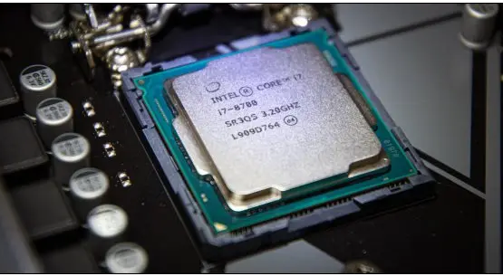
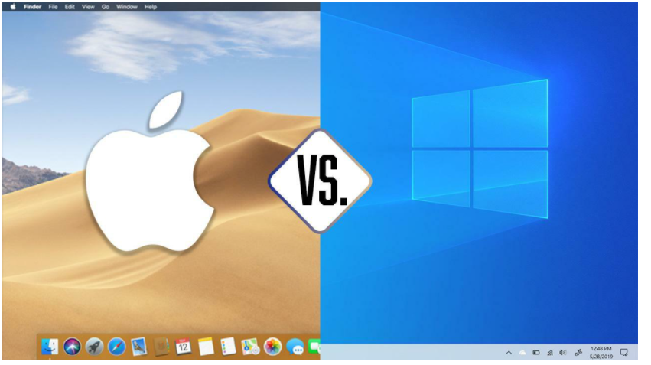
Level 1 | Your Digital World
Hardware
Software
Key Digital Rights:
Key Digital Responsibilities:

Slide 12
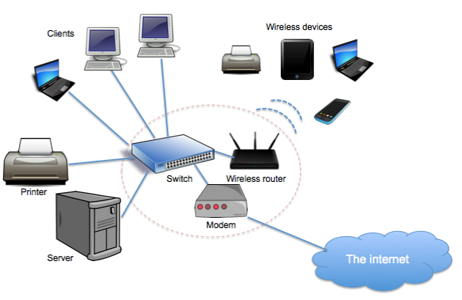
Level 1 | Your Digital World
Computer Networks
A computer network is made up of 2 or more computers or computing devices that are linked together so that they can share hardware, software or data with one another.
In this network map, the computers (1) can access data on the server (2), send something to the printer (3) and connect to the internet (4).
This picture shows a LAN or a Local Area Network. This is typical of a small grouping of devices like you might find in a home, a school, or an office.
1
3
2
4
Notes:
https://www.schoolsofkingedwardvi.co.uk/ks2-computing-computing-theory-5-computer-networks/

Slide 13

Level 1 | Your Digital World
WAN – Wide Area Network
WAN
CENTRAL DATA
What is my bank balance please?
LAN
Mumbai office
LAN
Chennai office
LAN
Kolkata office
LAN
Delhi office
There is also a larger network called a Wide Area Network or WAN.
  A WAN spans a large geographic area
  This is a way for LANs to connect to a larger network
Can you think of other examples of a WAN?

Slide 14

Level 1 | Your Digital World
Hands-on!
Let’s turn on our computers.

Slide 15
Level 1 | Your Digital World
Knowledge Check
1
Name the OS on your computer.
5
The full name of LAN is…
2
Local Area Network
Little Area Network
Low-cost Area Network
Lucky Area Network
The brains of the computer is called the…
MCU
CPU
PCU
GPU
6
A computer works in the following way…
3
Another name for hardware that helps you input into a computer is…
Output-Process-Input
Input-Output-Process
Input-Process-Output
Output-Input-Output
4
The internet is sent around mainly by…
Satellites
Power lines
Underwater cables
Mobile networks

Slide 16

Created by

