Slide 1

Digital Citizenship
Lesson 13
WHAT IS PLAGIARISM AND HOW TO AVOID IT

Slide 2

Level 1 | Digital Citizenship
Case Study
Imagine that you and some friends created a short, animated film. You wrote clever dialogues, designed the shots, and worked on the footage on the weekends. You posted the video on YouTube, and people loved it! One day, you saw your film uploaded on someone's website. They wrote the caption, "Look at this cool stop-motion video!" But there was no mention of your name or your friends' names, and it was not linked to YouTube. How would you feel if something you had worked hard to create was being shared by other people without your name attached to it?
Discuss
What is happening in this scenario?
How would you feel about the incident?

Slide 3

Level 1 | Your Digital World
What is Plagiarism?
Plagiarism is the practice of taking someone else’s words, ideas, thoughts, or expressions and presenting these as your own without giving credit to the author. This includes not only written work (books, blogs, articles, websites, etc) but also data or images (tables, diagrams, photographs, etc).
Plagiarism is seen as a form of fraud and academic dishonesty. In academic work, words, ideas and thoughts are seen as someone’s personal property. Therefore, it is important to treat the original creator’s personal property in the same way you would treat any other form of property that does not belong to you.

Slide 4
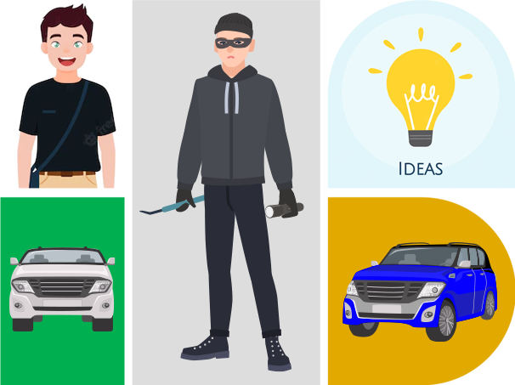
Level 1 | Your Digital World
What is Plagiarism?
Meet Vicky!
He stole someone’s car and said it was his.
Wouldn’t that be theft?
You do the same when you use someone else’s words/ideas and present these as yours own.
Vicky later changed the color of the car and said it was his.
Wouldn’t that still be theft?

Slide 5


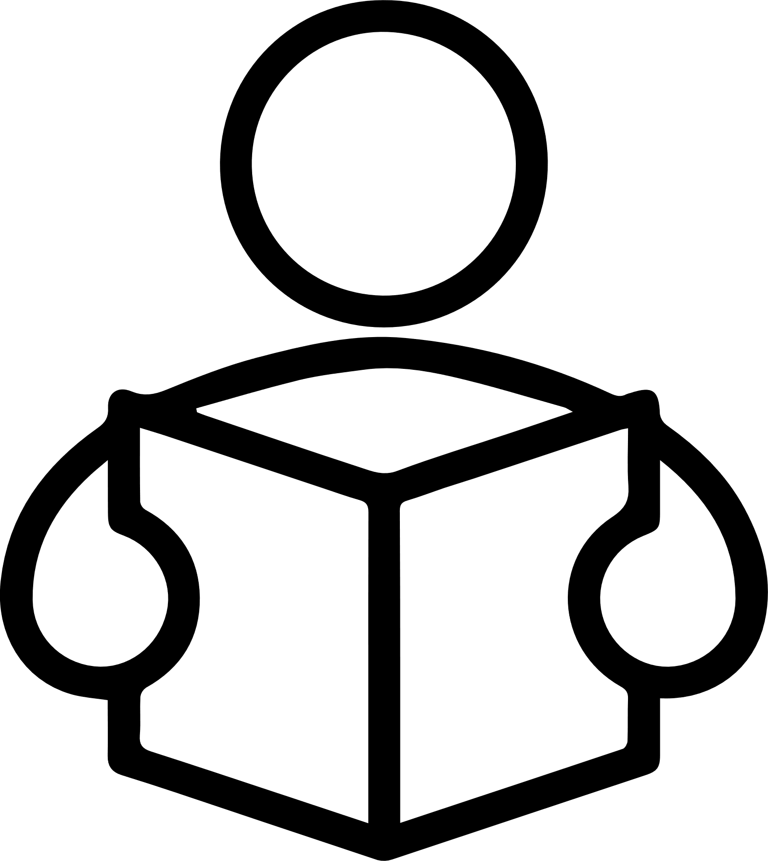
Level 1 | Your Digital World
Activity: The K-W-L Chart
K (What I already know about the Topic) | W (What I want to Know) | L (What I Learned)

Slide 6

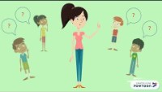
Level 1 | Your Digital World
Let’s Learn More!

Slide 7

Level 1 | Digital Citizenship
What is Paraphrasing?
Avoiding Plagiarism by Paraphrasing
You should avoid overusing quotation marks in a piece of writing. To do so, you must learn to paraphrase effectively. Effective paraphrasing is a key skill a student must possess to avoid committing plagiarism.
Paraphrasing means changing the wording of a text without changing its meaning. It means expressing someone else’s work in your own words in such a way that the facts remain the same. Simply put, you must use your own words to express the original idea.
Let us look at an example to understand how to paraphrase.
Original: Tris has tons of stuff to throw away.
Paraphrased version: Tris needs to get rid of a lot of junk.
Alternative paraphrased version: Tris has quite a lot of junk to get rid of.

Slide 8

Level 1 | Digital Citizenship
What is Copyright? ©
Copyright is a form of protection provided by the Government to authors and creators.
It is a legal term used to describe a collection of rights that creators have over their work.
The right to PRODUCE work.
The right to RE-PRODUCE the work.
The right to DISTRIBUTE copies of the work.
The right to PERFORM the work publicly.
The right to DISPLAY the work publicly.
The right to BROADCAST the work digitally.
What is Copyright Infringement?
Any violation of copyright law is known as copyright infringement. In other words, copyright infringement is the use of copyright-protected work without the permission of the author/copyright holder.
Examples of copyright infringement include:
Using copyrighted images/photographs without permission or giving due credit to the original creator.
Copying and publishing articles/blogs or even parts of articles/blogs without permission of the copyright holder.

Slide 9
Level 1 | Digital Citizenship
Always Make Sure to Cite Your Sources
Acknowledging Sources
If you borrow from someone else’s words, ideas, thoughts, or expressions, you must give credit to the original creator that by citing the source. There are two ways to do this.
Citation and Summary
Samantha claims that India is ready for fundamental change.
Quotation and Citation
According to Samantha, “India is ready for fundamental change.”
Summary
Citation
These citations are linked to a list of references mentioned at the end of the main body of the piece of writing. The citation makes it clear that you borrowed this ideas from Samantha.
Quotation

Slide 10

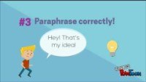
Level 1 | Digital Citizenship
Let’s Learn Some Simple Tips to Avoid Mistakes

Slide 11

Level 1 | Digital Citizenship
Quiz Time! Plagiarism or Not?
Failing to use quotations in quotation marks. ______________
Copying words or ideas from someone else without giving credit. ______________
Creating an original intellectual piece. ______________
Changing words but copying the sentence structure of a source without giving due credit. ______________
Paraphrasing and citing the source while using someone else’s intellectual creation. ______________
Notes:
https://quizizz.com/admin/quiz/5ecc6d34a5c152001be1555c/email-etiquette

Slide 12

Created by

