Slide 1
Digital Citizenship
Lesson 8
ARE YOU FOLLOWING ME?

Slide 2
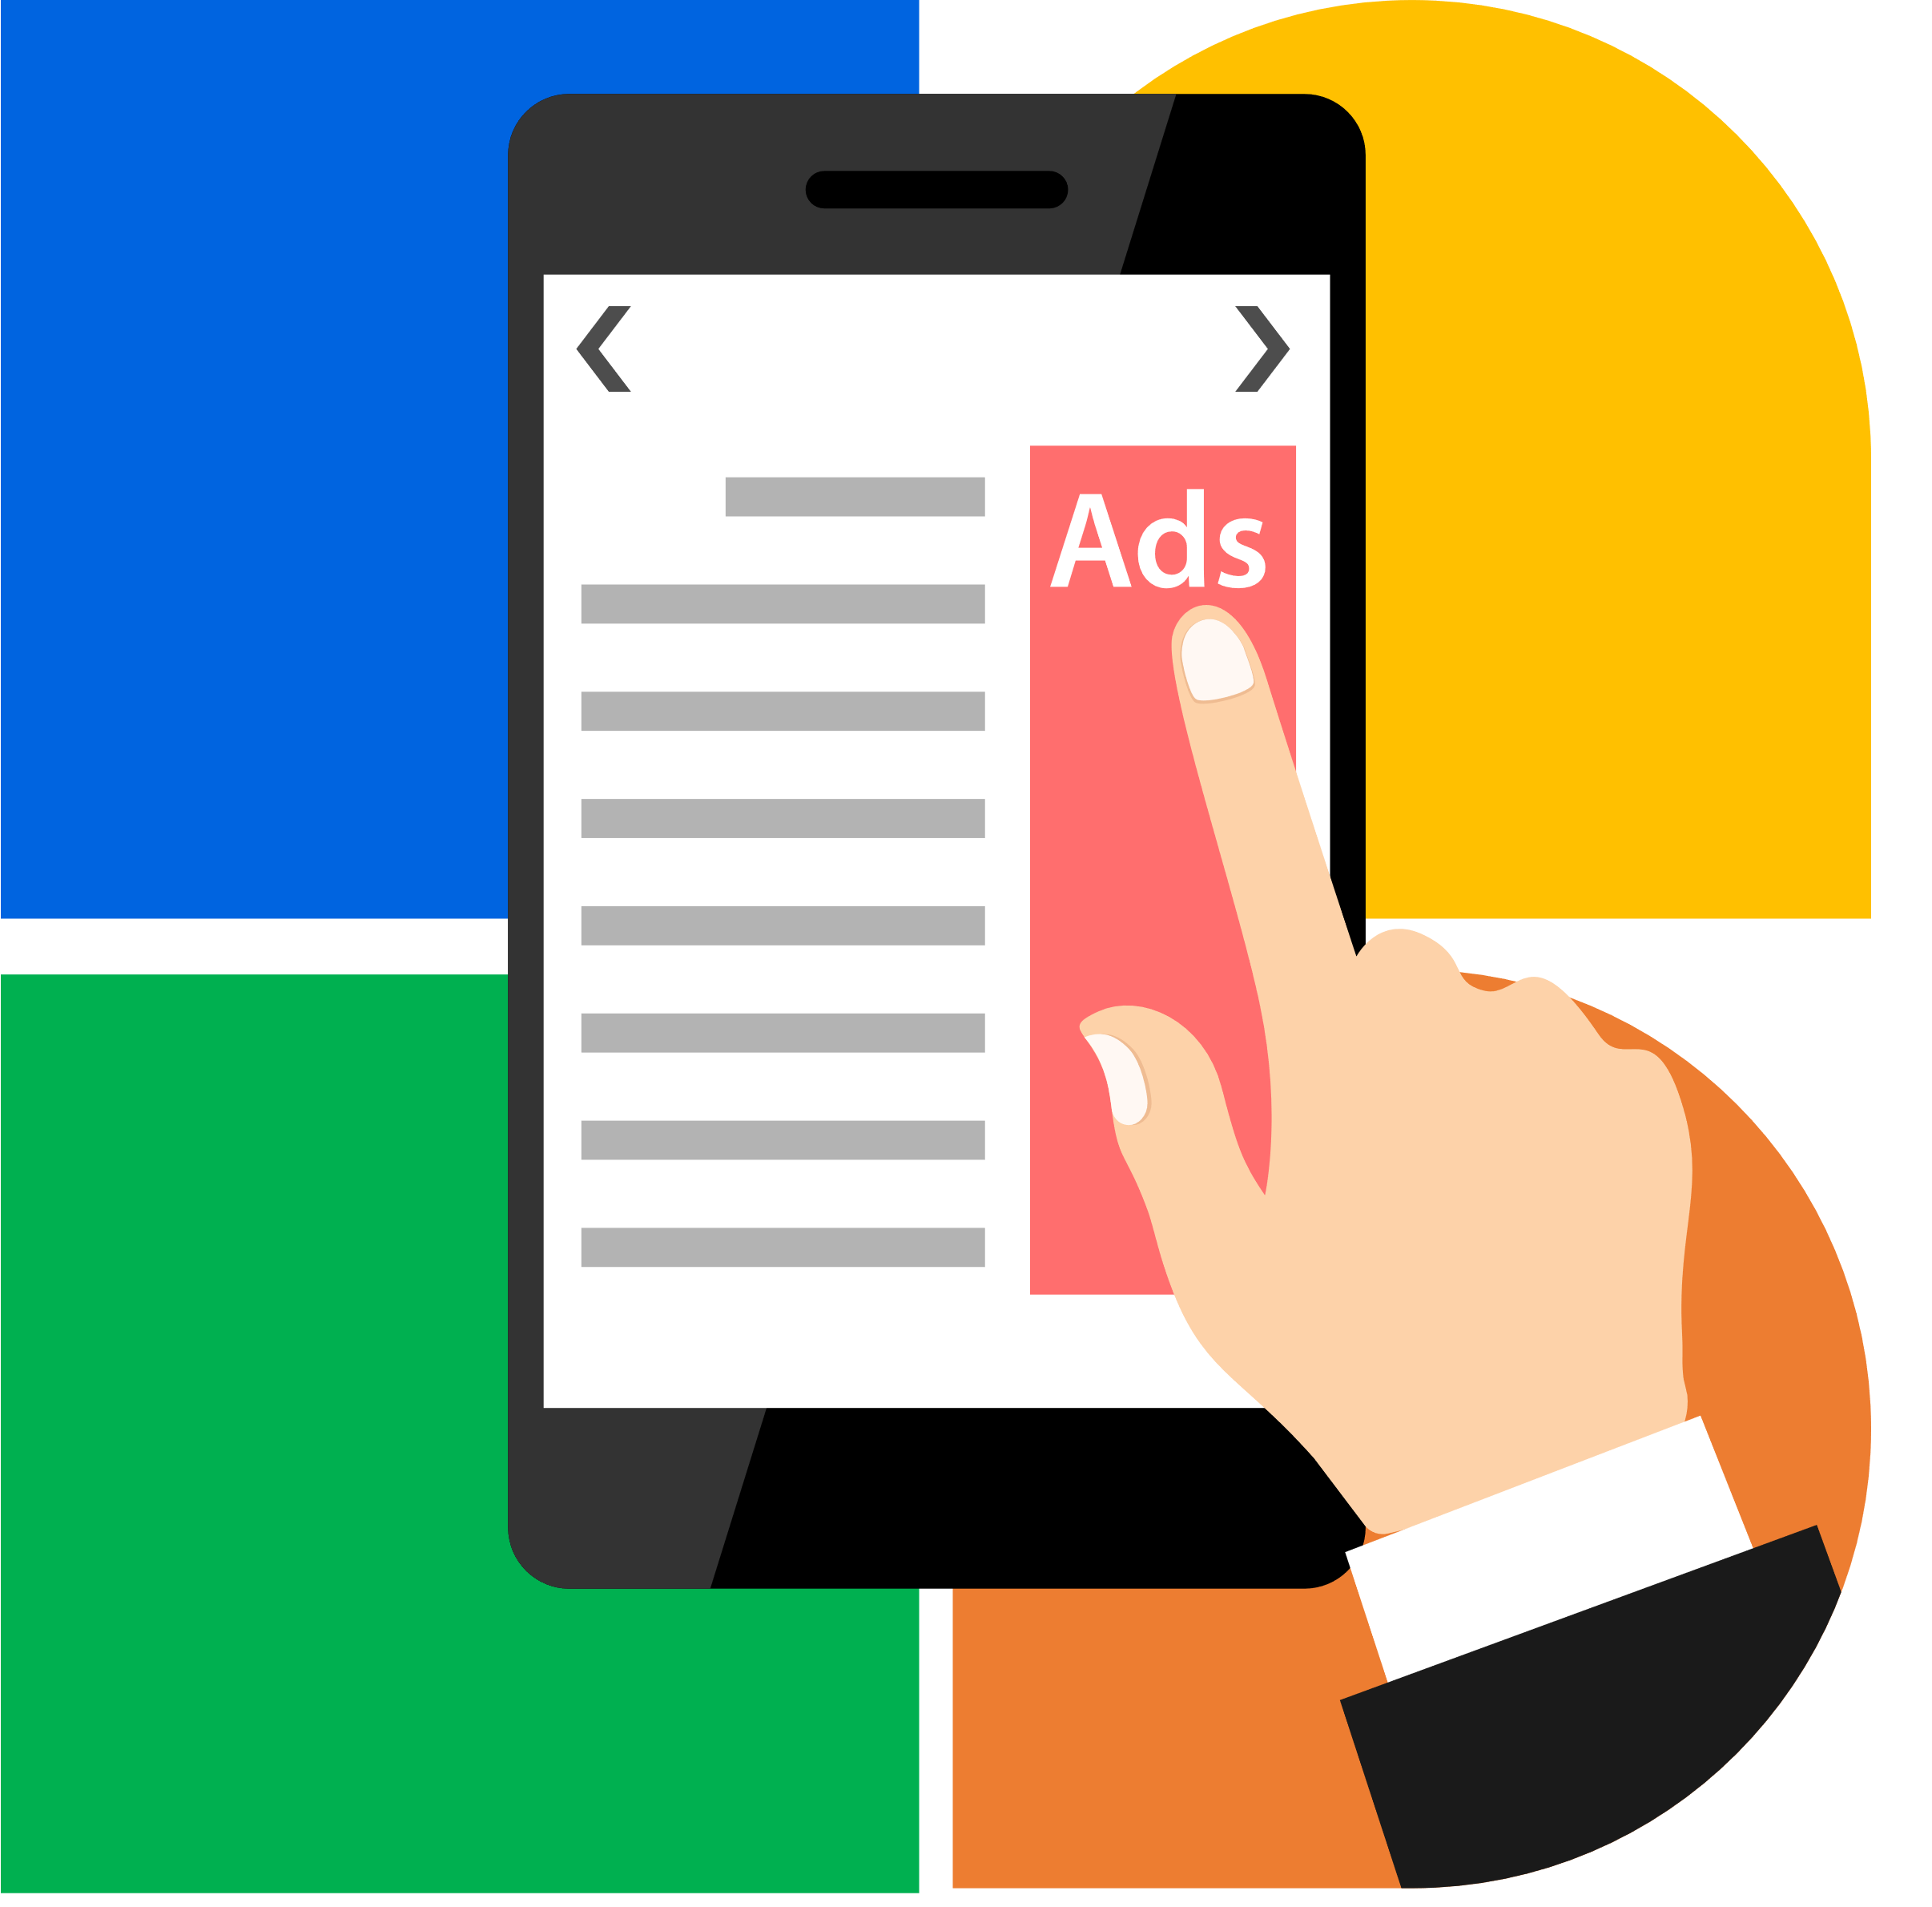
Ad Attack!
Have you ever searched for a particular product online and immediately after received a deluge of advertisements on the same product?
Why or how did that happen?
Was it a positive or negative experience?

Slide 3
Level 1 | Digital Citizenship
How could this happen? Let’s understand cookies!

Slide 4
Activity
What are cookies and how do they work?
Can cookies be harmful?
Can cookies be helpful?

Slide 5
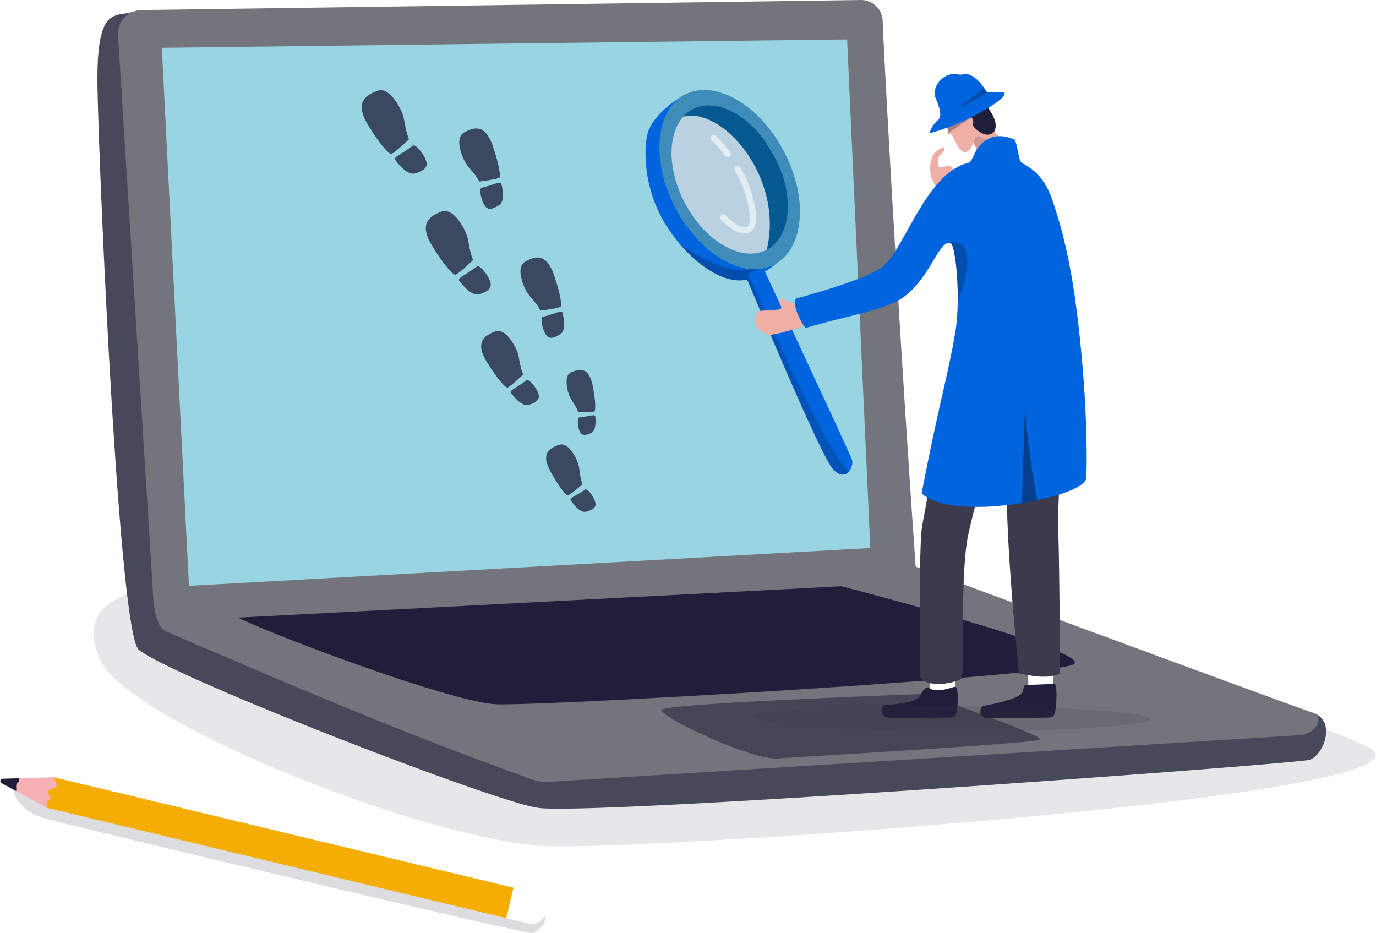
Have you ever seen a message like this?
Websites are required to inform you that they use cookies. All websites use them.
You will see this on your first visit to a website. After that, you will not get any alerts, but the website continues to track you.

Slide 6
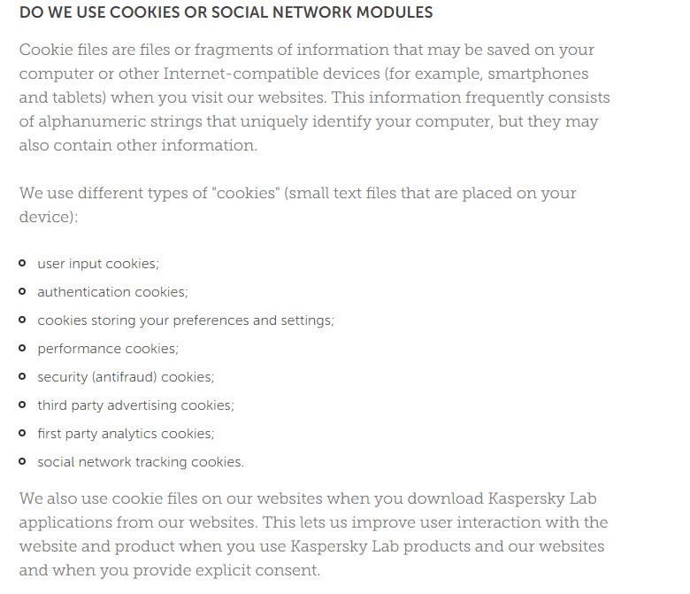
What happens when you click on this message?
You’ll see a long explanation about why they use cookies, but don’t forget to check the types of cookies used.
Let’s understand this once more!

Slide 7
Level 1 | Digital Citizenship
Targeted Marketing
Let’s see how targeted ads work!
Notes:
https://www.commonsense.org/education/videos/we-the-digital-citizens

Slide 8
Discussion
What are some of the advertisements that you constantly come across while browsing online? How are these linked to your browsing history?
Have you ever been tempted to buy something based on one of these targeted ads? What was your experience?

Slide 9
Managing Your Cookies
You can change your cookie settings. Let’s find out how!
Google Chrome Users: (search Google Chrome cookie settings)
https://support.google.com/accounts/answer/61416?hl=en&co=GENIE.Platform%3DDesktop
Microsoft Edge Users: (search Microsoft Edge cookie settings)
https://support.microsoft.com/en-us/search?query=enable%20cookies%20in%20edge

Slide 10
Level 1 | Digital Citizenship
Wrap-up: True or False?
Cookies are useful in that they speed up my search experience if I have searched the topic before.
Third-party cookies are a way for websites to share my preferences across different websites.
Targeted ads are advertisements that everyone can see when they are using the internet.
Once I open my browser to search, I have no control over the cookies that the website collects.

Slide 11
Level 1 | Digital Citizenship
Activity 4: Home Assignment
Create an Adobe Spark webpage or video detailing on one of the following topics
How are advertisers using your digital footprint to understand who you are and what you like?
What are cookies and how are they used to build your digital profile?

Slide 12
Created by

