Slide 1
Digital Citizenship
Lesson 5
HOW TO ACT RESPONSIBLY AND ETHICALLY ONLINE

Slide 2
Level 1 | Digital Citizenship
Let’s Refresh Our Memory
In which situation should you follow the rules of digital etiquette?
What is one difference between online and face-to-face communication?
Internet trolls aim to…
Why might people act meaner online than in person?
Sending an email to your grandmother
Sending a birthday card to your cousin
Reading a text message from a friend
Picking the ringtone for your smartphone
Body language is more important in online communication
People tend to be more honest online
Miscommunications happen more frequently face to face
Online, you can't tell tone of voice
Start arguments
Make friends
Quietly observe
Lead discussions
Typing gives them time to consider what they say
They can stay anonymous
Most people have fewer friends online
Social media sites encourage users to argue
The best way to respond to trolls is to _____ them.
What's the best text to tell your mom that you'll be an hour late for dinner?
Posting something on a social networking app is most like…
What should Liz do before posting a photo of Bobby online?
Threaten
Ignore
Copy
Insult
b there in 60, cu l8r!
I'll be home in an hour. See you later!
BE THERE IN AN HOUR. SEE YOU LATER!
I'm running late be there in an hour
Handing in a homework assignment
Saying something to your family over dinner
Talking on the phone with a friend
Announcing something in a public place
Share the photo with Bobby friend
Tag Bobby in the photo
Ask Bobby for permission
Send the photo to Bobby
2

Slide 3
Level 1 | Digital Citizenship
All About Netiquette for Social Media
Notes:
https://www.commonsense.org/education/videos/we-the-digital-citizens

Slide 4
Level 1 | Digital Citizenship
Discussion
What is the ‘golden rule’ as outlined in the video?
What is one important thing to remember about posting on social media?
What is the importance of social media etiquette?
Identify any 3 rules that you should think about before publishing anything on social media.

Slide 5
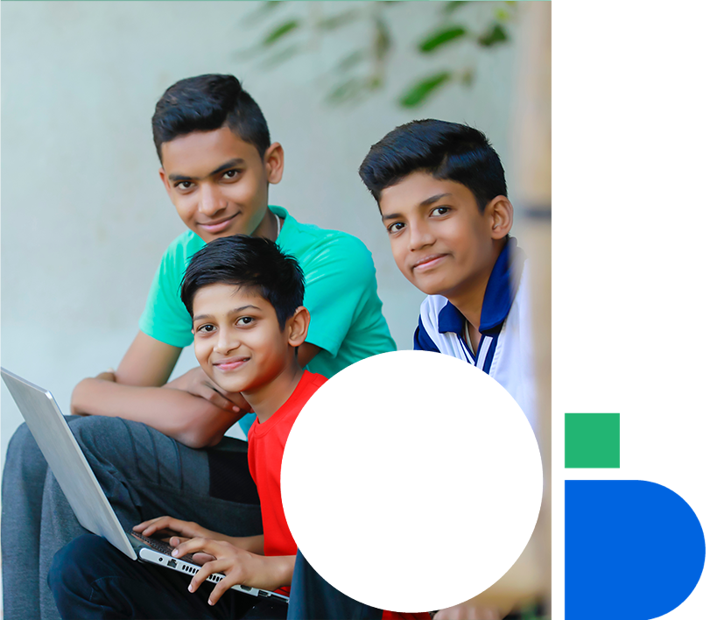
Level 1 | Digital Citizenship
In pairs or small groups, read the below scenarios and discuss
You come home from school one day and log in to your account. You see an invite to join a group that has been created to make fun of one of your classmates. If you do not accept the invite, your friends will surely pressurize you to join the group eventually. What should you do?
1
Your friends post a picture of you without consulting you. When asked to remove it from the social media, they refuse. How would you respond?
2
You and your friend got into an argument at school. It really made you angry because your friend posted that you have a crush on another student. Now, you are questioning yourself: How will I even go to school tomorrow? Everyone will know and tease me. So, you decide to write your own post against your friend, thinking he deserves to get a taste of his own medicine. Could there be a better way to handle such a disagreement with your friend?
3

Slide 6
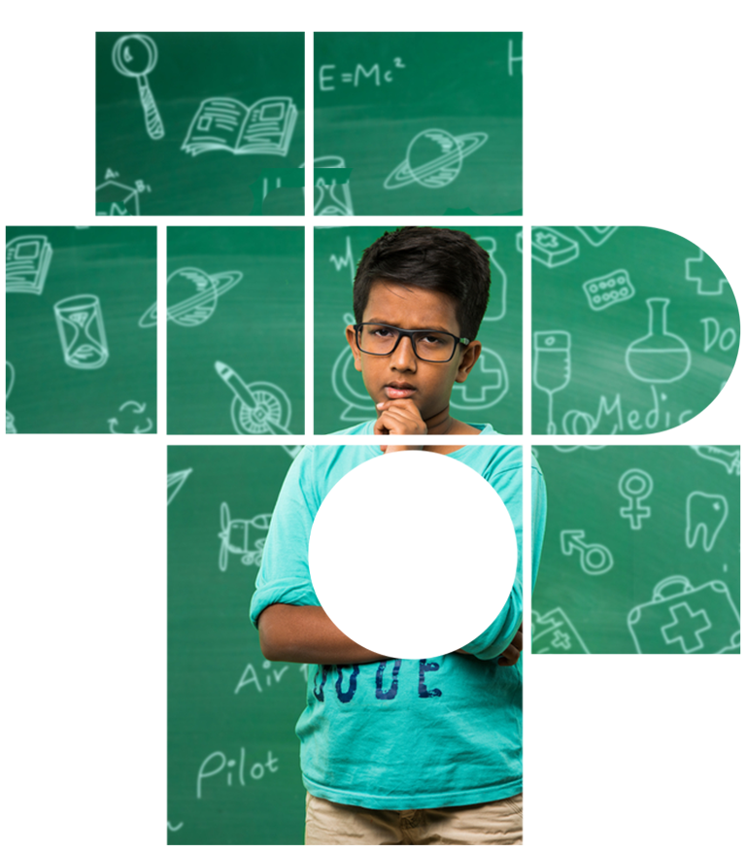
Level 1 | Digital Citizenship
Something to Think About
Sometimes we forget the importance of treating others how we would like to be treated.
In case of initiating sensitive discussions, it is much better to communicate directly rather than airing your grievances publicly.
This applies to sending a hurtful DM or email too. It’s best just to talk face to face if you have something difficult to say. It can avoid digital drama and nurture healthy relationships.

Slide 7
Level 1 | Digital Citizenship
Fake News Alert!
Another aspect of Netiquette is to spot and stop the spread of fake news.
Notes:
https://www.commonsense.org/education/videos/we-the-digital-citizens

Slide 8
Level 1 | Digital Citizenship
Test Your Knowledge
What do you
understand about
fake news?
How can we
differentiate between
fake and real news?
Should we post
any information that
we see or receive as
news without
verifying?

Slide 9
Level 1 | Digital Citizenship
Take-home Activity
ATTEMPT THIS QUIZ AT HOME.
QUIZ

Slide 10
Created by

