Slide 1
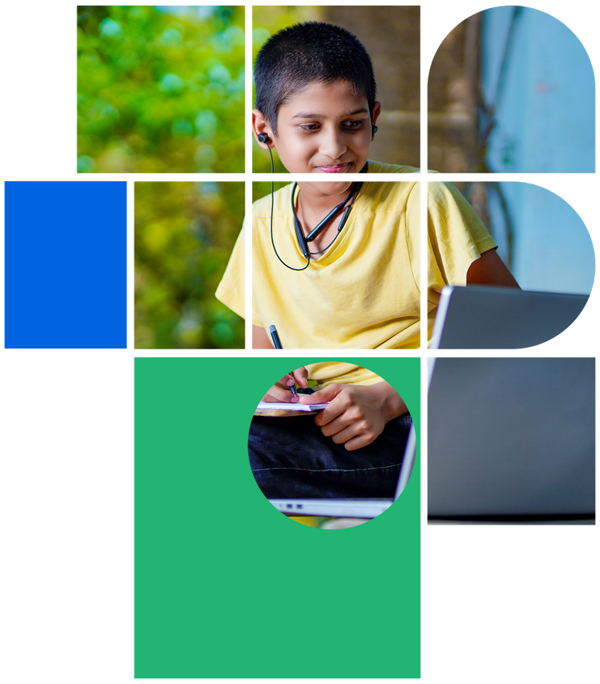
Digital Citizenship
Lesson 1
WELCOME TO
DIGITAL CITIZENSHIP

Slide 2
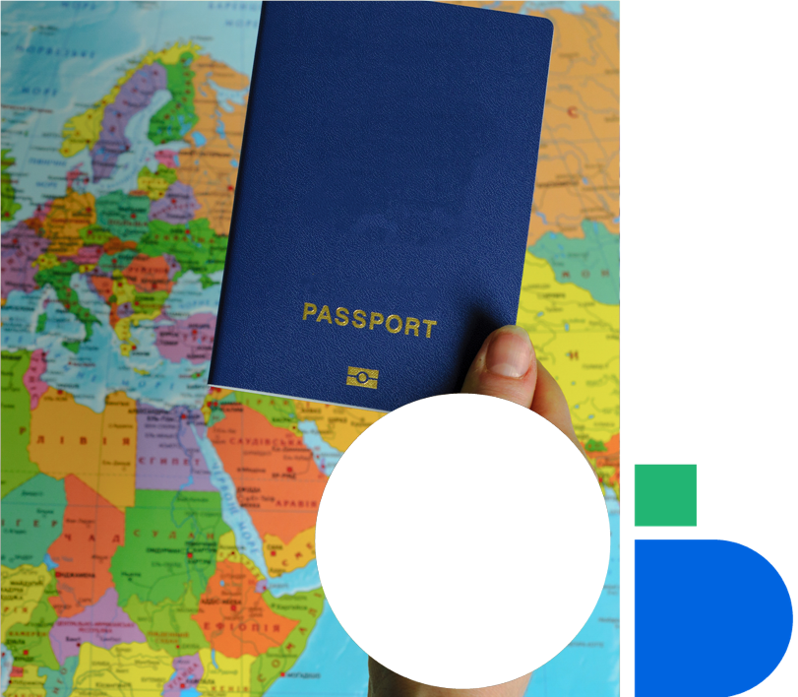
Level 1 | Digital Citizenship
What is Citizenship?
What does it mean to be a citizen?
Which country are you a citizen of?
Citizenship comes with rights and responsibilities
Can you name the rights that you have as a citizen?
Can you name any of the responsibilities that you have as a citizen?

Slide 3
Level 1 | Digital Citizenship
Reasonable Restriction
Under Article 19 of the Constitution of India, the State may impose reasonable restrictions on the six fundamental rights defined in the Constitution.
If the State decides to impose a restriction on the rights of the citizens, that restriction should be ‘reasonable’. In other words, it must be neither too strict nor too lenient. While this is not specifically defined in the Constitution of India, you can ask yourself whether a reasonable person would find the restriction ‘reasonable’ or not.

Slide 4
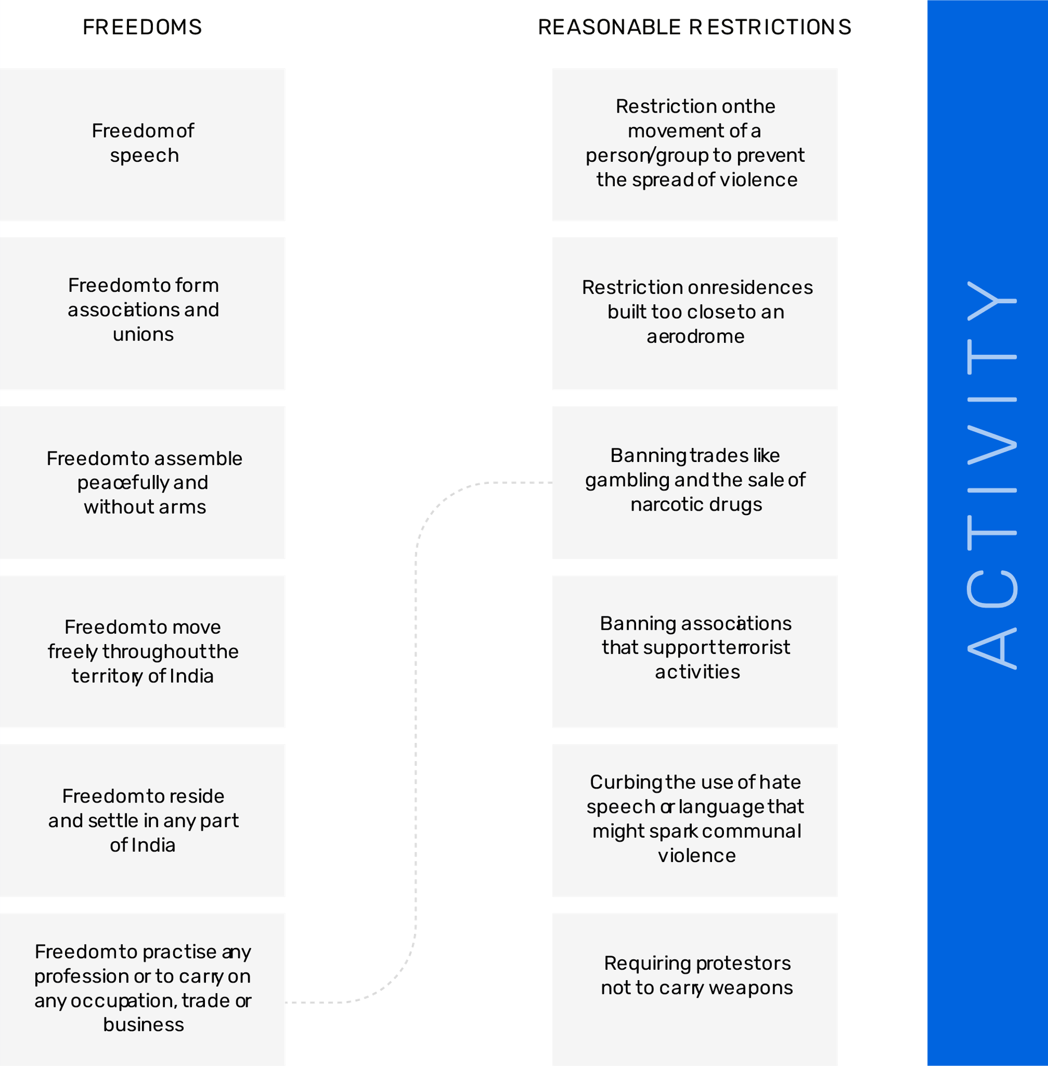
Level 1 | Digital Citizenship
Let’s Examine Some Reasonable Restrictions

Slide 5
Level 1 | Digital Citizenship
Who is a Digital Citizen
According to Dictionary.com, a digital citizen is:
A person who develops the skills and knowledge to effectively use the internet and other digital technology, especially in order to participate responsibly in social and civic activities.

Slide 6
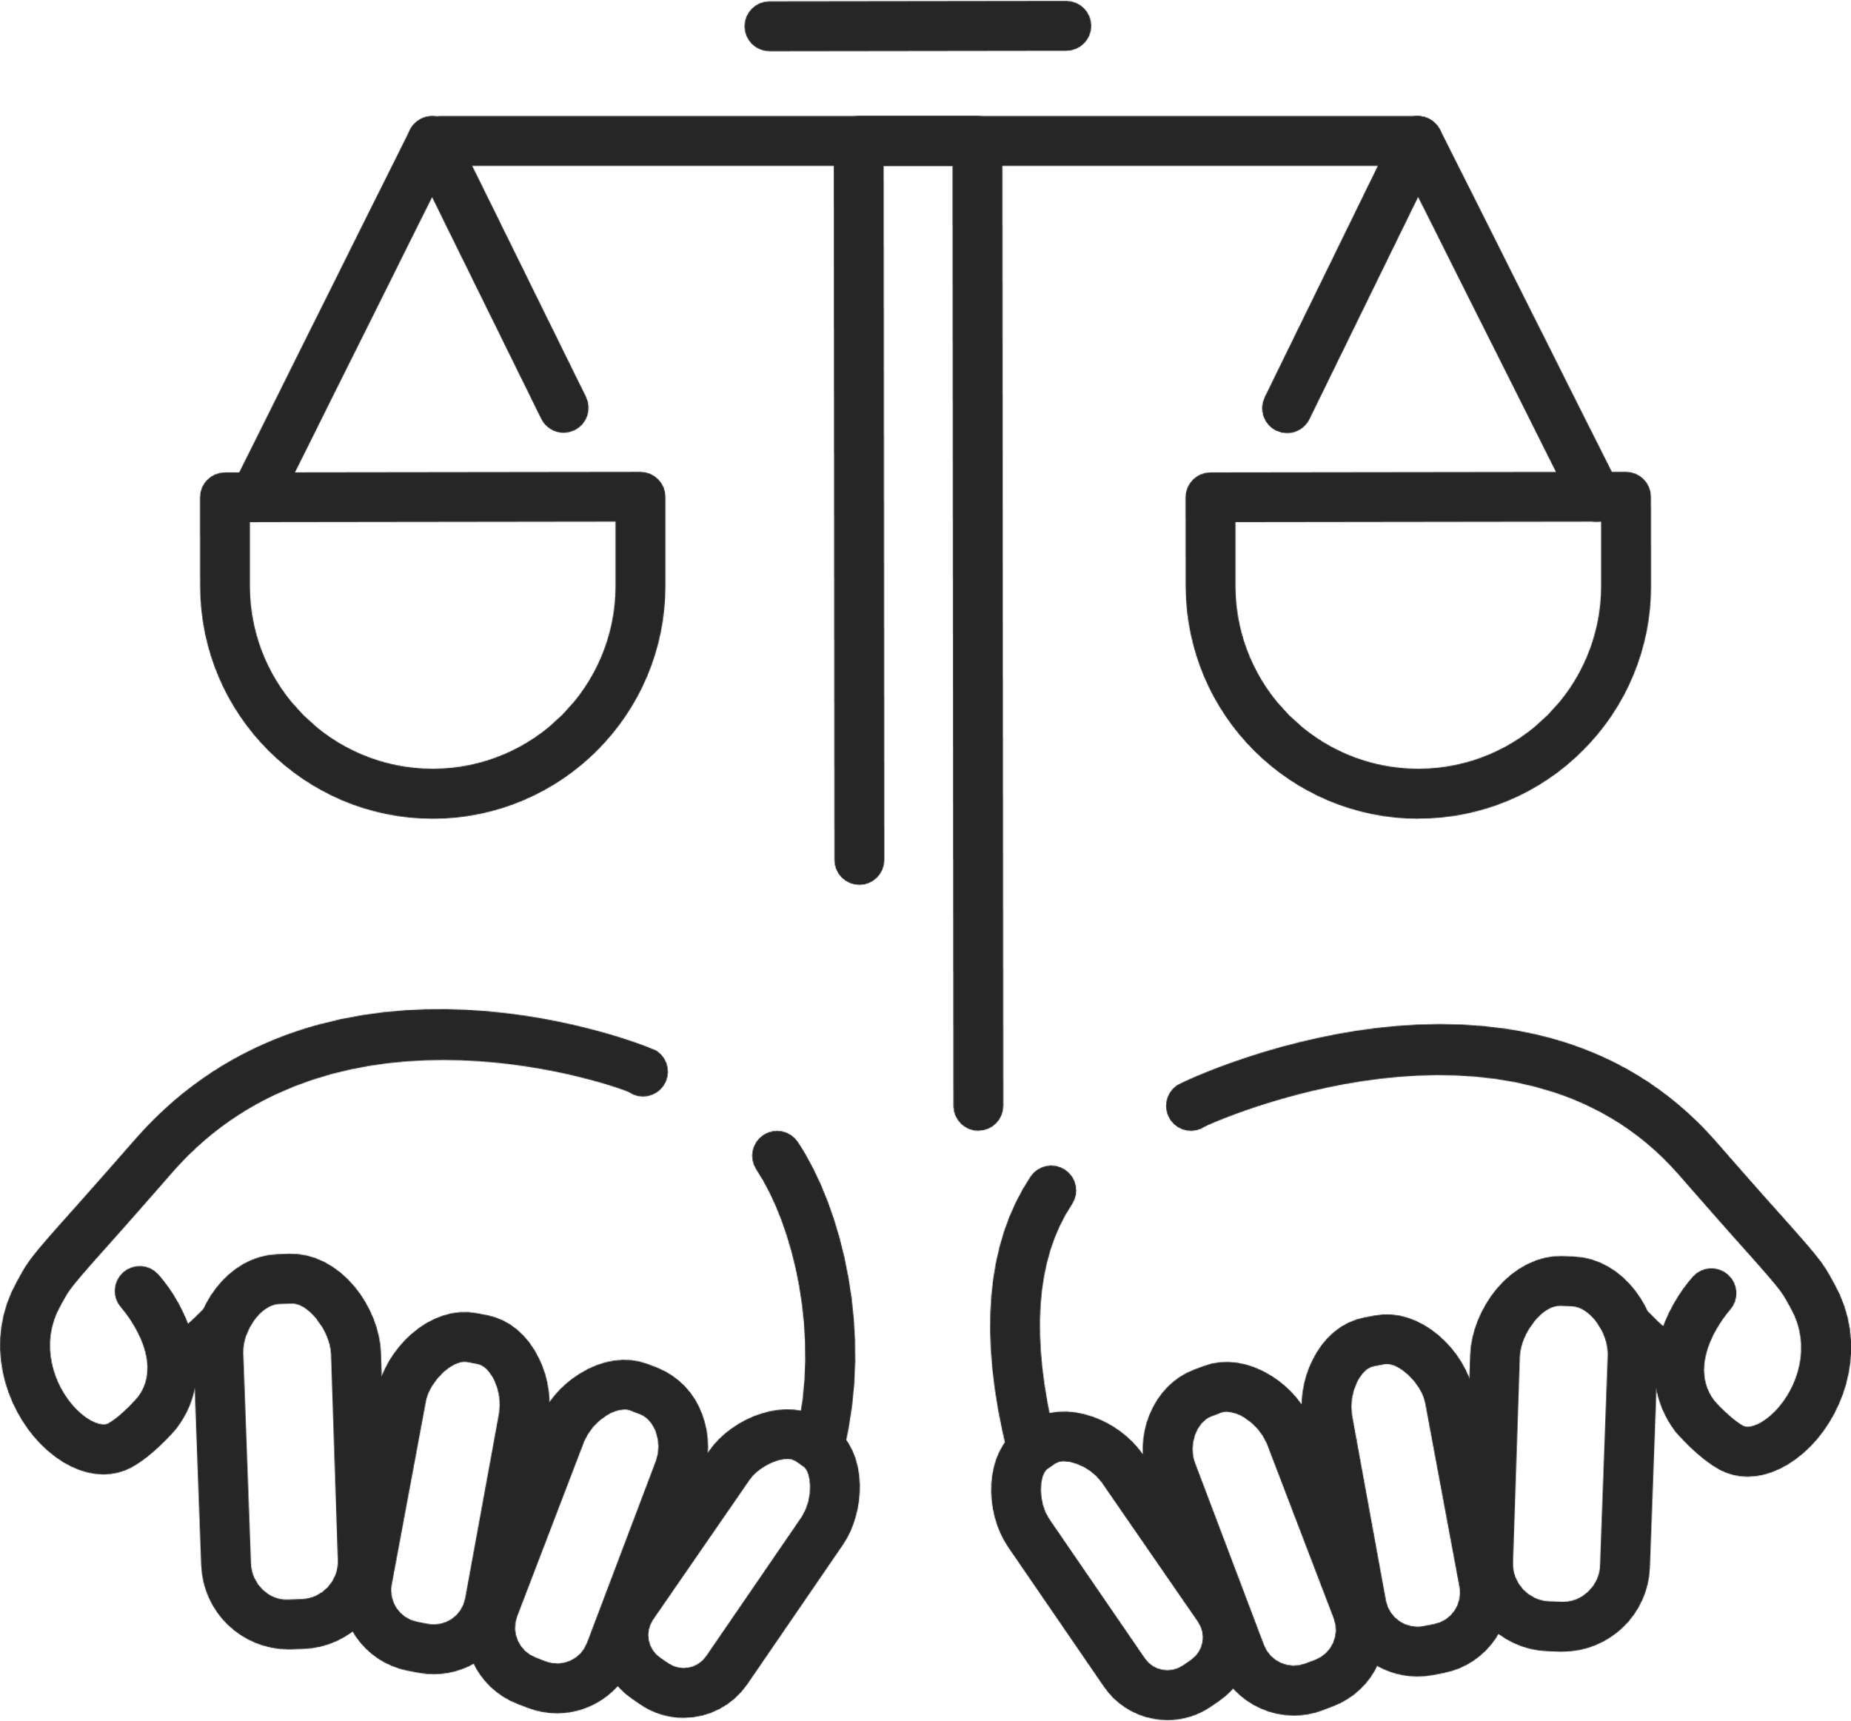
Level 1 | Digital Citizenship
What are the Rights and Responsibilities of a Good Digital Citizen?
Key Digital Rights:
Right to access and use computers and/or other electronic devices
Right to access and use digital content
Right to create and share digital media
Right to privacy in digital communities
Right to express your ideas and opinions freely
Right to report anyone or anything that seems inappropriate
Key Digital Responsibilities:
Using appropriate language and behaviour when interacting with others (i.e. no cyberbullying)
Respecting the opinions and ideas of others
Obeying all intellectual property laws
Not using or sharing others' work without permission
Following rules and/or codes of conduct for every internet site
Reporting cyberbullying, threats, and inappropriate use of digital resources

Slide 7
Level 1 | Digital Citizenship
Who Will Be the Monitors of the Online World?
If no one is monitoring the internet, then it is up to each one of us to make sure that we are acting responsibly!
We may even have to abide by some
“reasonable restrictions”.

Slide 8
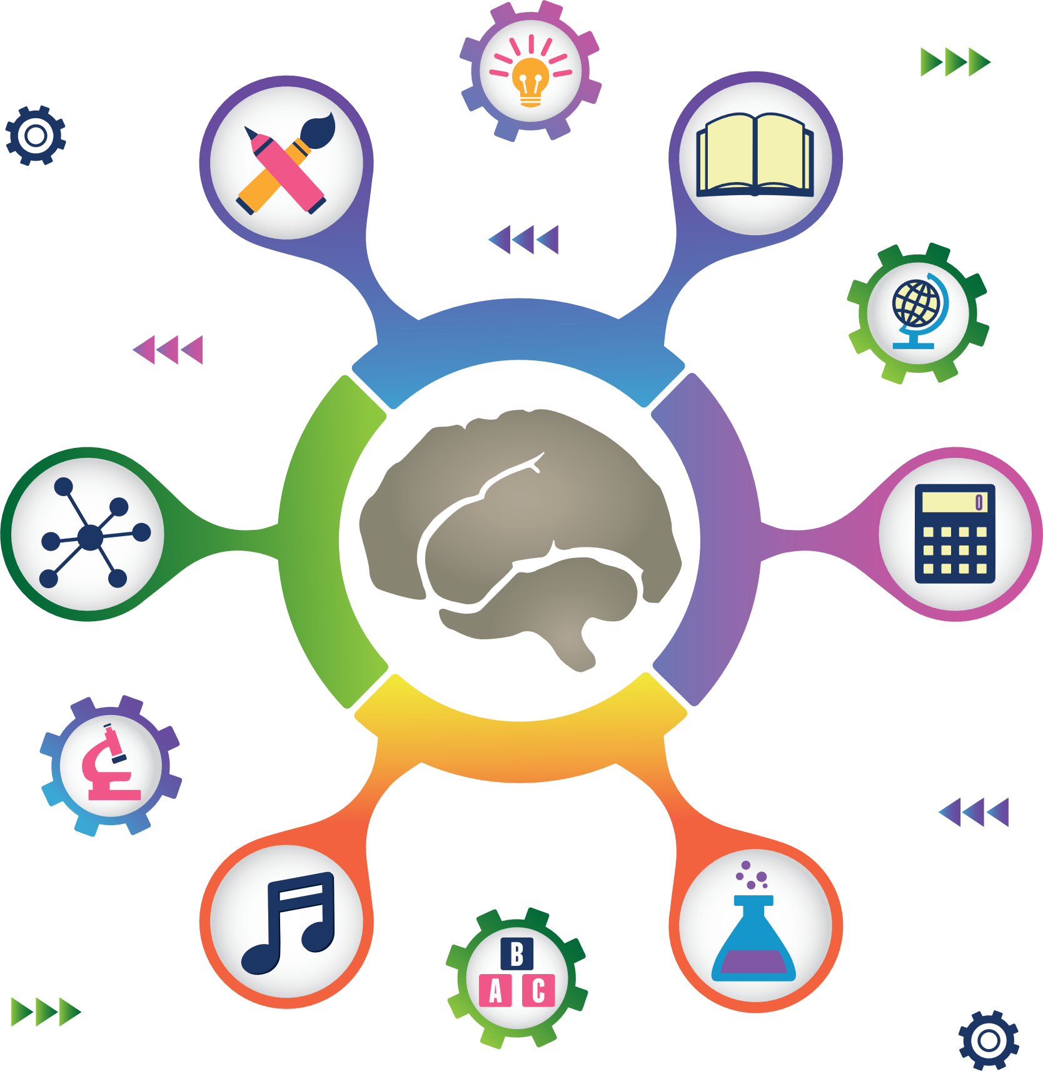
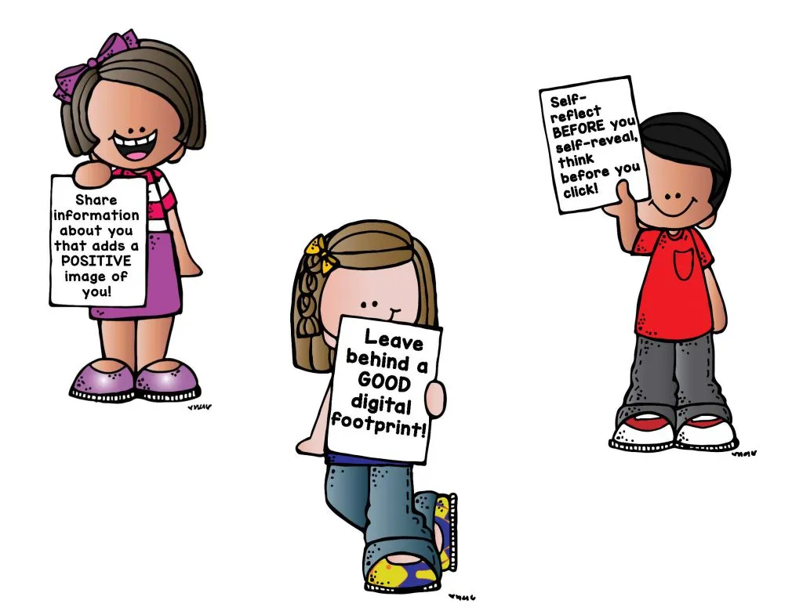
Level 1 | Digital Citizenship
Activity Time: Let’s Make a Mind Map
What are the characteristics of a good digital citizen?

Slide 9
Level 1 | Digital Citizenship
Welcome to Digital Citizenship!
The syllabus of this course will introduce the 7 basic aspects of digital citizenship:
Welcome to the Digital World
Privacy and your Digital Footprint
Cyber Security
Cyber Exploiters
Digital Etiquette
Digital Well-being
Information
Literacy
Learn the basics of your devices and the internet
Learn what kind of trail you leave online
Learn how your devices are kept safe
Learn how advertisers try to get you to buy
Learn how to behave when you are online
Learn how to be healthy by going offline
Learn about your responsibilities when you use the internet for research

Slide 10
Level 1 | Digital Citizenship
Let’s Test Your Knowledge
Citizenship is_____________ .
As a citizen of your country, you have___________.
The relationship between two individuals
The relationship between individuals and the State
The relationship between two states within a country
The relationship between two or more countries
Rights
Responsibilities
An Aadhar card
Rights and responsibilities
A digital citizen is a citizen of __________.
A reasonable restriction on the internet might be ____________ .
The physical world
The digital world
The United Nations
The internet
Not allowing people to keep their data safe
Not allowing friends to meet in a game and play together
Not allowing children below 13 years of age to create their own social media accounts
Not allowing teachers to send students their homework over email

Slide 11
Level 1 | Digital Citizenship
Notes:
https://www.commonsense.org/education/videos/we-the-digital-citizens

Slide 12
Created by

