Slide 1

Digital Citizenship
Lesson 15
CLICK THE BAIT!

Slide 2
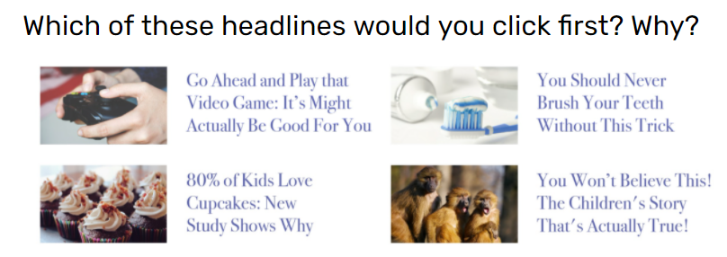
Level 1 | Digital Citizenship
Activity: Dodging the Clickbait
Which of these headlines would you click first? Why?
Go Ahead and play that Video Game: It’s Might Actually
Be Good For You
You Should Never Brush Your Teeth Without This Trick
80%of Kids Love Cupcakes New Study Shows Why
You Won’t Believe This! The Children’s Story That’s Actually True!
Which one is the most popular headline? Analyze why.

Slide 3
Level 1 | Digital Citizenship
What Makes You Want to
Click the Bait?
The curiosity gap is the space between
what we know and what we want or need to know!
It refers to the desire of a person to figure out what’s
missing or what comes next. Marketers use this
tool to keep their audience or customers engaged.

Slide 4
Level 1 | Digital Citizenship
Activity: Analyze This
What do you think this headline means? Based on what we discussed, what do you think is the objective of the article?
Have you come across such headlines on the internet? Share a few examples. What was the information and what was the bait?
Have you ever forwarded a clickbait before checking if it is real or not? What do you think that you should do next time?
Go Ahead and
play that Video Game:
It’s Might Actually
Be Good For You

Slide 5
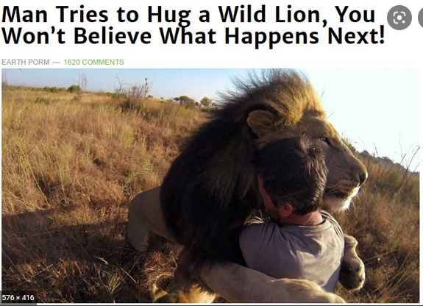
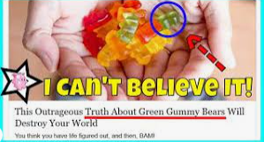


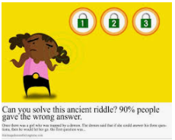
Level 1 | Digital Citizenship
How Do You Know It Is Clickbait?
Look for the telltale signs:
It seems impossible or unbelievable.
It tries to shock you.
It refers to a celebrity or a popular topic.
Check for words like epic, shocking, outrageous, amazing, mind blowing, you won’t believe, etc.
Check for things that you wish were true but just are not.
Check for promises that you will learn a secret or prove that you are very smart.

Slide 6

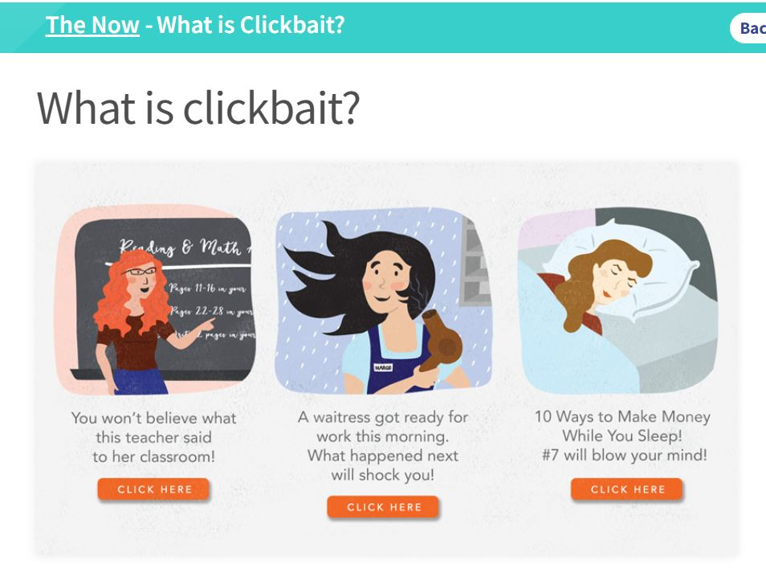

Level 1 | Digital Citizenship
Possible Consequences of Clickbait
Let’s read about it!
Click Here
Notes:
https://edu.gcfglobal.org/en/thenow/what-is-clickbait/1/

Slide 7
Level 1 | Digital Citizenship
Discussion: Possible Consequences of Clickbait
Can Clickbait be dangerous? How so? Please explain.
What should you do if you see a clickbait headline or receive it forwarded to you?

Slide 8

Level 1 | Digital Citizenship
Activity: Express Quiz
QUESTION 1 OF 5
Select one answer from the list below.
Clickbait is ……………………………………created just to get clicks.
Emails
Headlines
Phone calls

Slide 9
Level 1 | Digital Citizenship
Activity: Express Quiz
QUESTION 2 OF 5
Select one answer from the list below.
Which of the following are clues that something might be clickbait?
​​It seems impossible or unbelievable.
It tries to shock you with language like "You Won't Believe This!".
It refers to a celebrity or popular topic.
All of the above.

Slide 10
Level 1 | Digital Citizenship
Activity: Express Quiz
QUESTION 3 OF 5
Select one answer from the list below.
Arun is reading an article and sees a link that says "Go Ahead and Play That Video Game:
It Might Actually Be Good for You". He is curious about why video games might be good, because his mother says they're a waste of time. Arun’s interest in clicking this link is an example of:
​​Advertising
Curiosity gap
Attitude
Confluence

Slide 11
Level 1 | Digital Citizenship
Activity: Express Quiz
QUESTION 4 OF 5
Select one answer from the list below.
Most clickbait links are a type of ………………………………… . This means the more times people click on these links, the more money they make.
​​Storyboard
Curiosity gap
Hacker
Advertising

Slide 12
Level 1 | Digital Citizenship
Activity: Express Quiz
QUESTION 5 OF 5
Select one answer from the list below.
How confident do you feel about identifying a headline that might be clickbait?
​​I feel very confident.
I feel somewhat confident.
I do not feel confident.

Slide 13
Level 1 | Digital Citizenship
Try This at Home!
Create your own clickbait headline.
Remember to use the clues from Part 1 and "The Curiosity Gap" to help you.
Draw or insert an image next to the headline to make it really catchy.

Slide 14

Created by

