Slide 1
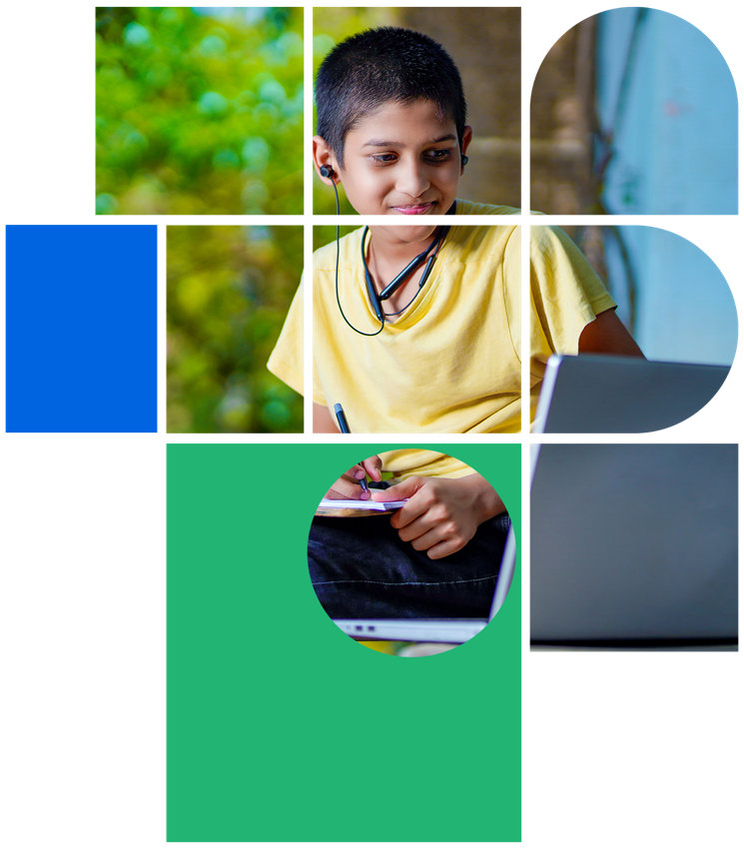
Digital Citizenship
Lesson 12
DIGITAL SECURITY, FIREWALLS AND SPAM

Slide 2


Level 1 | Digital Citizenship
Safety Measures
Tip
What are the actions you take to ensure your physical safety?
When you carry any digital device, such as a computer, phone, tablet, headphones, etc., always be aware of its position. Keep it secure and out of sight when not in use.
Don’t leave your device lying around where someone might be tempted to steal it.
And don’t take your device with you if it’s not needed.
What about your computing devices?
Do you take measures to keep them physically secure?

Slide 3

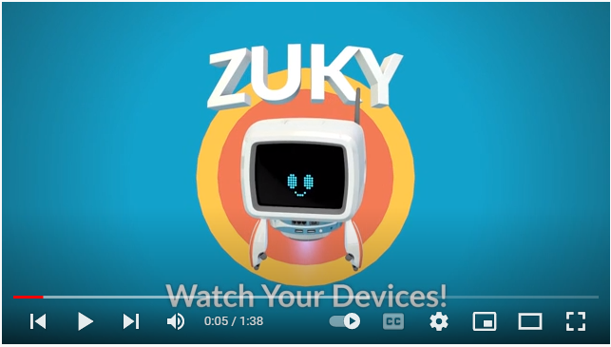
Level 1 | Digital Citizenship
Let’s meet Zuky the robot who will help us keep our devices safe!

Slide 4
Level 1 | Digital Citizenship
What about data theft? Have you thought about it or have you heard of someone’s data being stolen?
What is a Firewall?
A firewall is a network security device that monitors incoming and outgoing network traffic and decides whether to allow or block specific traffic.
That sounds like a traffic police, doesn’t it?

Slide 5
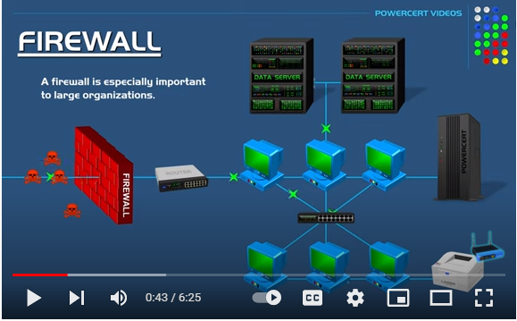
Level 1 | Digital Citizenship
Let’s examine a firewall for better understanding!

Slide 6

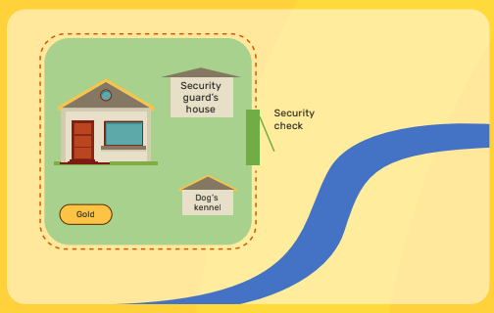
Level 1 | Digital Citizenship
Think Like a Hacker!
Scenario 1
Imagine that there is a big house next to a river. Recently, it was discovered that 200 years ago the house was built by pirates who may have buried a treasure chest in the yard of the house.
The house is very well guarded by a high fence, a dog and a team of security. There is only one entrance to the compound. Everyone needs to pass through the security check in order to enter.
You are a thief and you have decided that you want to dig for the treasure chest so that you can steal it.
Think of as many different ways as you can to get into the property to get to the treasure chest. Not only that but, you will need to bring your shovels and tools to dig the treasure chest up.
Here is the map of the property.
Now, brainstorm ideas on how you can break in, bring your tools, dig up the treasure, and leave the property with the gold.

Slide 7
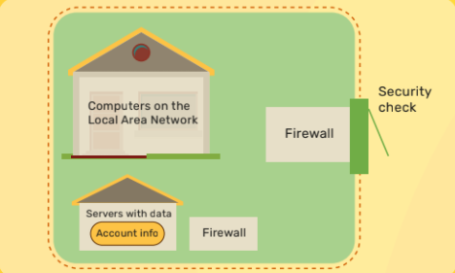
Level 1 | Digital Citizenship
Think Like a Hacker!
Scenario 2
Now imagine that instead of a mansion with a treasure chest, the house is the data center of a big bank. Instead of a treasure chest, the bank is guarding the account information of all of the people who have money in this bank.
This data is kept on servers that are guarded by a firewall. It is not easy to get this data.
You are a hacker and you have decided that you want to break through the firewall and steal the account details of all of the bank’s customers.
If you can do that, you should be able to use that data to pretend that you are one of these customers and you can create a lot of problems in their lives.
Think of as many different ways that you might try to hack through the firewall or sneak past the firewall.

Slide 8
Level 1 | Digital Citizenship
Think!
Definitions:
How can you break in?
SPAM
In both cases, one way is to act like you belong there and go in through the front door.
How would you do this to get into the mansion?
How would you do this to get past the firewall?
Spam is unwanted and unsolicited digital communication that is sent out in bulk.
The email may be just a marketing advertisement for the latest clothing trends or it may include a request for information and ask you to send something back.
This link may infect your device with a computer virus.
One way to get through the firewall is to first send a regular piece of email to someone in the bank.
If you can get them to click on a link that they are not supposed to click, it can allow you access to the network.
Computer Virus
A computer program that when executed, can modify other computer programs and insert different instructions which might be used to steal or destroy data.

Slide 9
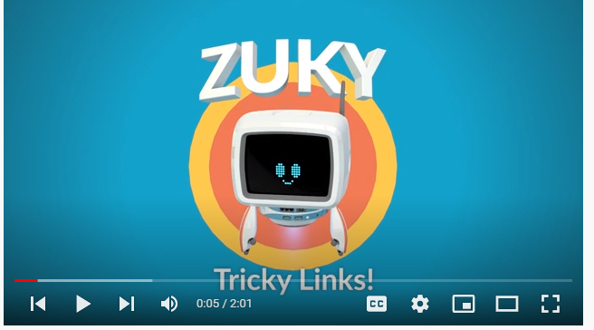
Level 1 | Digital Citizenship
Let’s Learn about Spam and Tricky Links

Slide 10

Level 1 | Your Digital World
Activity: Recognizing Spam
Let’s read through some emails and see what we can learn by carefully analyzing the messages.

Slide 11
Level 1 | Digital Citizenship
Tricky Links: Email 1
From: the_shop_on_the_corner
To: Ms. Rajaji, most loyal customer
Dear Ms. Rajaji
    Today is a very lucky day for you! You have been selected from among our thousands of customers to win a shopping trip for ₹ 50,000
    We will be sending this prize money directly to your bank account.
    Please click the below link to enter your details.
    Congratulations!
    www.This is the link to enter your bank details.com

Slide 12
Level 1 | Digital Citizenship
Tricky Links: Email 2
From: your grandmother
To: you
  Hello beta,
  It has been so long since you called me, and I feel very sad.
  I have an urgent request but, please do not tell appa or amma. This is just between us since you are the grandchild that I trust the most.
  I have fallen down and injured my leg. The doctor says that the treatment will cost almost ₹ 20,000!
  The hospital has said that if you can dontate blood instead of payment, they will be able to treat my leg for only ₹ 2,000.
  Please click this link to schedule your blood donation.
  www.This_is_the_link_to_schedule_your_blood_donation.com
  Please help me else I may not be able to walk again.
  Love, Granny

Slide 13
Level 1 | Digital Citizenship
Tricky Links: Email 3
From: Message Me service admin
To: you
  There has been a data breach and it is critical that we secure all Message Me accounts.
  In order to ensure uninterrupted service for your Message Me account, please reply to this message by filling in the below form.
  Thank you for your prompt attention
  Restore my Message Me account now!
  User ID:
  Password:

Slide 14
Level 1 | Your Digital World
Summary
What are some ways to spot spam?
Do you know about the spam folder in your email?
The email is from someone you don’t know.
You don’t recognize the URL in the email.
It refers to an account that you don’t have.
The email sounds too good to be true.
The email has an unfamiliar greeting.
There is a suspicious attachment or link.
Let’s check it out!

Slide 15
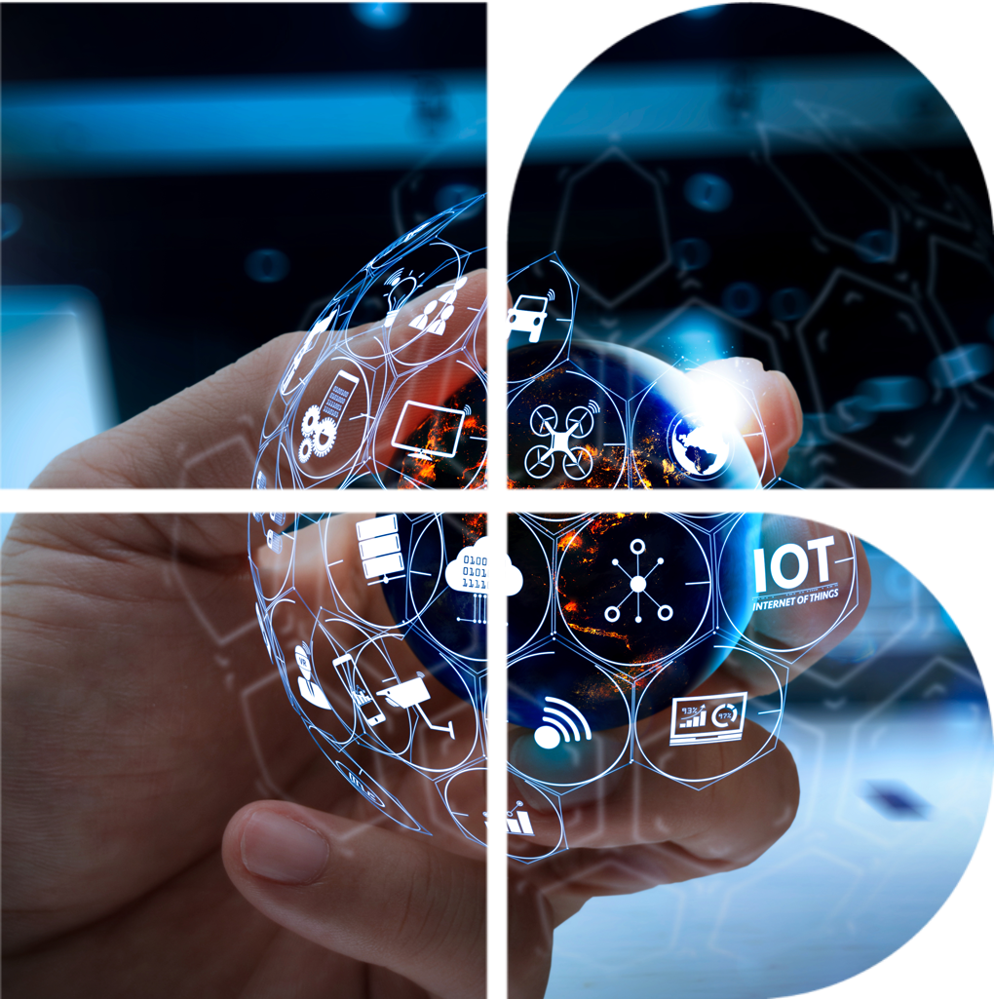
Level 1 | Digital Citizenship
Take-home Activity
Using your list of do’s and don’ts create a poster in any digital design software to remind yourself of the right ways to stay internet safe.
Keep your poster handy at home when you are on the internet.

Slide 16

Created by

