Slide 1
Digital Citizenship
Lesson 11
PERSONAL SECURITY - UNDERSTAND THE DO’S AND DON’TS OF INTERNET USAGE

Slide 2
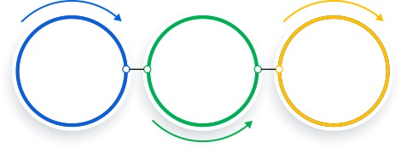
Level 1 | Digital Citizenship
What is Cybersecurity?
Cybersecurity is the state of being protected against criminal or unauthorized use of electronic data…
…or the measures taken to achieve this.
Cybersecurity has both online and offline components.

Slide 3
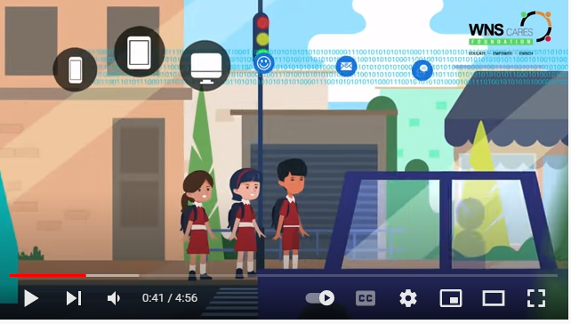
Level 1 | Digital Citizenship

Slide 4
Level 1 | Digital Citizenship
Think!
Cyber thieves might want to get to your data or accounts, such as your bank account. How would they do this?
Cyber thieves might also want to steal your identity. Why would they do this?
Cyber thieves might also want to meet you in person. Why would they do this?

Slide 5
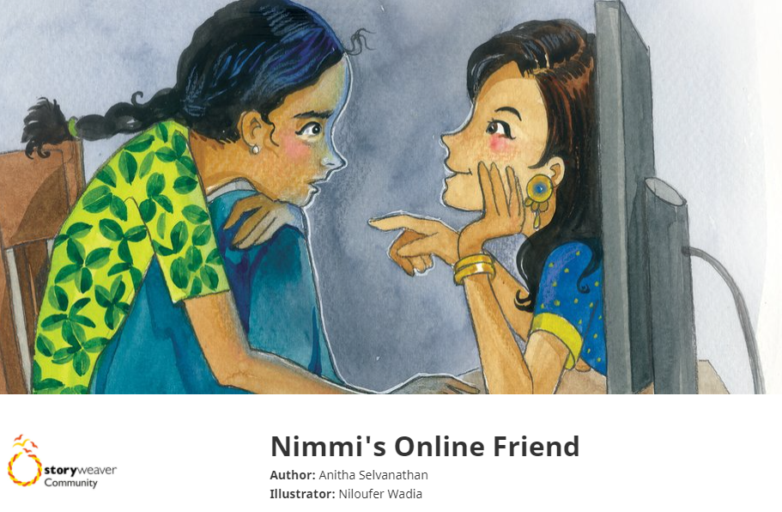
Level 1 | Digital Citizenship

Slide 6
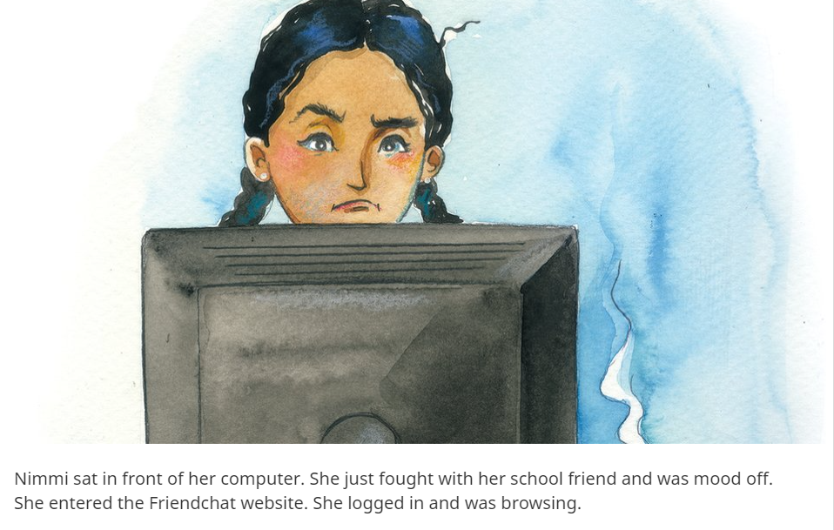
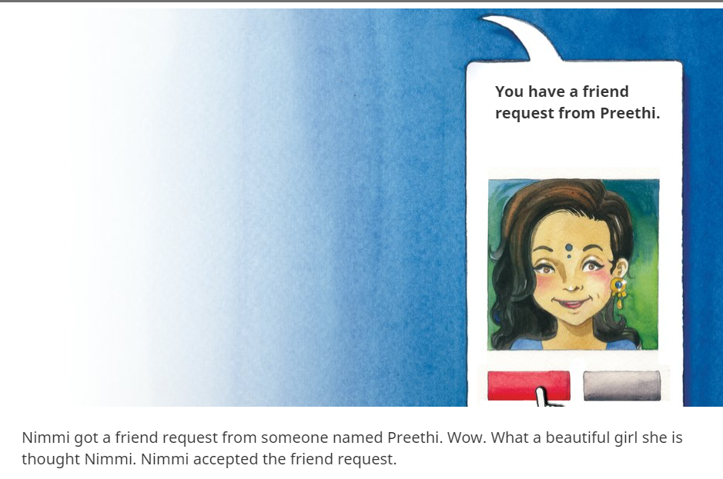
Level 1 | Digital Citizenship

Slide 7
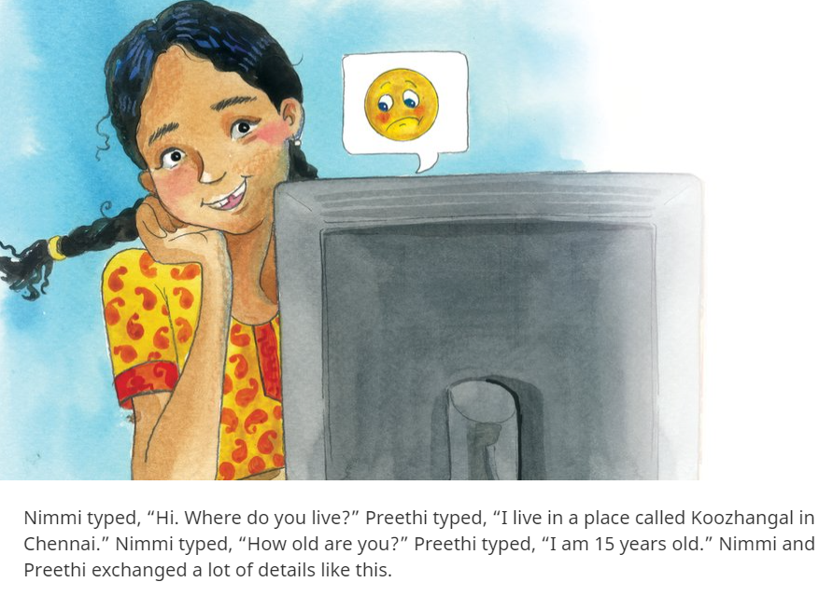
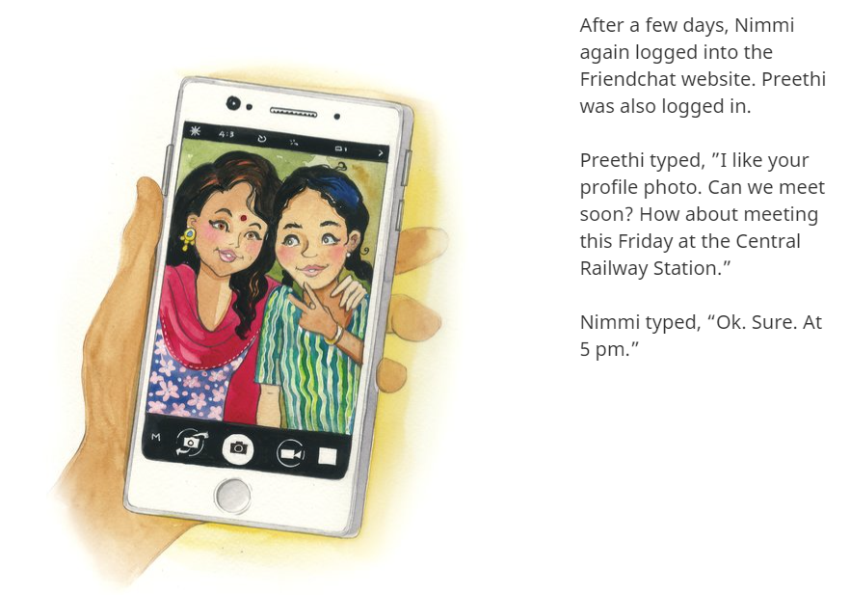
Level 1 | Digital Citizenship

Slide 8
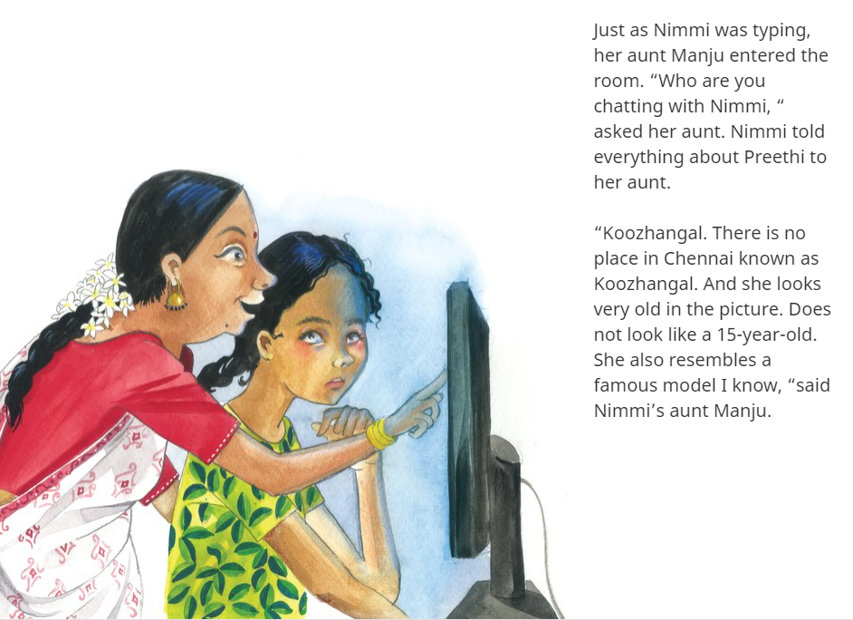
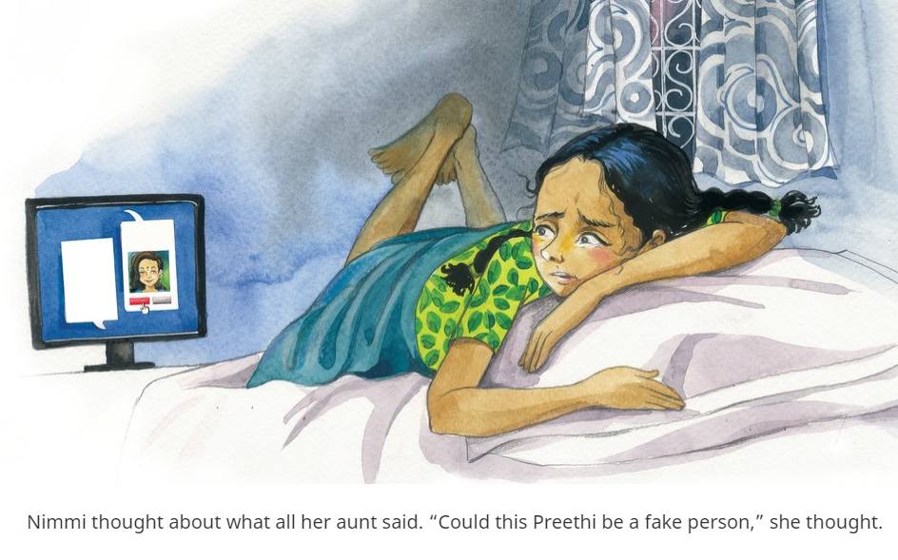
Level 1 | Digital Citizenship

Slide 9
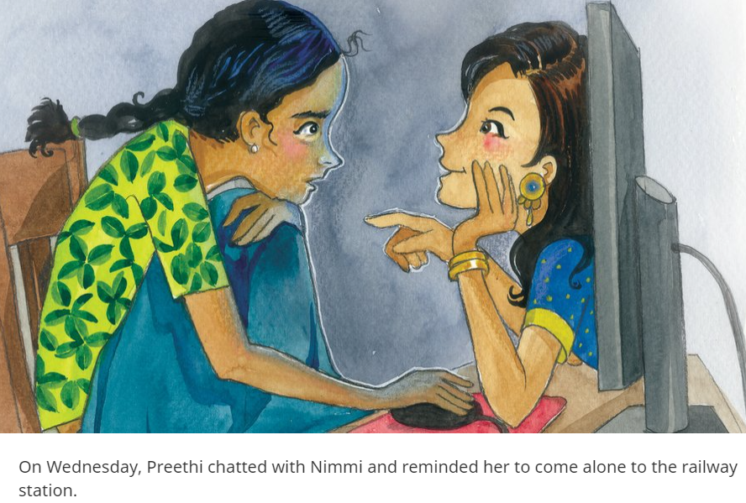
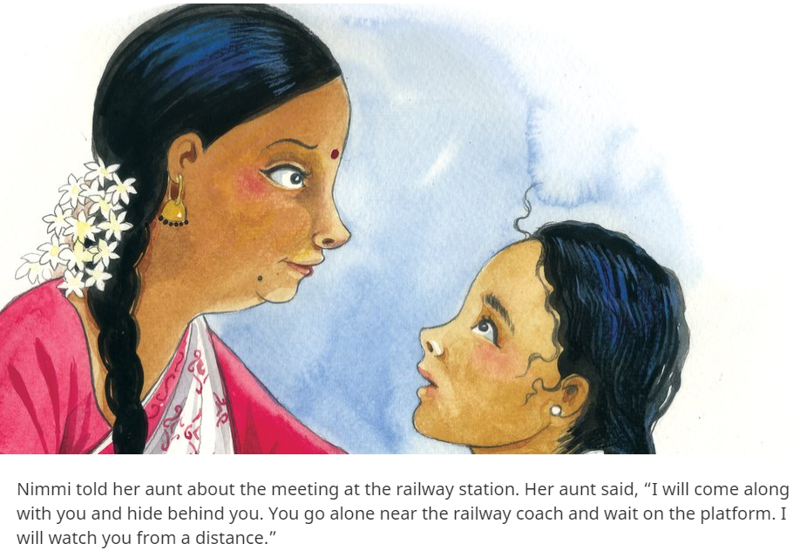
Level 1 | Digital Citizenship

Slide 10
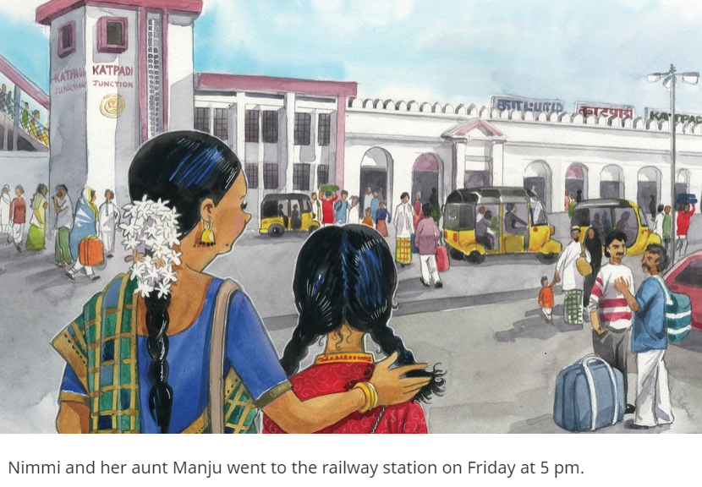
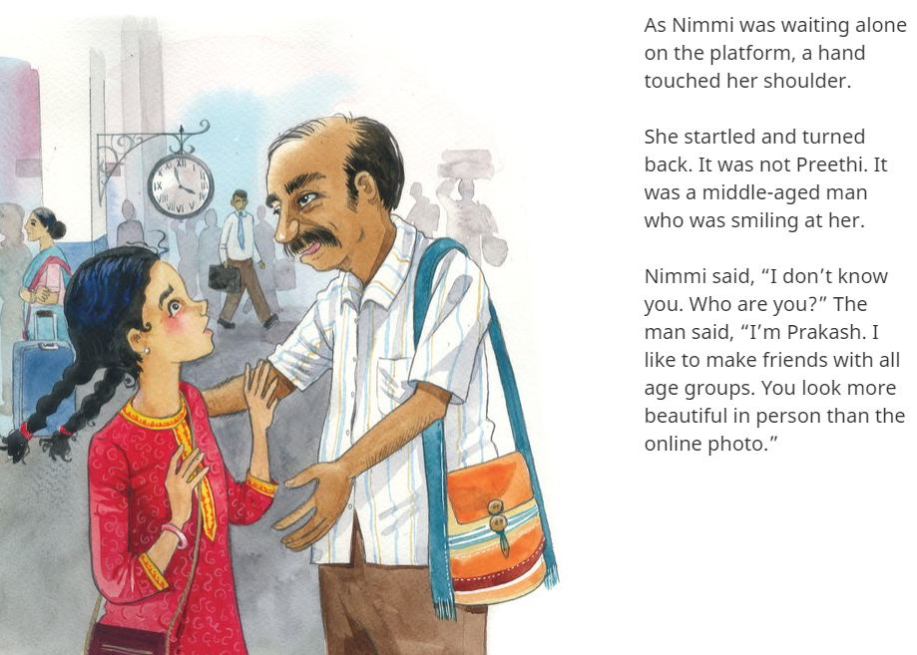
Level 1 | Digital Citizenship

Slide 11
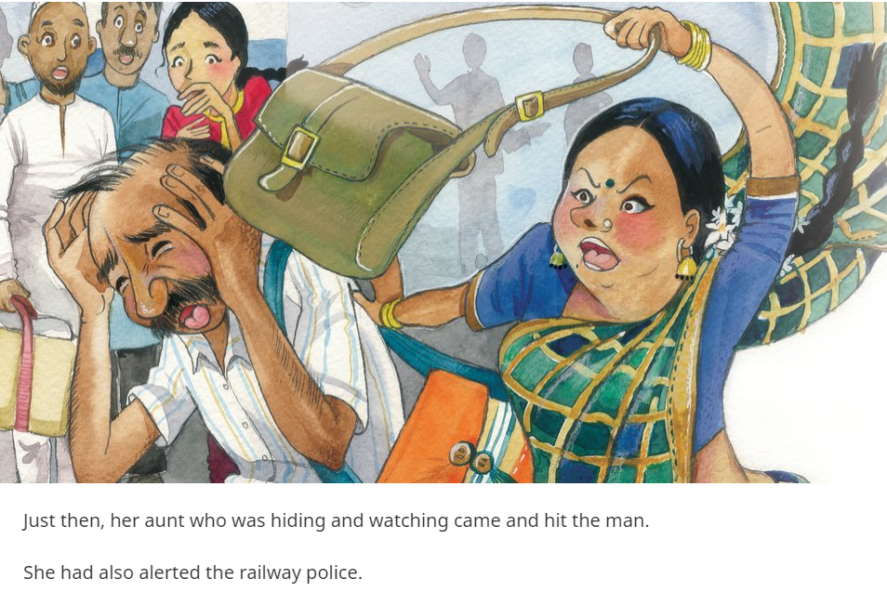
Level 1 | Digital Citizenship

Slide 12
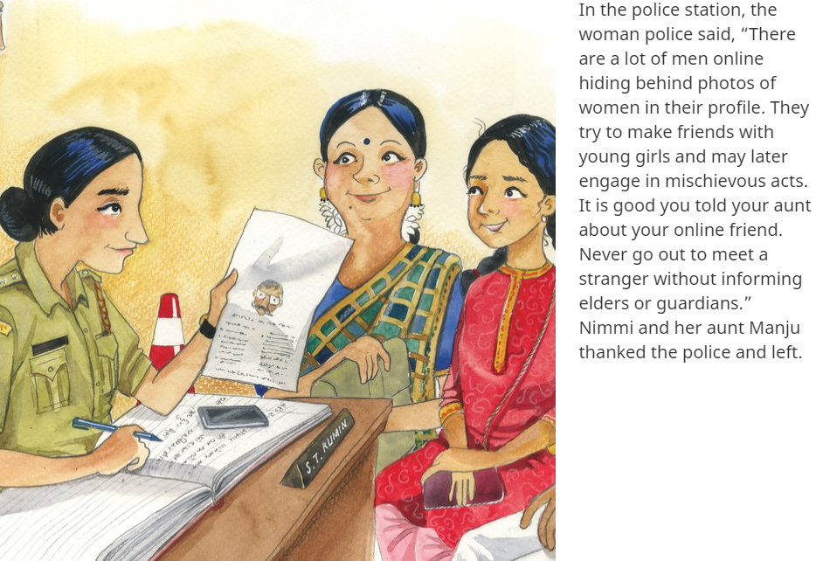
Level 1 | Digital Citizenship

Slide 13
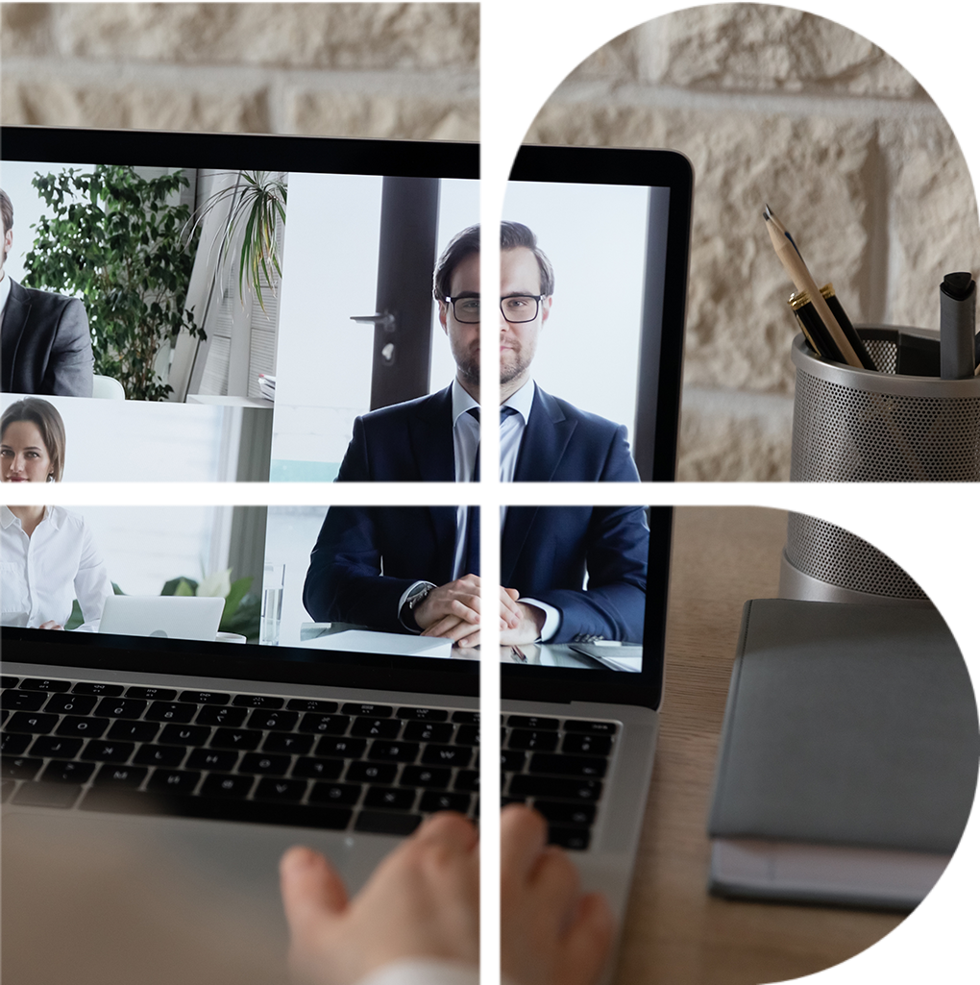
Level 1 | Digital Citizenship
Discuss
Have you ever experienced this kind of situation?
Why is Nimmi duped by the online predator?
Do you agree with the approach taken by Nimmi and her aunt?
What would you do in such a situation?

Slide 14
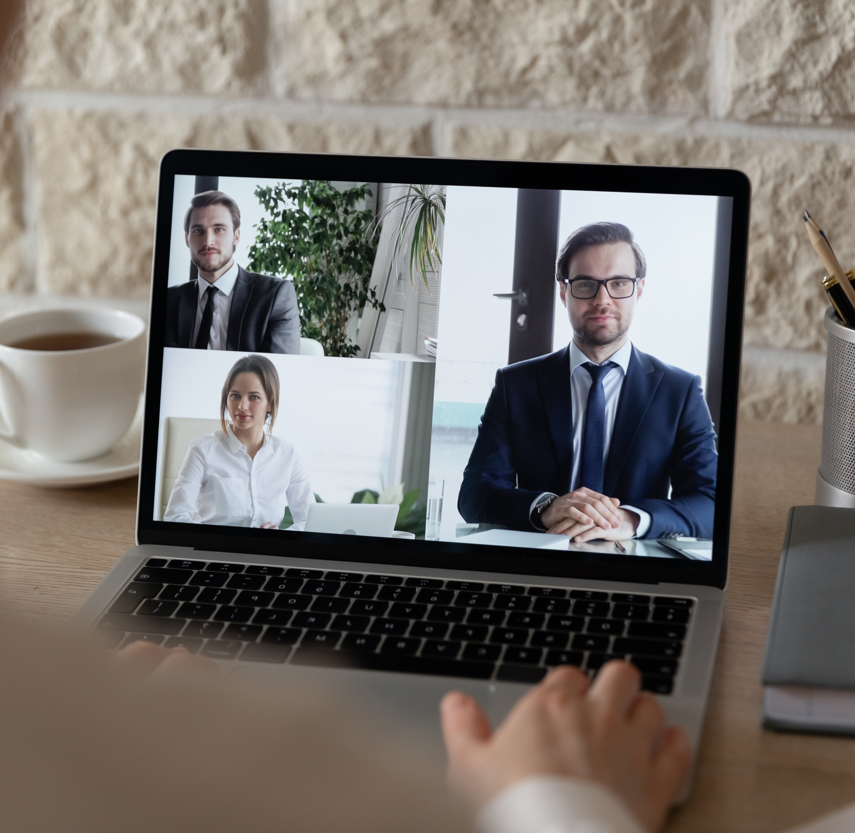
Level 1 | Digital Citizenship
Activity Time!
How do you meet new friends?
Where do you meet your new friends?
How do you get to know these friends?
How is meeting someone online (like in a game) different from meeting someone in school?
What information is okay to share with online friends and what should you not share?

Slide 15
Level 1 | Digital Citizenship
Activity Time!
Let’s make a list of all the do’s and don’ts of our own personal behaviour on the internet.
Break into pairs and share your thoughts on the do’s and don’ts and note them down in the worksheet.

Slide 16
Level 1 | Digital Citizenship
Quiz
I will not accept any friend request from someone I don’t know. ……………..
I will share my school timetable on social media. Everyone will be really impressed knowing how hard I work. ……………….
When my new online friend asks to meet me at the coffee shop, I will inform my parents. …………………..
When visiting the mall, I should always keep my phone’s GPS locator turned on so that my family can find me easily. ……………………….
I love filling out those silly surveys online that ask me questions like the name of my school or my first pet’s name. ……………………….
I just got an email saying that I’ve won a trip to Paris! I am so excited. I click on the link to see what sites we might visit. ……………………….
I just changed my email password and it is a strong one. I included numbers, capital letters, and symbols. It’s so good, and I am never going to tell anyone what it is. -------------------------

Slide 17
Created by

