Slide 1

Digital Citizenship
Lesson 10
UNDERSTANDING HOW
TO CREATE BALANCE

Slide 2

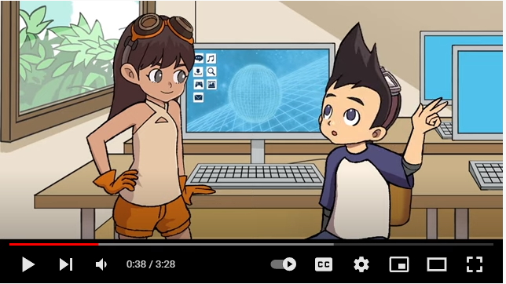
Level 1 | Digital Citizenship
Notes:
https://www.commonsense.org/education/videos/we-the-digital-citizens

Slide 3
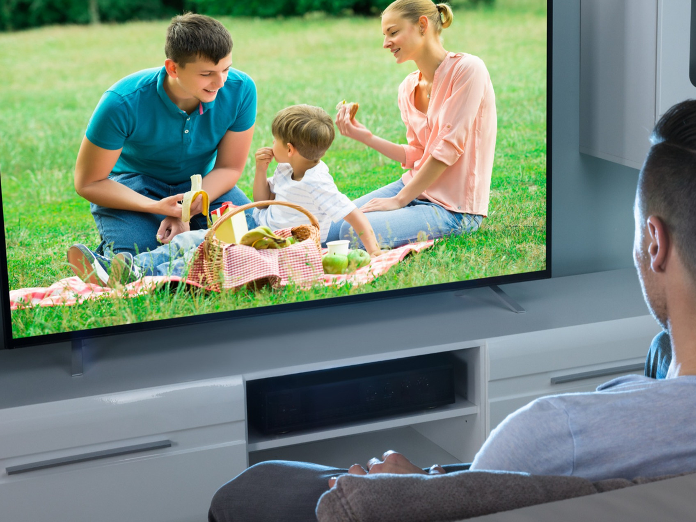
Level 1 | Digital Citizenship
Reflection
ccc
Have you ever
Checked your messages at night when you were supposed to be sleeping?
Spent more time online than you meant to?
Spent hours binge-watching a show or all day watching a cricket match?
How did each of these make you feel?

Slide 4
Level 1 | Digital Citizenship
Impacts of Too Much Screen Time
1
Make it hard for you to sleep at night.
2
Potentially lead to attention problems, anxiety or depression.
Too much screen time can:
3
Make you easily angered if your screen time is limited.
4
Make you feel like you have less energy.
5
Put you at risk for mindless eating, leading to weight gain or obesity.

Slide 5

Level 1 | Digital Citizenship
Activity Time!
Make a mind map that identifies how prolonged screen time affects physical and mental wellbeing.

Slide 6

Level 1 | Digital Citizenship
Let’s examine our habit trackers!

Slide 7
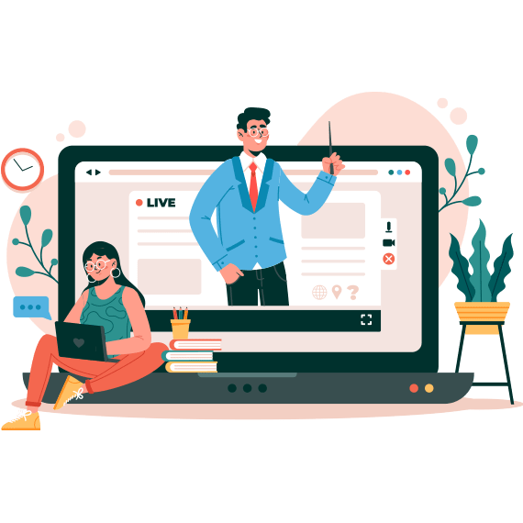
Level 1 | Digital Citizenship
Would you like to share which habits you were able to track?
What are the online and offline activities that you are indulging in?
cc

Slide 8
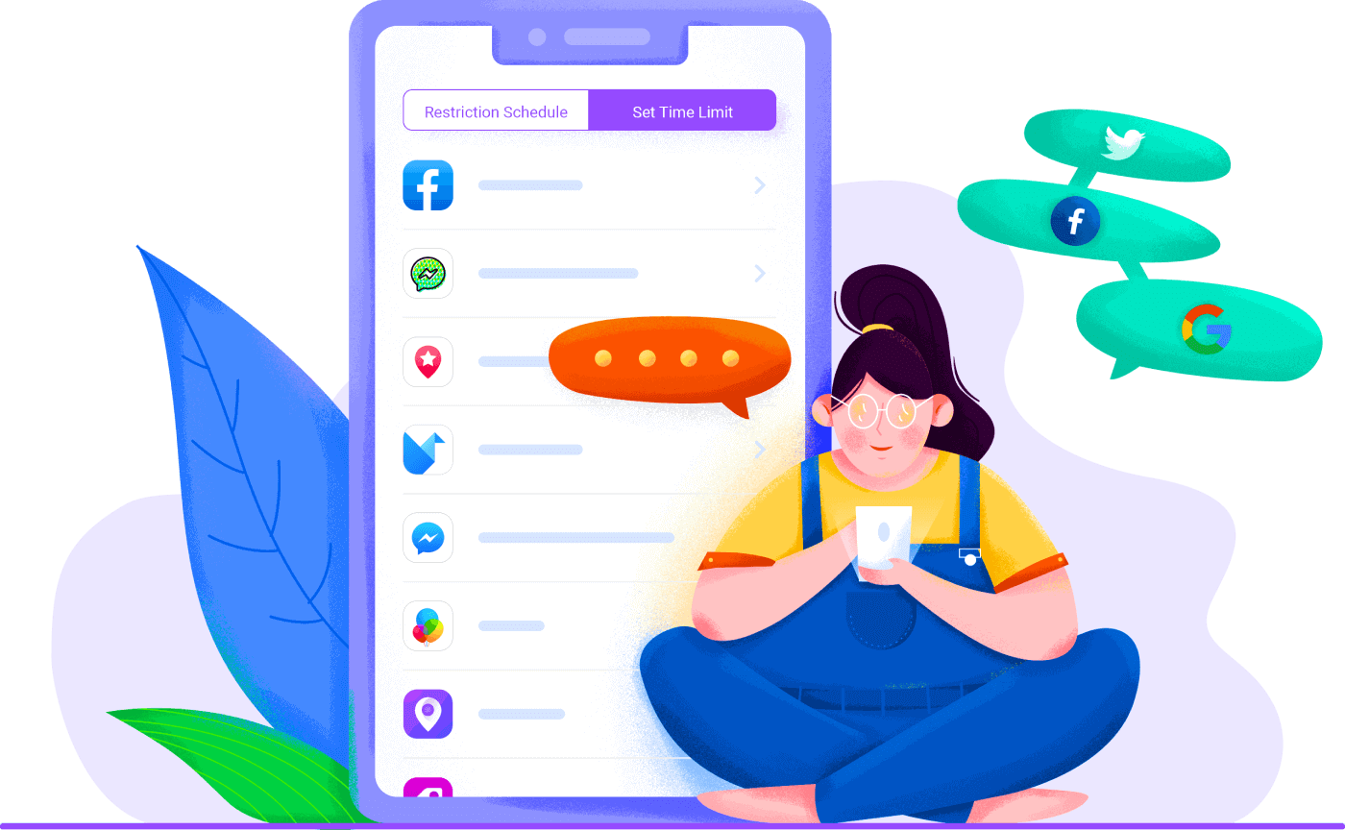
Level 1 | Digital Citizenship
Screen Time: Habit Tracking
  What does your tracker say about the amount of screen time that you are spending?
  Have you been successful in reducing your screen time?
  What are the physical impacts of excessive screen time?

Slide 9
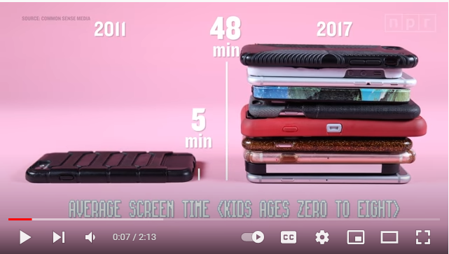
Level 1 | Digital Citizenship
screen time rules
Notes:
https://www.commonsense.org/education/videos/we-the-digital-citizens

Slide 10


Level 1 | Digital Citizenship
Activity Time!
Scavenger Hunt

Slide 11
Level 1 | Digital Citizenship
Post It!
What are the activities you can do instead of spending time on screens?
1
Brainstorm to come up with your best ideas.
2
Write your ideas on a sticky note.
3
Stick your notes on the board to share with your classmates.

Slide 12


Level 1 | Digital Citizenship
Key Takeaways
What have you learnt from this class about screen time?
Don’t forget to update your habit tracker with some of your favourite ideas!

Slide 13

Created by

